Slide 1
Program Choice in CQI
Using ERS reports to meet the needs of providers
Jennifer McMullen

Slide 2
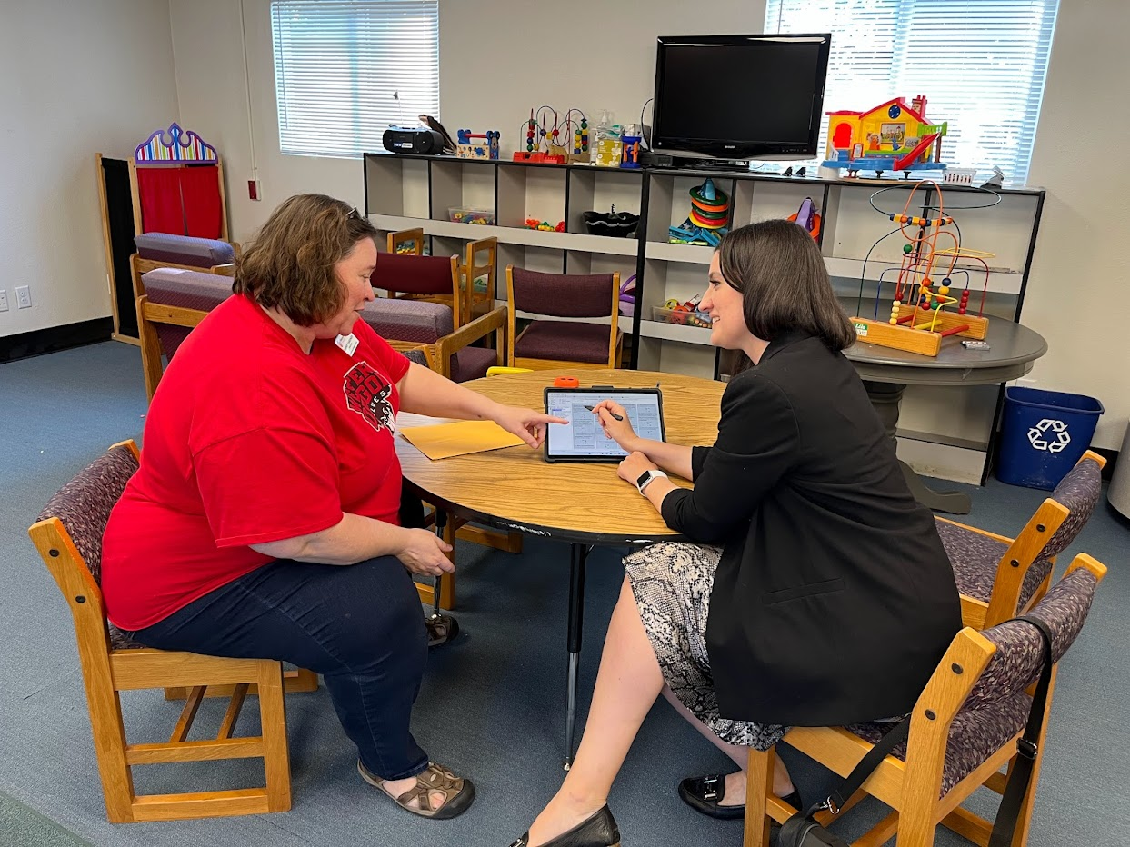
Foundational Assumptions
Supporting providers through CQI must be based on relationships
We focus on the positive and work from a strengths-based perspective
Notes:
This webinar today is going to focus on goal setting and areas of improvement. We don’t ever want to enter this conversation thinking that we start there. Although I am going to jump right into goal setting and addressing growth suggestions, the things that we are going to talk about today will likely not be effective if that’s how we address our work with programs. Continuous Quality Improvement is difficult work to participate in (from both sides – program and support), and it is only effective when there is trust built on positive relationships that focus on the strengths. The strategies we are going to discuss today are part of an ongoing professional relationship and shouldn’t be your first conversation with the program.
Poll:
I work mainly with providers who are selected for observation as part of their program funding.
I work mainly with providers who choose to complete an observation for Spark.
I work equally with both types of providers.
I have not yet worked with a provider who has had an observation.

Slide 3
To promote rich learning opportunities, it is recommended to provide an hour of access to materials. Consider extending indoor free choice time to offer more opportunities for children to engage with various materials.
Notes:
Use the emojis to indicate how a provider might feel

Slide 4
Adults circulated through the classroom and added individualized teaching during free play. However, some children didn't receive individualized learning. Consider providing much individualized teaching during indoor and outdoor free play, so every child receives some interaction that matches their interests and abilities.

Slide 5
Add materials to represent diversity in classroom materials (dolls with different skin colors, culturally specific foods or dress up clothes, additional books/images throughout the room, etc.).

Slide 6
To protect the health of the three children in pull-ups, you can ensure that adults have a plan to check/change all children in pull-ups, at least every 2 hours.

Slide 7
Children had access to unit blocks and block accessories. However, adults encouraged the use of fine motor materials in the block play area. This made it difficult for children to use the play area for its intended purpose and limited the amount of free floor space for children to build sizable structures. Consider encouraging children to keep like materials together so that children can engage in specific types of play without interference from other play materials.

Slide 8
Children were not engaged during transitions; they wandered and started conflicts. Consider coordinating roles during transitions and check-in with children, to ensure they are productive and engaged to promote smooth transitions.

Slide 9
Assessment may be mandatory
Participation in CQI may be mandatory
WHAT and HOW assessment results are used in CQI is 100% provider choice.
Notes:
There is a very simple idea that can completely change the way a provider thinks and feels about assessment. It can be stated something like this: “This is a standardized assessment that captures a snapshot in time. It looks at specific criteria, and what was observed may or may not reflect what usually happens in your program. You will see things in this report that might be out of your control (like challenges with your facility) or that aren’t important to you. You will probably find other things that are helpful to you and that you would like to focus on. You might even find things that match goals you are already working on. You get to decide what information from this assessment is important to you and what you want to work on.”
This statement can help a provider stop viewing an assessment report as a checklist of things to fix. It becomes a menu to choose from. This idea empowers them to respond as they want to. There is often a sense that an assessment is a “grade” or a judgment about their program. Helping shift perspective can make all the difference.
We are going to take a look at how supporting this process could work in practice after an ERS assessment

Slide 10


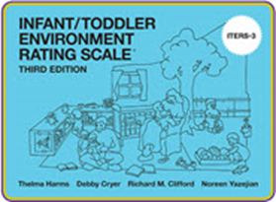
ERS Tools
Space and Furnishings
Personal Care Routines
Language and Literacy (or Language and Books)
Learning Activities
Interaction
Program Structure
Notes:
A quick review… (or maybe an introduction). There are three different kinds of ERS tools for Family Child Care, Center Based Preschool, and Center Based Infant/Toddler care. Each scale is divided into 6 subscales. The reports are organized with feedback from each subscale. Under each subcale, there are multiple items.

Slide 11


Space and Furnishings
    Indoor Space
    Furnishings for care, play and learning
    Room arrangement for play and learning
    Space for privacy
    Child-related display
    Space for gross motor play
    Gross motor equipment
Notes:
For example, Space and Furnishings in the ECERS includes Indoor space, Furnishings, Room arrangement, Space for privacy, Child related display, Space for gross motor play, and Gross motor equipment. Each one of those items has many indicators that are scored separately.

Slide 12
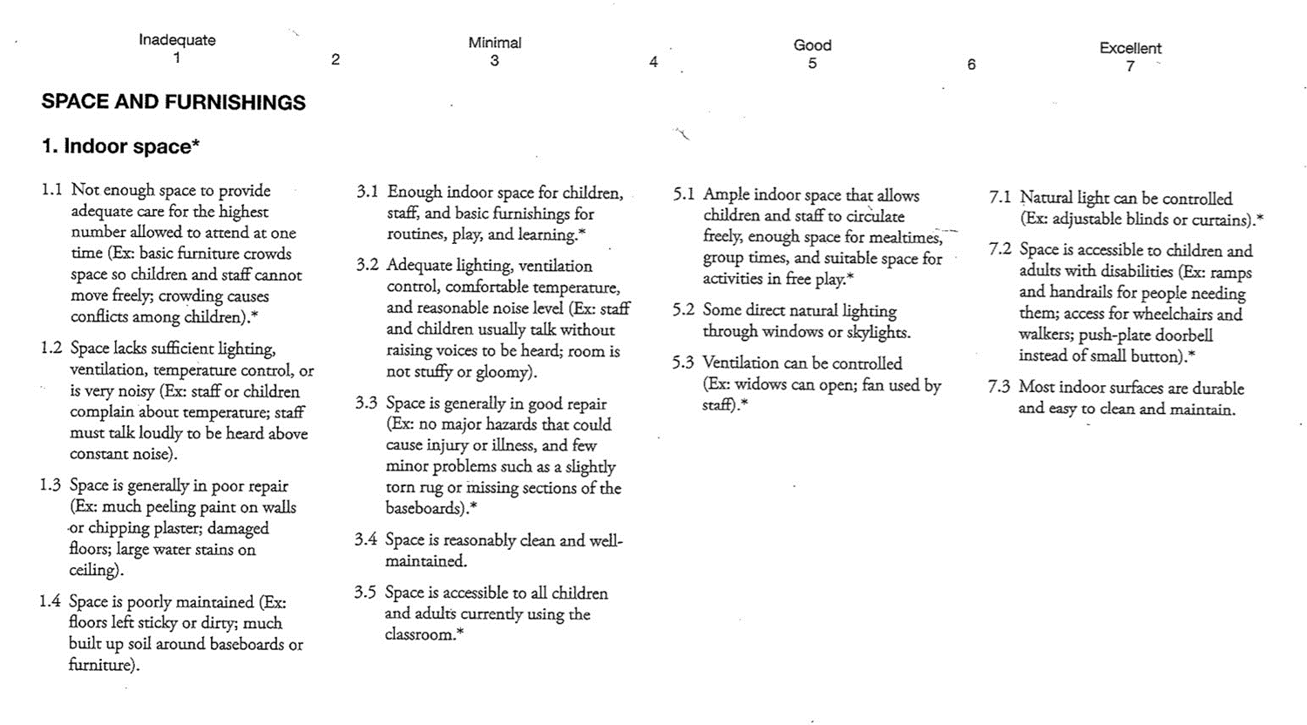
Notes:
Here you can see one indicator under the Space and furnishings subscale, Indoor space. You can see that there are 15 different indicators on this item that are scored Yes or No. This subscale has 7 different items that will be similar. This means that each subscale has a huge amount of information that is considered.

Slide 13
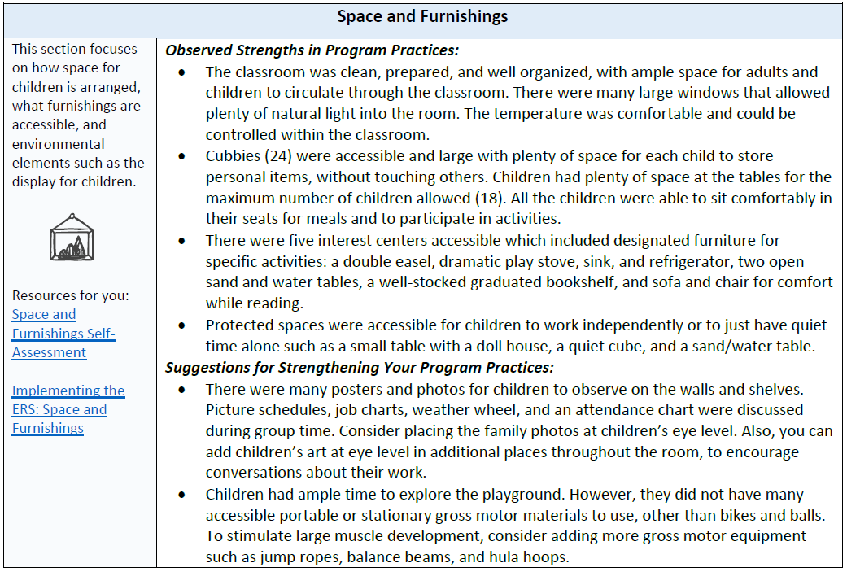
Notes:
All that information gets distilled down into a short narrative by the assessor. There are advantages to that. Someone who is extremely familiar with the assessment tool is summarizing the information down into something that is hopefully more digestible. The assessor is often highlighting areas that had the most impact on scores. The goal is for the program to have one or two concrete suggestions they could implement right away.
The disadvantage to this is that the suggestions may not be something that the provider wants to implement. There are a lot of reasons for that. Sometimes the barriers are financial (we can’t afford more gross motor equipment), philosophical (we just go out for recess, and we don’t want to spend time putting out and cleaning up equipment), or other kinds of resistance. This is the place where a CQI conversation has the potential to stall out. If a provider gets stuck on the idea that this is a requirement or a checklist to fix, an unwanted suggestion can generalize to an unwanted report.
I want to mention that there are lots of other strategies for working through resistance and supporting change thinking. I don’t want to gloss over the fact that a program might be resistant to a growth suggestion that is really important to their program, and that might need to be addressed. Going back to our Foundational Assumptions, your relationship with the program is going to inform what strategies you are using.
Today, we are talking about the strategy of Program Choice – encouraging a program to move on from a suggestion that they aren’t on board with, and to find a suggestion that matches with their own goals for their program. That can sometimes be as simple as, “It sounds like this isn’t something you want to address right now. Let’s look at the other sections in the report and see if we can find a goal that works better for you.
Another issue that can happen is that the program is on board with the issue that was addressed, but the suggestion for improving the practice doesn’t work for them for whatever reason. Let’s look at the suggestion here to place family photos and children’s art at eye level. Let’s imagine that the program says, “I don’t have another square inch in my classroom to add children’s art. I can’t put more stuff on the walls, because my fire marshal only allows me to cover a certain percentage of the wall space!” This is a great opportunity to say, there are lots of ways to meet the ECERS criteria. You can choose how you do that. Let’s see if we can come up with a different strategy that works for you.

Slide 14
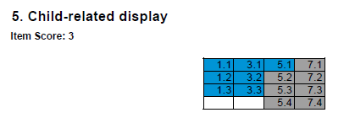
Notes:
This is the part that takes a little more digging into the tool. The score report is provided along with the narrative. This is a great time to look at the score report and see what was missed. You can work with the provider to find other ways to meet the criteria in the report. If you aren’t familiar with the score reports, each box shows the score for one item. Blue boxes mean the program received credit for that indicator, and gray boxes mean they did not receive credit. Once you find the appropriate item on the scale (here, Child-related display), the next step is to pull out your copy of the scale and see what those indicators are.

Slide 15
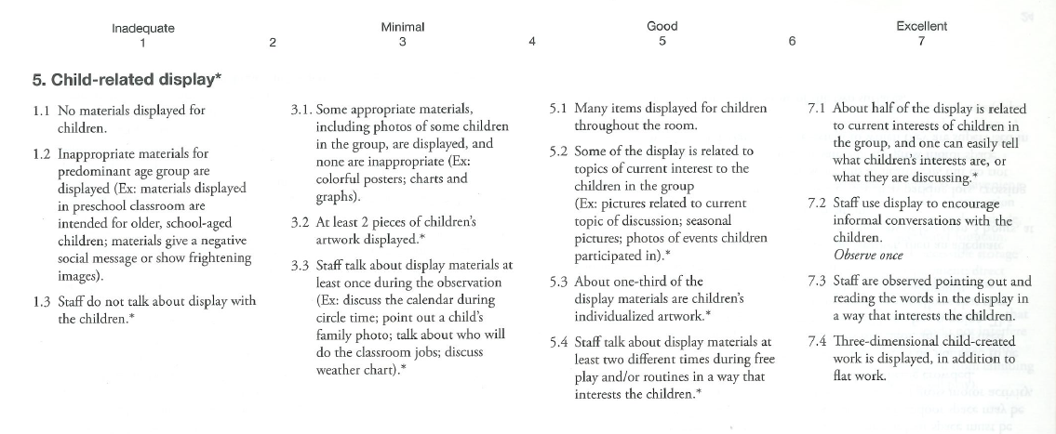
Notes:
So here you can see the criteria. The items that were marked on the score sheet as not receiving credit have a blue circle. The indicator that refers to children’s individualized artwork is 5.3. You can see that it says that about 1/3 of the display is children’s individualized artwork. If the resistance is that “I can’t add anything else on the walls,” you could work with providers to come up with other strategies. What ideas do you have about how you could do that? Some suggestions: replace commercial or teacher designed displays with children’s artwork; display artwork on the sides of furniture; table top/shelf top displays such as frames, bookstands, etc.; clothesline style hanging displays… and anything else that works for the program.
Although family photos are not specifically addressed in the indicators that were missed, moving them where children could easily see them may stimulate conversation about their families, which would give credit for 5.4 and 7.2.
You could take it one step further by looking at additional criteria for this item and how they could be implemented in the classroom.
So…. What do I do if none of the feedback meets the provider’s needs?

Slide 16
Find the appropriate Subscale
1
Review the Items to see where that information is located
2
Look at the score report and address the indicators that were not met
3
Notes:
These same strategies can be used if a provider doesn’t find information in the report about a goal they are working on or feedback they were hoping to receive. There are 461 indicators on the ECERS, and 464 indicators on the FCCERS. There is a very high likelihood that you will find information related to a program’s goals. Similar to the process of identifying another strategy, it will take your support to dig into the scores and find the information that meets their needs.
Sometimes, an ERS report can be affirmation or evidence that the program is making progress or has achieved their goals. At other times, it can be hard to understand why a program didn’t get credit for a certain indicator. The assessors are always available for follow up and to answer questions as best they can.

Slide 17
Supporting Provider Choice
Before reviewing the report
While reviewing the report
Ask what goals they are working on, or review goals you have set together
Ask what they are hoping for feedback on
Talk about the subscales and find out their priorities for improving quality
Affirm their decision to accept or reject feedback that is offered
Support them to find alternative strategies to meet ERS criteria
Help connect feedback in the report to their identified goals or priorities
Notes:
We’ve gone through all this information fairly quickly. What I want to highlight is two main concepts for using the strategy of provider choice: the first is setting the stage, and the second is supporting them through review of the report. Like we discussed at the beginning, part of setting the stage is giving permission to make choices. Another part of that is supporting providers to think about their own goals and priorities in preparation for receiving feedback. The strategies laid out on this slide can come at any point in your process with them – these discussions could happen before they receive an observation, after the observation before the report is received, or after the report has been reviewed. These conversations provide an important base for affirming their choices while you are reviewing feedback together.

