Slide 1
Using the Change Cycle to Support Coaching Conversations
Jennifer McMullen

Slide 2
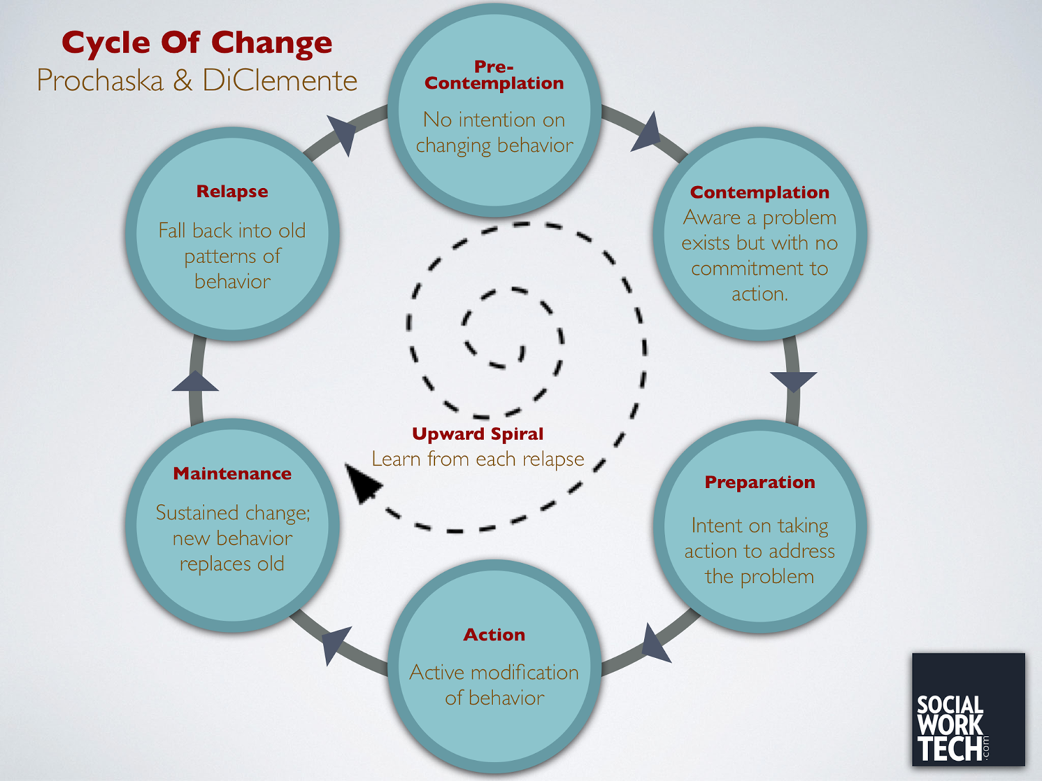
Notes:
This is a model that has been in the social work field for quite some time. It may be familiar to some of you already.
Review each stage, giving examples of behaviors or responses at each stage. Discuss how relapse is a natural part of change.

Slide 3
The Coach’s Role
Pre-Contemplation
- Show empathy
- Raise doubt
- Reflect and listen
Preparation
- Support a change plan
- Remove obstacles
Action
- Support and affirm successes
- Continue to remove obstacles
Maintenance
- Support sustaining behavior long term
Relapse
- Frame as a learning opportunity
- Focus on what was learned
Contemplation
- Explore ambivalence
- Elicit change talk
Notes:
Review the coach’s role at each stage of change. Discuss that the wrong strategy at the wrong time can be counterproductive.

Slide 4

Notes:
Success in supporting change and perception of success are not always the same thing. We may hear resistance and interpret it as a lack of participation in change. Remember that pre-contemplation and contemplation are an important part of the change cycle. When people are resistant to change or have big feelings about feedback, it’s not the coach’s job to take responsibility for those feelings or push them to change they are not ready for. This can feel counterintuitive when you are in a coaching role. The expectation is that you are supporting change and growth. However, you are not the change maker. Ultimately, we have more impact helping people move to the next step in the change cycle than trying to push them to be ready for change when they are not.

Slide 5
Let’s practice
You give the following feedback to a program:
“Based on your ECERS report, it looks like children only had 15 minutes of Free Play during your observation. They recommend you shorten transitions and group times to allow children more time to interact with the materials in your classroom. What steps do you think we could take to address that?”

Slide 6
Stage | You might hear | Feedback Strategies | What you might say
Precontemplation | That’s not an issue for us… That won’t work because… The way we do it works for us… | Show empathy Raise doubt Reflect and listen
Contemplation | I see what you’re saying, but it’s just not practical because… I’ve thought about that, but the problem is… We want to, but we can’t meet all our curriculum goals if we do that | Explore ambivalence Elicit change talk
Preparation | I noticed that last time I was in the classroom. We need to… That’s a great idea. We can work on that. We know it’s a problem, but we don’t know what to do about… | Support a change plan Remove obstacles
Action | We’ve been working on that for a while… We have a training plan/ordered some materials… That’s actually improved a lot. We used to… | Support and affirm successes Continue to remove obstacles
Maintenance | *This would be reflected in areas of strength | Sustaining behavior long term
Relapse | We were doing that for a while, but every time we hire new staff… We tried more free play, but kids just couldn’t handle it. The behavior got out of control. | Frame as a learning opportunity Focus on what was learned

Slide 7
Thank you!
Jennifer McMullen
mcmullenja@wou.edu

