Slide 1

Spark September Webinar
September 28, 2023

Slide 2
Welcome and Introductions
Ash Mickels, Spark Specialist, DELC
Debbie Gouger, Spark Lead Administrative Project Specialist
Marina Meaney, Spark Lead Project Specialist
ChienFei Huang, Spark Administrative Project Specialist
Ivette Guevara, Spark Project Specialist
Lauren Peterson, Spark Program Director

Slide 3
Agenda
Redesign Updates
Portfolio Alternatives
Quality Improvement Cycles
Spark Transition Team
Spark Accountability Team
Help Desk

Slide 4
Portfolio Submission Changes
Reminder: As of October 1, 2023, programs must be listed with ERDC to receive, submit, or resubmit a Spark portfolio.
Additional information can be found on the Spark website. https://oregonspark.org/current-participants/

Slide 5
Portfolio Alternatives Update
Quality Improvement Cycles – Debbie Gouger

Slide 6
Spark Application - updates
Electronic format on Formsite
Already translated in Spanish and Russian
Introductory message has information about Oct 1 deadline & portfolio alternative.
Programs will select if of ERDC listed or not
Programs will receive a specific notification based on listing status (verified)

Slide 7
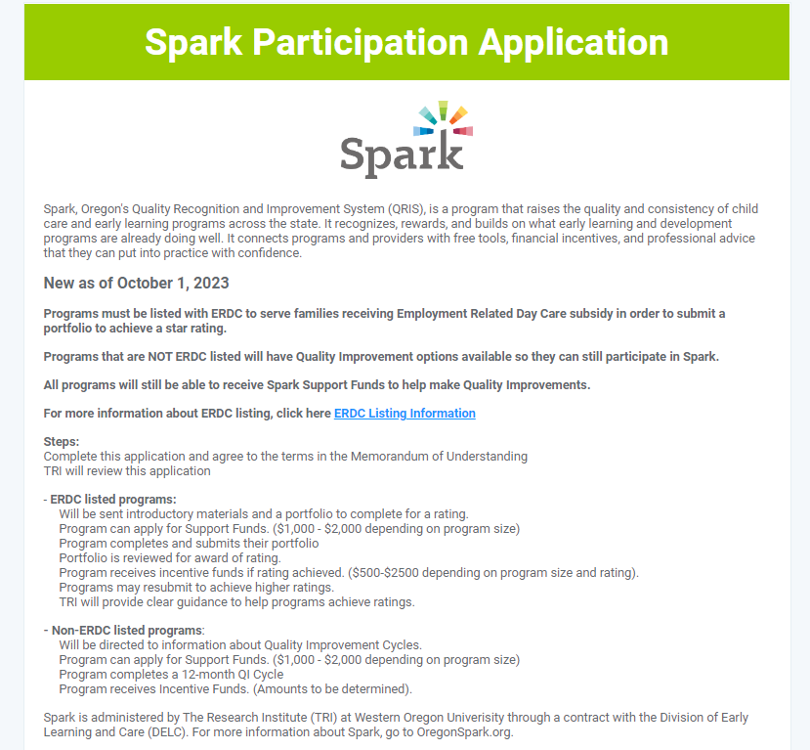
Programs are informed of the change when they open the application. The pathway for each listing status is clearly explained and they have a link to the listing information if they want to know more and consider getting listed.
Link to listing information

Slide 8
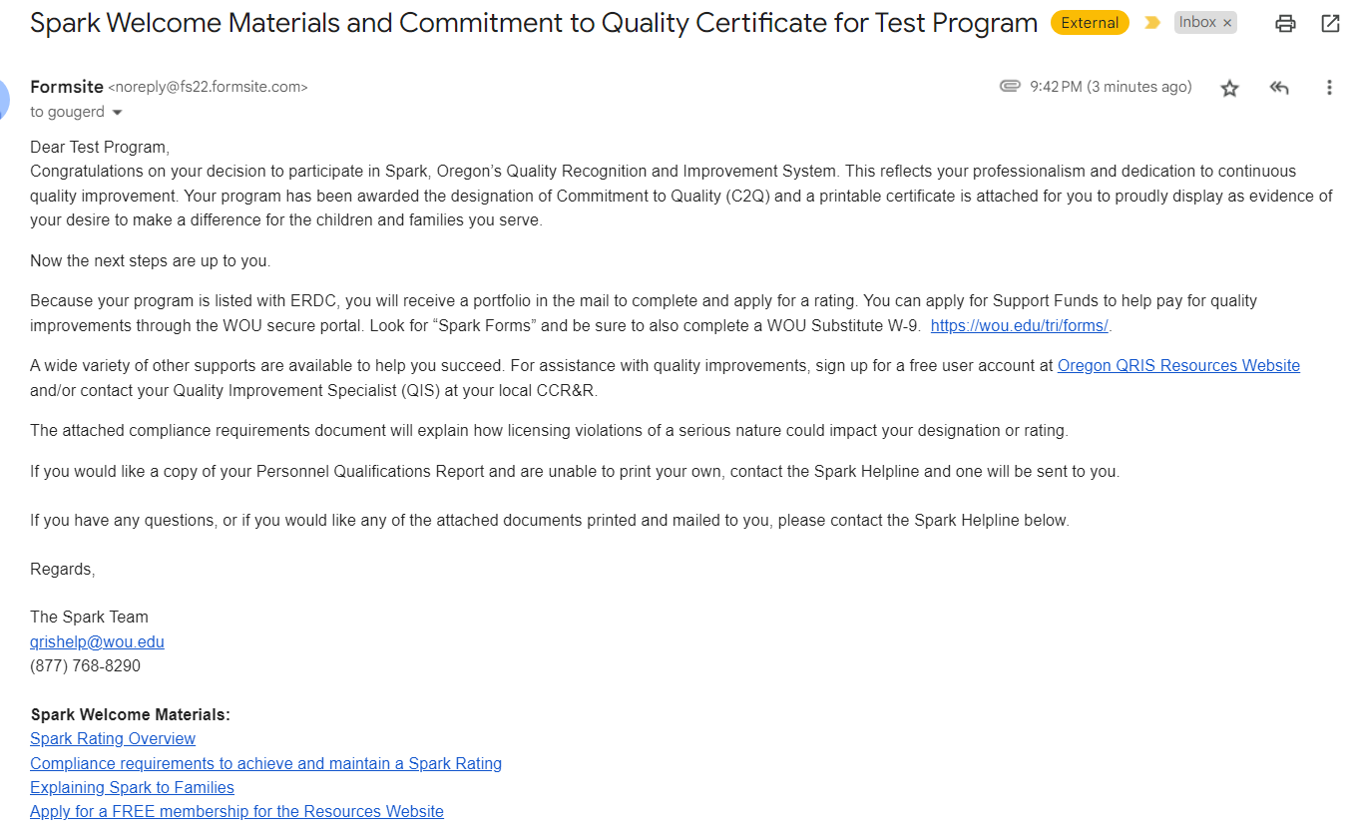
Notification – ERDC Listed
Link to apply for Support Funds
Spark Welcome Materials

Slide 9
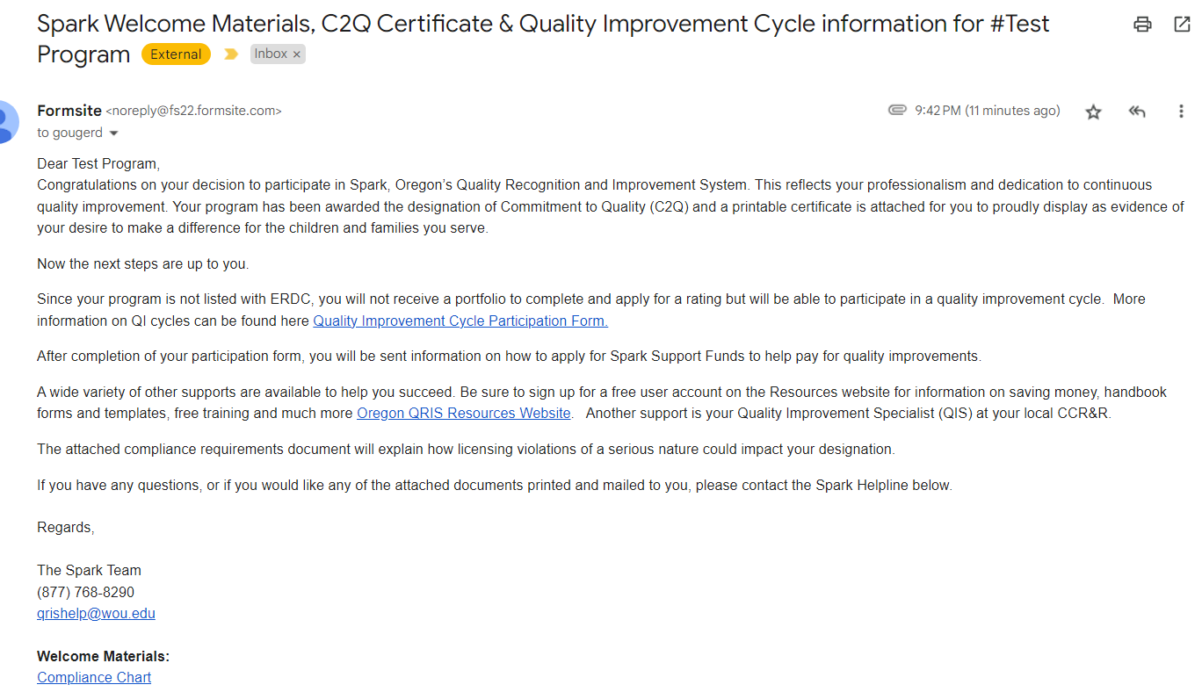
Notification – Not ERDC Listed
Link to Quality Improvement Cycle Participation Form
Spark Welcome Materials

Slide 10
Quality Improvement Cycles
Steps of a QI cycle (simplified)
Choose a goal
Record the goal on QI Cycle Participation Form
Complete Spark Request for Support Form
Explore resources, work on goal, reach out for help if needed
Complete reflection after 12 months
Incentive funds distributed (amount to be determined)

Slide 11
QI Cycle Participation Form
Explains steps in detail
Has section on goal planning & resources
  Tips on how to choose goals
  Examples of goals have been provided in each Spark domain and potential resources (clickable links)
Has section for goal documentation – using SMARTIE goal framework (Specific, Measurable, Achievable, Realistic, Time-bound & Tracked, Inclusive, Equitable)
Email notification sent after submission to submitter and QIS

Slide 12
Submission Confirmation Email
Includes:
A copy of their participation form
Links to payments portal to request support funds
Link to Reflection Form (to be completed after 12 months but provided if they want to see it)

Slide 13

QUESTIONS

Slide 14
Spark Transition Team Update

Slide 15
Spark Transition Team
15 early educators from 13 CCR&R regions
5 members in each language group (Russian, English, Spanish)
Diverse program types and roles
  1 Head Start
  5 Registered Family
  6 Certified Family
  2 Certified Centers
  1 License Exempt
Notes:
-Teachers, program administrators, providers and program owners
-regions we are covering: marion, polk, yamhill, lane, Multnomah, douglas, klamath, Lake, Malheur, Wallowa, Baker, Jackson, Josephine

Slide 16
Spark Accountability Team
Ash Mickels

Slide 17
Spark Help Desk
Notes:
Money delay announcement

