Slide 1
August Spark Webinar
August 31, 2023

Slide 2
Welcome and Introductions
Ash Mickels (they/them), Spark Specialist, DELC
Lauren Peterson (she/her/hers), Spark Program Director, TRI
Debbie Gouger, Spark Lead Administrative Project, TRI
ChienFei Huang, Spark Bilingual Administrative Project Specialist, TRI
Marina Meaney, Spark Lead Bilingual Project Specialist, TRI
Ivette Guevarra, Spark Bilingual Project Specialist, TRI

Slide 3
Agenda
Welcome and Introductions
Portfolio Alternatives
Spark Transition Team
Redesign Update and Listening Team Recommendations
Website updates
Spark Help Desk

Slide 4
Portfolio Alternatives
What is Changing October 1?

Slide 5
Beginning 10/1/2023
Programs must be DHS listed to complete a portfolio and achieve a rating.
WHY?
While Spark in undergoing redesign there still must be a way for programs to receive tiered DHS reimbursement based on their rating.
We want to engage programs in Spark while the redesign in underway.

Slide 6
What can Non-DHS listed programs do?
If they don’t want to get DHS listed, they can choose a self-selected goal to complete a 12-month Quality Improvement cycle.
They will still be able to:
C2Q status after applying to participate in Spark
Apply for Support Funds
Have access to support from Spark
Receive incentive funds when completed (amount to be determined)

Slide 7
How do programs participate in QI Cycles?
Complete the Spark application on Formsite - it will explain that they must be DHS listed to receive a portfolio to complete.
They will also be directed to the link about becoming DHS listed
When they complete the application, they will indicate if they are DHS listed or not.
They will either be sent introduction materials and a portfolio or directed to the Quality Improvement Cycle information (also on Formsite)

Slide 8
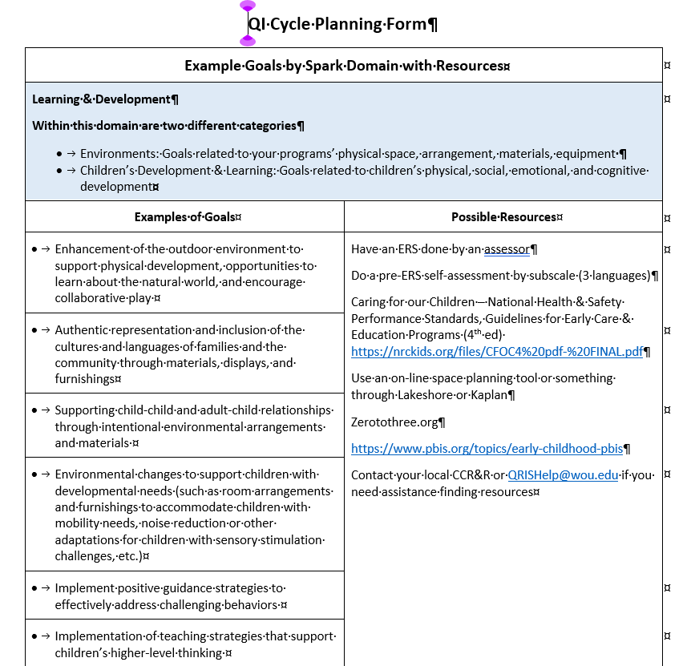
Programs will be offered examples of goals, and resources to help them choose a goal and work to achieve it.

Slide 9
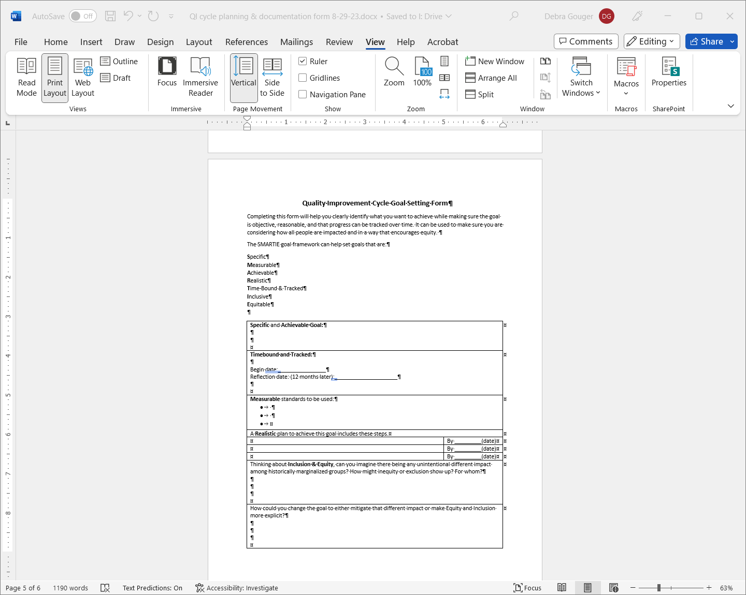
Programs will be directed to a QI Cycle Goal Setting Form to document the goal they wish to achieve.
Notes:
Will put screenshot of QI Cycle documentation form

Slide 10
12-Month Reflection
They complete the 12-Month QI cycle after completing the reflection form.
After it is completed, they will get incentive funds.
The amount is being determined but it won’t be more than the incentives for achieving a rating.

Slide 11
Spark Transition Team

Slide 12
The Spark Transition Team
Marina Meaney / Lead Bilingual Project Specialist (Russian)
  meanym@wou.edu
Ivette Guevara / Bilingual Project Specialist (Spanish)
  guevarai@wou.edu
ChienFei Huang / Bilingual Project Specialist (Chinese)
  huangca@wou.edu
Notes:
Marina
The Spark Transition Team is a group of 15 early educators in Spark 3, 4, or 5-star-rated programs. The Spark Transition team will assist in gathering information and ideas from other Spark-rated programs about their experiences in Spark to help with the transition to the redesigned Spark system.
ChienFei shares flyers and job descriptions

Slide 13
Overview
Mission
  Planning transition from current QRIS star-rated model to the newly redesigned Spark system
Scope of work
  Gathering information from Spark-rated programs about their experiences in Spark and their ideas about transition process
Equity lens
  Leading with equity, diversity and inclusion principles
Notes:
Marina
Provide all communications and documents in English, Spanish, and Russian
Interview and hire linguistically diverse applicants from various backgrounds, experience, and locations across Oregon by prioritizing those who have been historically underserved and underrepresented.
Ensure to get input from diverse representation across geographies, identities, provider/program type, and languages spoken, in addition to English among the Spark rated early learning programs
Compile outcome report with authentic data from the Transition Team

Slide 14
Timeline
Present - September 8: online application is available
September 8-15: reviewing applications and scheduling interviews
September 15 – 22: interviewing and selecting 15 members
September 25-29: onboarding process
October 2 - November 3: working process (outreach and recording findings)
November 6 – 17: generating a report
November 20: final report being ready for DELC
Notes:
Marina

Slide 15
Work Compensation
A Participation Stipend will be offered to members of the Transition Team:
Amount will be calculated based on the total number of activities each team member participates in:
  approximately $50 per activity
  up to a total of $1200 per participant
Payment will be made when the work is completed
Notes:
Marina
When the participant is selected and accepted to be part of the Transition Team, they will be given and sign a full job description and Western Oregon University Substitute W-9 form at the orientation meeting.

Slide 16
Recruiting Messaging
Email to CCR&Rs
Email to Spark-rated programs (3, 4, 5-Star)
Spark website (Redesign and Current Participants page)
Spark Facebook page
Spark QIS webinar (August 31)
Notes:
ChienFei
Flyers, job description and application link are on Spark website.
All recruiting message were sent last week and at this moment, we have received 22 applications.
English 18
Spanish 4
Russian 0
Please encourage programs to apply!

Slide 17



Slide 18
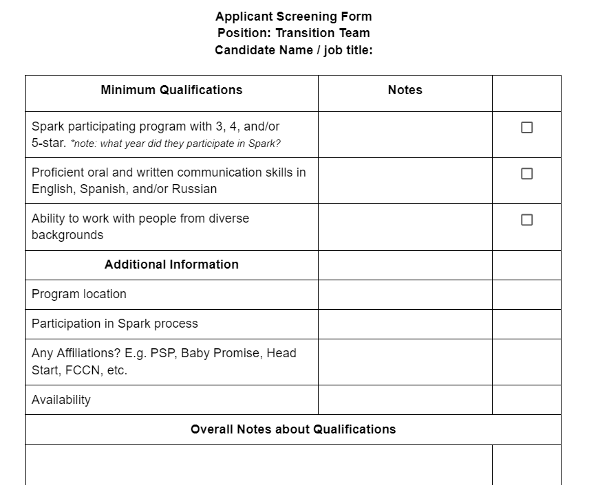
Screening Form
Notes:
ChienFei
We will be using a Screening Form you see here to help us screen through all the applicants to determine not only if they qualify for the role, but to also help us determine candidates who could be best fit based on the criteria determined. In the interview process we will ask candidates more specific questions to help us determine their experience and strengths that can help us build a strong Transition team. We want to encompass a wide range of experiences and backgrounds to best create a team that will be able to reach a vast variety of programs and providers in Oregon.
We will not prioritize applicants based on their star-rating.

Slide 19
Application & Interview Process
Application is available online in English, Spanish and Russian
Application is available until September 8th, at 5 p.m.
Follow up message will be sent to all applicants via phone call, text message, and email
We will be selecting candidates by September 22nd.
Notes:
ChienFei
The application for the Transition Team will close September 8th at 5pm. If folks need support or have questions regarding the application or process of consideration please reach out to our QRIS helpline and our team will reach out as soon as possible with support. All applications will be screened and reviewed by the Spark team as they begin to come in. Following the screening and determination of qualifications the Spark team will reach out to provide an invitation to interview. We will communicate out via phone call, text message and email. We will be selecting 15 applicants to join the transition team and support this work for the next couple of months. I do want to mention that we will be providing rolling interviews through this process as well to help with the short timeframe we have to select the participants. All participants will be informed of our decision by September 22nd.
Interviews and Selection:
We will use the criteria in the job description as a baseline to select applicants for the interview.
All candidates will be asked the same interview questions to reduce bias.
Interviews will be conducted in the applicant’s preferred language.
Interview time slots will be given to candidates for selecting the time at their most convenience.
An interview rubric will be used to help the panel select the qualified candidates to ensure the process is fair, consistent, and objective.

Slide 20
Outreach
WHO will be surveyed?
  Currently operating Spark-rated programs (C2Q, 3-, 4-, and 5-star)
HOW will the survey be conducted?
  By phone, in person, via ZOOM meeting and/or other platforms
  A list of questions will be developed through a collaborative efforts by the Spark Transition Team
WHEN will the surveys be done?
  Surveys will be conducted by the Spark Transition Team members during the month of October with the plan to complete the surveys by the first week of November.
Notes:
Ivette
Once those teams have been established, the outreach work will begin.
The Transition Team will be responsible for collecting information from Spark-rated programs regarding program experiences in Spark and their ideas about transitioning into the redesigned Spark system. So, Who…? How…? When…?
Questions Spark and DELC want to know:
List of research questions that could include but are not limited to:
Why did you pursue a star rating?
What does it mean to you?
What does it communicate to families?
What strengths would Spark rated programs like families to know about their program?
After reviewing the redesign recommendations, how do you propose we transition current Spark rated programs into the new version of Spark?

Slide 21
Reporting
The synthesis report will be generated by the Transition Team members with support from the Spark team
Report will be presented to DELC mid-November
The Transition Team recommendations will include:
Key considerations from Spark-rated programs to take into account when transitioning the existing Spark rating to the redesigned Spark system.
How to best meet Spark-rated program needs
Achieve the Agency’s goals of an equitable, inclusive, responsive, connected, and supportive system focused on Continuous Quality Improvement
Notes:
Ivette
The Synthesis Report for the Transition team will summarize data and themes of what was learned, the Transition team with the support of the Spark team will compile findings and recommendations into a written report that will then be presented to DELC and the Spark Accountability Team by mid-November.
The transition team recommendations will include:
Key considerations from Spark-rated programs to take into account when transitioning the existing Spark rating to the redesigned Spark system.
How to best meet Spark-rated program needs
AND
Achieve the Agency’s goals of an equitable, inclusive, responsive, connected, and supportive system focused on Continuous Quality Improvement.

Slide 22
Design Team Recommendations
Notes:
2 groups of 15
Equipo de Escucha monolingual Spanish language
Spark connections English/bilingual
Recommendations include a variety of of ideas, some very Spark specific, and some related to the early learning system more generally where we will explore what the Spark response can be.
There is a lot of great information here for all of us

Slide 23
Listening Team Recommendations
Two Listening Teams (PAR Groups) engaged in extensive outreach over the summer to get input and feedback from families and early educators about Spark and their experiences with early education.
Equipo de Escucha consisted of 15 monolingual and bilingual Spanish speaking parents and early educators.
Spark Connections consisted of 15 monolingual and bilingual English (and other languages) speaking parents and early educators.
Notes:
Feedback included experiences with many aspects of the early learning system including, but not limited to Spark.

Slide 24
Equipo de Escucha
Grow childcare options and make them more accessible to families, especially in agricultural areas.
Invest resources so that childcare centers are better prepared (in their environments and staff training), to care for children with different abilities, needs, and so that parents have confidence that their children will be well cared for.

Slide 25
Equipo de Escucha
3. Reform Spark so that training is more accessible to providers and prevents them from being overburdened.
4.Improve facility observations and supplement them with training and coaching for providers, including supporting immigrant and refugee families and children with special needs.

Slide 26
Equipo de Escucha
5. Facilitate collaboration among provider organizations. (DELC, CCRR, Spark, USDA, etc. )
6. Increase awareness of Spark among parents and providers and inspire confidence in the system.

Slide 27
Spark Connections
Remove the star rating system and replace with badges of competence providers do and have meaning for parents.
Use coaches and strengths-based systems to support the development of providers (strengths-based support to be licensed followed by strengths-based growth support.)

Slide 28
Spark Connections
3. Use observation to ease the burden on providers to demonstrate quality.
4. Focus on attaining positive outcomes for providers so they can achieve positive outcomes for children.
5. Existing licensing be the marker for ECE providers and focus Spark on supporting the development of providers

Slide 29
Spark Connections
Offer rewards to teachers/directors of child care programs to prevent burnout and help them feel valued.
Provide resources and trainings to support social-emotional/behavior support in the classroom.

Slide 30
Questions?

Slide 31
Website Updates

Slide 32
Renewal page: renewal online submission
Observation & Assessment helpline: assessment_team@wou.edu
QIS portal: FCCN Participation Funds forms
  Early educator materials – Applications/Forms

Slide 33
Spark Help Desk

