Slide 1


Using ERS Reports to Support Continuous Quality Improvement
Jennifer McMullen
The Research Institute at Western Oregon University

Slide 2
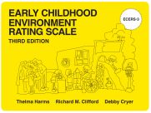
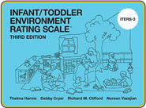
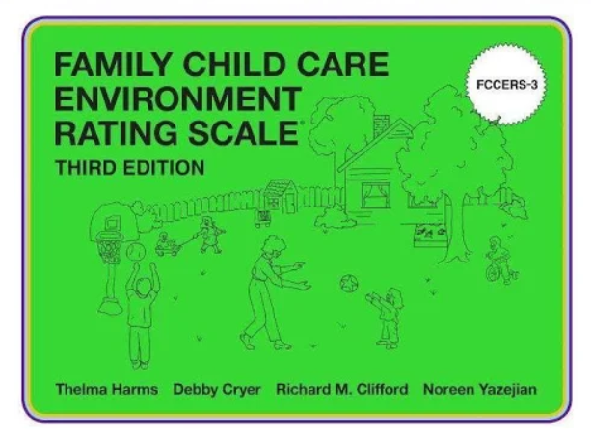

Types of ERS Tools
ECERS-3 (Early Childhood Environment Rating Scale – 3rd Edition)
ITERS-3 (Infant/Toddler Environment Rating Scale – 3rd Edition)
FCCERS-3 (Family Child Care Environment Rating Scale – 3rd Edition)
SACERS-U (School-Age Care Environment Rating Scale – Updated)
Notes:
There are four Environment Rating Scales (ERS) that are designed to assess process quality in an early childhood or school age care group
The tools are periodically updated and validated
The Environment Rating Scales were developed to evaluate the process quality in settings
for children. Process quality refers to the experience of children within the care environment
including their interactions with others, materials, and activities (Phillipsen, Burchinal, Howes,
& Cryer, 1997). Process quality is assessed primarily through observation and has been found to
be more predictive of child outcomes than structural indicators of quality such as staff to child
ratio, group size, cost of care, and type of care (Whitebook, 1989)
Builds a holistic base for quality. Looks at a wide range of indicators of quality. It is most often used as a tool for CQI.
Snapshot in time and is not reflective of a single adult or child. Therefore, strengths and recommendations are intended to inform the entire teaching team who work with the children.
Spark Assessors are able to conduct assessments in three of the four tools. ECERS-3 is for children aged 3 – 5 years old. ITERS-3 is for children birth to 3 years old. FCCERS-3 is for children birth to 12 years old in home based settings. SACERS-U is not currently being used in Oregon.

Slide 3
How are the scales used in Oregon?
For Continuous Quality Improvement (CQI) in state funded programs
    A sample has been selected by the ELD
    Selected programs can choose between ECERS-3 or CLASS
    Some programs are selected for Fall and Spring observations, and some selected only for Winter
For Spark
    An outside observation can be used as evidence for Standard AB5
Notes:
Show of hands if one of their sites has been selected for observation this year.
Currently, if a site is selected for observation in the state sample, the expectation is that all state funded preschool classrooms at that site will be observed. This includes OPK and PSP.
Discuss why they may want to choose CLASS or ECERS-3, depending on program goals. (Dual coding is available if desired with CLASS._

Slide 4
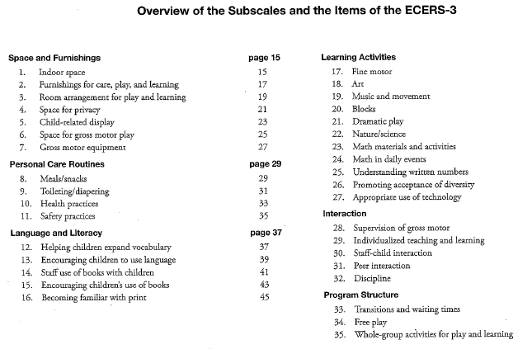
Subscales and Items
Subscale
Item
Notes:
Explain the three components of the scales: subscales, items, and indicators. Review (page 13 in their scales).

Slide 5
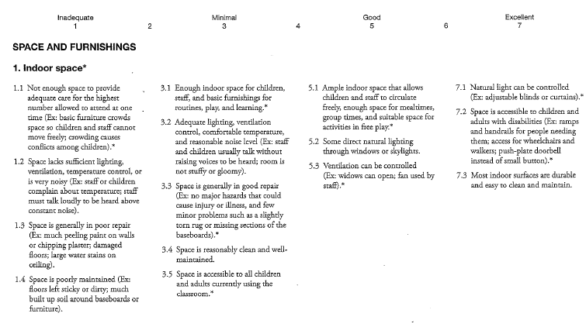
Subscales, Items, and Indicators
Subscale
Item
Indicator
Notes:
Review (page 15 in their scales). Make sure to look at notes for clarification. (5.1 for ample space)

Slide 6
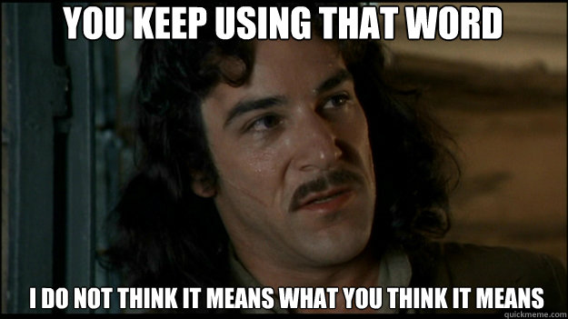
Definitions
Notes:
Page 10 in the scales:
Accessible
Play area/interest center
Timing of free play
Notes for clarification on each page of the scales.

Slide 7
Additional Notes for Clarification
ERSI Additional Notes for Updated ECERS-3
Notes:
Navigate to the ERSI website to show them where to find the updated ECERS-3 additional notes. Tell participants to plan on gluing/taping the notes to the corresponding pages in their ECERS-3 book if they are using their books to provide support.

Slide 8

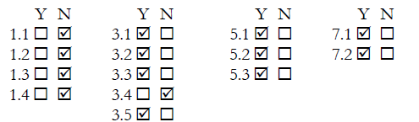
Scoring Sample
Notes:
Describe how to score this sample item following the scoring system (page 9 in the scale). Ask a participant to share their thoughts and explain their justification.
Note that if all the 5’s and 7’s were no, the score would be the same.

Slide 9

Scoring Considerations
Terms used and definitions
Timing
Quality and consistency of practices over a three-hour observation
Notes:
Look at Item 26: Promoting acceptance of diversity (pg. 65). At 5.1 and 5.2, “accessible” means for an hour of the observation (from the additional notes).
The hour accessibility mark has implications throughout the scale.
Look at Item 25: Understanding written numbers (pg 63). At 7.3, “frequently” just means it must be observed twice.
Look at item 30: Staff-child interaction (pg. 73) 5.2 “usually” means most of the time with few exceptions. 7.1 must be consistently observed across children with only minor lapses (see notes for clarification). Give example of a teacher repeatedly becoming exasperated with one child who pushes her buttons.

Slide 10
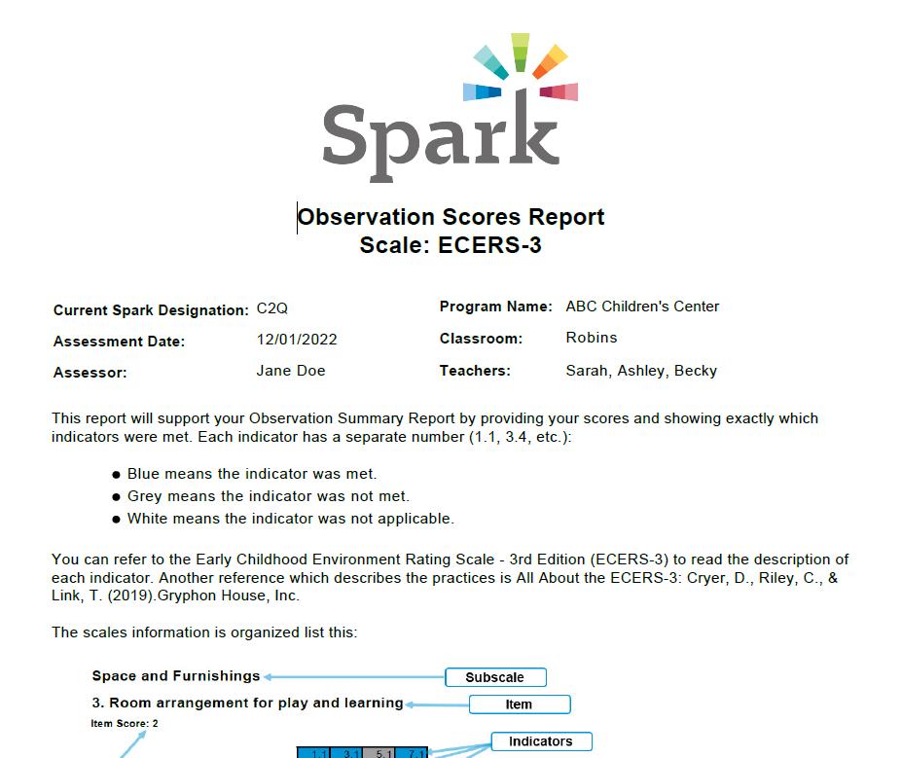
Reading and using score reports
Notes:
Look at sample reports – score report and narrative report.
Highlight –
Follow links in narrative report to demonstrate resources
Demonstrate how to navigate to links on Spark website
instructions for reading scores
how to compare scores to ECERS-3 book
averages at the end of the report.
Discuss benefits of reviewing scores vs narrative reports with program staff.

Slide 11

Strength-based Practices to Support CQI
There are four elements that can support the CQI process
    Brief feedback with the assessor
    Narrative report
    Scores
    Implementation Handouts and Checklists
ERS Assessment Reflection Guide
Notes:
If you are going to participate in ECERS-3 assessments and use the results for CQI, it is recommended that you get copies of the scales and possibly All About the ECERS-3 to support implementation.
Discuss: Using strength-based practices to support CQI, including follow teacher’s lead in terms of what they want to work on, regardless of results. The supportive and reflective principles TRI used when developing the ERS Assessment Reflection Guide are these:
Reflective conversation and review of assessment process results (information shared in ERS Assessment Summary Report).
Information shared in debriefing is used to guide quality improvement.
Teacher and Supervisor/Coach can use information together to set goal(s).
Activity: Review ERS Assessment Reflection Guide.
Ask participants, “What other CQI processes do you use that assessment results could fit into?”

Slide 12
Follow-up Support Planning
Some recommendations:
Use the completed ERS Assessment Reflection Guide
Transfer goals to agency CQI tool or plan
Use SMART goals
Provide resources and supports as needed
Notes:
Now that you and the teacher/program staff have completed the ERS Reflection Guide – now what? Continue implementing strength-based, reflective practices and apply the recommended strategies.

Slide 13
Thank you!
Jennifer McMullen
Observation and Assessment Coordinator mcmullenja@wou.edu
Notes:
Thank everyone

