Slide 1
Rural Early Learning Facility Improvement Project
An introduction to this project
Notes:
Welcome to the introduction to the Rural Early Learning Facility Improvement Project. Today will be discussing the project, its phases, and requirements.
This slideshow will be available on the Spark website in the coming weeks.

Slide 2

Project Objectives
Become licensed and serve more children
Increase licensed capacity and serve more children
Provide a safer, or more appropriate, indoor and/or outdoor environment for children
Notes:
We want to increase the number of licensed sites and their capacity to care for children by improving the physical space and environment of selected applicants. Participants must complete one of the first two bullet points and the final bullet point while they are participating in the grant.
Photo by Lum3n: https://www.pexels.com/photo/white-earphones-near-papers-269610/

Slide 3
Grant Opening and Closing
Grant opens Spring 2023
Available till funds run out
Notes:
The Rural Early Learning Facility Improvement Project is open to providers in Coos, Curry, Douglas, Klamath, and Lake Counties.
Grant opens Spring 2023
All information about this grant will be found on the Spark website
Grant funds are available until all grant funds have been spent

Slide 4

Where to find the Grant Documents
Notes:
Photo by Liza Summer: https://www.pexels.com/photo/content-young-ethnic-woman-freelancing-with-laptop-on-bed-6348128/

Slide 5
Grant Forms
On the Spark website
Only available digitally
Available in Spanish and English
Notes:
All grant materials will be located on the Spark website. There will be links to the guidebook in Spanish and English along with links to the grant forms using Formsite. We will not be providing paper copies of the grant materials.
We choose to do this because we wanted to reduce the about of data entry errors. All links to this grant will be on the Spark website.
Because these forms are available as Formsite forms you will be able to save your progress as needed.
If an exemption is needed, grant documents will be available in hardcopy.

Slide 6

Project Eligibility
Notes:
Photo by Monstera: https://www.pexels.com/photo/amazed-woman-standing-with-textbooks-for-studies-6238133/

Slide 7
Ineligible Programs:
Head Start and Early Start
School districts
Notes:
Unfortunately, not all child care programs are eligible to apply for these grant funds.
Head starts and school district are not eligible

Slide 8
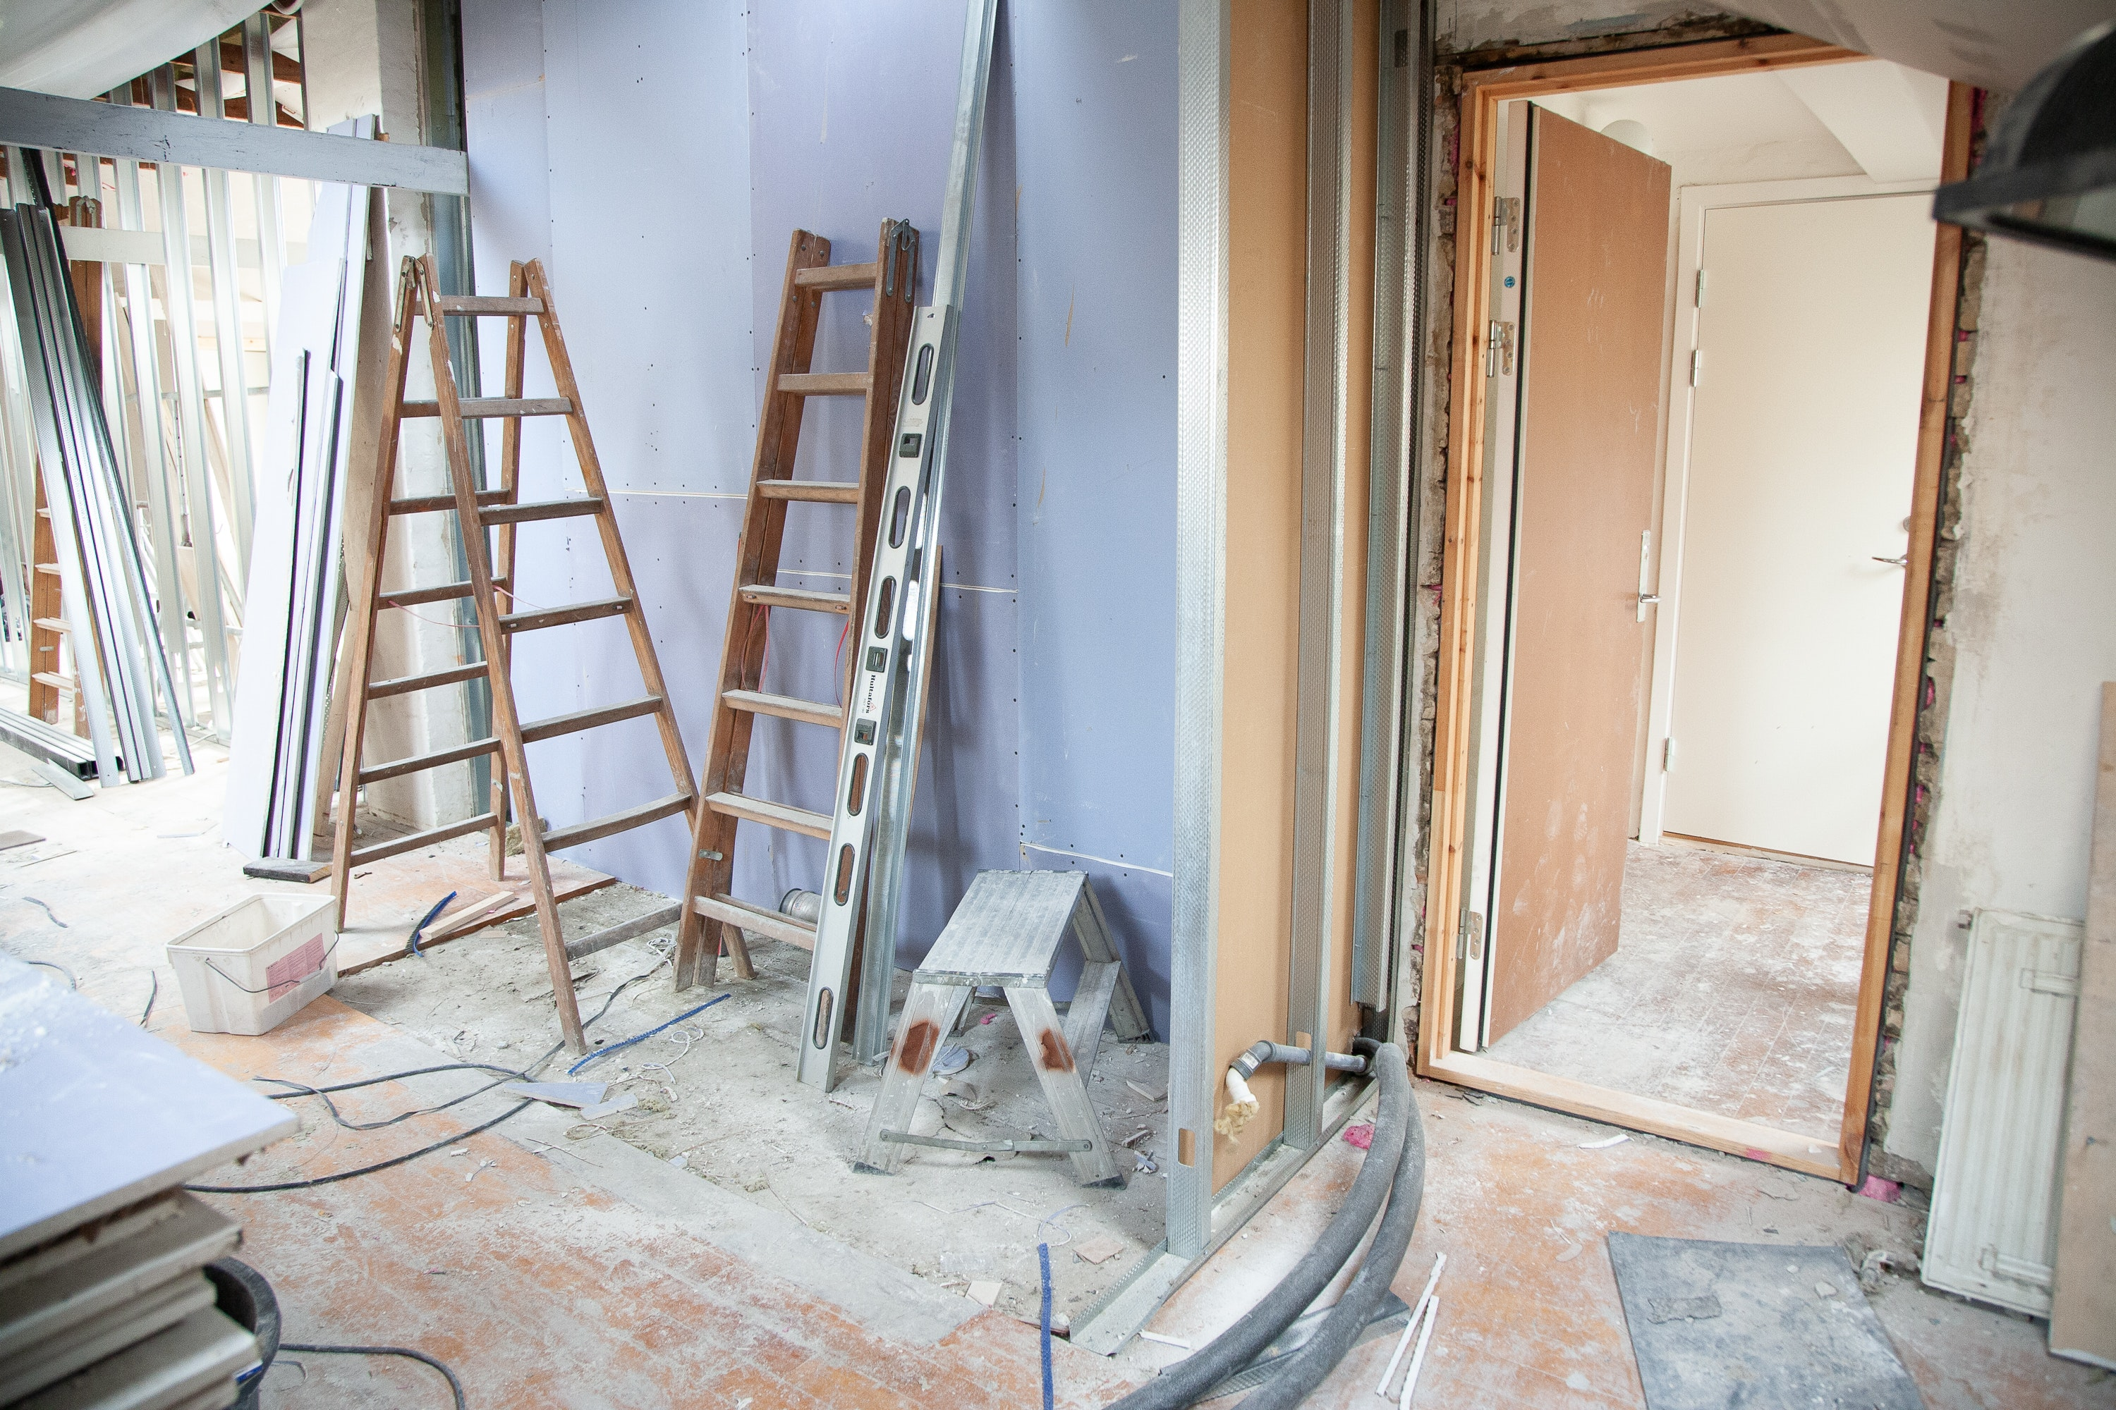
Eligible Programs…
Live in Coos, Curry, Douglas, Klamath, or Lake Counties
Provide or willing to provide full-day, full-year care
Provide or willing to provide care for children on subsidy (Employment-Related Day Care, ERDC) and children with special needs
Licensed with satisfactory compliance history & increase number of children in care
Committed to becoming licensed by end of project
Planning to change license type by end of project (RF to CF)
Project involves construction or major/minor renovation
Notes:
Now to the eligibility requirements (read list)
(Read after the second bullet point) Full-day, full-year services are defined as at least six hours per day, five days per week, minus planned closures for major holidays, etc.
IF you choose to participate in this grant, you must be able to communicate via email and respond to email.
Communication is vital in a grant like this where a project can go through many changes before you receive funding
Relief nurseries are the only programs that are eligible but don’t need to meet all the requirements
Photo by Rene Asmussen: https://www.pexels.com/photo/house-renovation-3990359/

Slide 9
CONSTRUCTION
Notes:
Construction is defined as the erection of a facility that does not currently exist. Examples include constructing a new building on the property owned by the child care program.

Slide 10
MAJOR RENOVATION
Structural changes
Extensive alteration of a facility
Notes:
Major Renovation is defined as:
Structural changes to the foundation, roof, floor, exterior or load-bearing walls of a facility, or the extension of a facility to increase its floor area; or
Extensive alteration of a facility such as to significantly change its function and purpose, even if such renovation does not include any structural change.

Slide 11
Minor Renovation (Indoors)
Indoor examples are:
  Heating, cooling, and/or ventilation issues
  Remediating lead paint and/or lead pipes
  Installing room dividers
  Installing age-appropriate plumbing, such as child-sized toilets and sinks
  Installing handwashing stations
  Flooring
  Painting
  Water leak mitigation (windows, roof leak, drywall repair)
  Fixed equipment (washers, dryers, refrigerators, freezers, dishwashers, stoves)
  Storage
  Issues identified by licensing or other regulatory agencies
Notes:
Minor Renovation is defined as a facility improvements which are not specified under the definitions of construction or major remodeling. Examples are provided in the following list:
Indoors
Heating, cooling, and/or ventilation issues
Remediating lead paint and/or lead pipes
Installing room dividers
Installing age-appropriate plumbing, such as child-sized toilets and sinks
Installing handwashing stations
Flooring
Painting
Water leak mitigation (windows, roof leak, drywall repair)
Fixed equipment (washers, dryers, refrigerators, freezers, dishwashers, stoves)
Storage
Issues identified by licensing or other regulatory agencies

Slide 12
Minor Renovations (Outdoors)
Outdoor examples are:
  Purchasing play equipment to improve outdoor spaces
  Creating an outdoor area with protection from the elements
  Fencing/hazard enclosures
  Storage
  Surface improvements (grass, outdoor carpet, sand, cement, decking)
Notes:
Outdoors
Purchasing play equipment to improve outdoor spaces
Creating an outdoor area with protection from the elements
Fencing/hazard enclosures
Storage
Surface improvements (grass, outdoor carpet, sand, cement, decking)

Slide 13
Not licensed
Commit to becoming licensed
RF,CF, CC
Notes:
In this slide we have an example of those steps an applicants will need to take if they are not currently licensed when they submit their application. You must commit to becoming licensed before you end your project and obtain either a RF, CF, or CC license.

Slide 14
Licensed as an RF
Commit to changing your license type
CF
Notes:
In this slide we have an example of those steps an applicants will need to take if they are currently licensed as a RF when they submit their application. You must commit to changing your license type to a CF before you end your project. As an RF you will need to provider your current license number. Applicants who are already licensed as a CF or CC need to provide their license number and commit to increasing the number of children enrolled if possible.

Slide 15
Satisfactory Compliance History
Licensed programs with three or more serious valid findings in the last 24 months are ineligible
  Serious valid findings are compliance violations that are categorized as one or more of the following issues:
    Children are in imminent danger
    All Safe Sleep violations
    More children in care than allowed by law
    Corporal punishment of other specific forms of inappropriate discipline are being used
    Children are not supervised
    Extreme unsanitary conditions
    Multiple or serious fire, health, or safety hazards are present
    Adults are present who are not enrolled in the Central Background Registry
    Providing care without being licensed with regulatory agency as required by rule
Notes:
The Research Institute will be responsible to check on the compliance history of each applicant by working with the Office of Child Care.
We will have the office of child care look back on the last 2 years or 24 months.
If you have specific questions about any of these compliance violations, please contact your local licensing office or your licensor
You will be notified if you do not meet the compliance requirement

Slide 16
Find Child Care Oregon
All participating programs must be identified in Oregon’s parent referral system as a program willing to accept subsidies (ERDC) and serve children with special needs.
Notes:
(Read this slide)
If you are currently licensed you will need to be identified in Find Child Care Oregon
If you are not currently licensed or working on getting licensed this is a goal that you will need to complete as you participate in this grant.

Slide 17
Completive Grant Process
Your application will be scored
A scoring rubric will be available
Submitting an application does not guarantee acceptance
Notes:
All applications will be scored based on a publicly available scoring rubric. If your application does not meet the scoring criteria it will be rejected.

Slide 18

Eligible? Apply!
Notes:
If you meet the eligibility requirements, you should submit a grant application. Your application will go through a review process to make sure that you meet the eligibility requirements. You will be notified via email if you are invited to participate in the grant.
After you have been notified that you have been selected you can begin working on your grant proposal.
Photo by Sora Shimazaki: https://www.pexels.com/photo/crop-faceless-person-typing-on-laptop-keyboard-in-darkness-5926370/

Slide 19

Project Phases

Slide 20
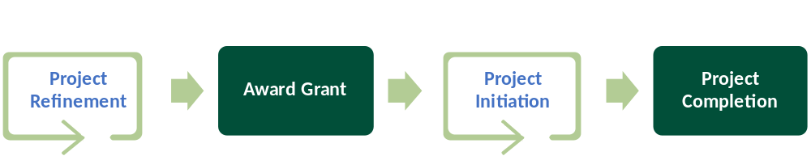
Notes:
These are the distinct phases of this grant. We will discuss them in detail in the following slides.

Slide 21

Grant Proposal and Project refinement Phase
Notes:
Photo by Gustavo Fring: https://www.pexels.com/photo/close-up-photo-of-person-in-sporstwear-4920429/

Slide 22
Project Proposal
Must be:
  Well developed
  Focused on the objectives and requirements of the project
Required local support from:
  Grant staff
  Licensing specialist
  CCR&R
  Hubs
  Or other partners
Notes:
Your project proposal must be:
Well developed
Focused on the objectives and requirements of the project
In this phase you will be working on your project proposal. Here are some examples of questions you should be asking yourself: What are some of the dream projects that I would like to do? If I had access to these funds, how would I make those dreams come true? What would it take to make this happen?
How long would it take? Who will do the work? Why are you asking so many questions?
To participate in this grant you need to work with local experts. You can get support while you complete your grant proposal from a variety of local sources. We have found that getting an outsider’s opinion and support makes for a better proposal. These individuals will help you provide a safer and/or more appropriate indoor/outdoor environment for children.
Your initial project proposal will probably change several times as you work to refine it. Remodeling and/or new construction can be complicated, and timelines often take longer than expected. It is okay if this phase takes a while to get through.

Slide 23

Project Refinement
Notes:
Now that your application has been selected, you have entered the Project Refinement Phase. In this phase, you will refine your project proposal. You might have to change what you are planning or start over from the beginning. You might feel like you won’t be able to complete your project, don’t give up.
Our experience in project refinement is that it often take a lot of time to develop a project and the project change several times before the final project is approved.
We will help you through this process.
Please do not make purchases of materials or have contractor start work on your project before you receive your grant funds.
Photo by Pixabay: https://www.pexels.com/photo/hot-iron-steel-glow-35860/

Slide 24

Award Phase
Notes:
Photo by John Guccione www.advergroup.com: https://www.pexels.com/photo/100-us-dollar-banknotes-3483098/

Slide 25

Are Grant Funds Taxable?
Notes:
Unfortunately, these grant funds are taxable. For specific details on the rate at which they will be taxed you should consult with a tax professional.
Photo by Karolina Grabowska: https://www.pexels.com/photo/american-dollar-bills-and-vintage-light-box-with-inscription-4386369/

Slide 26
Types of Awards
Preservation & Enhancement Grants
Expansion Grants
Notes:
There are two types of awards; preservation & enhancement and expansion grants

Slide 27
Preservation & Enhancement Grants
$1,000 - $5,000
Be meeting, or committed to meeting, all grant requirements
Submit completed grant proposal
Complete one business sustainability activity
Notes:
The Preservation & Enhancement Grants are for projects between $1000 and $5000 you must meet or be committed to meeting all the grant requirements.
You do not need to be licensed when you apply.
You can apply for a smaller amount of grant funding but not below $1000.

Slide 28
Expansion Grants
Up to $25,000
Be meeting, or committed to meeting, all grant requirements
Submit completed grant proposal
Licensed and in business for more than 1 year
Sustainability Plan
20% match
Complete two business sustainability activities
Notes:
Asking for more than $5,000? You need to be licensed and in business for the past year (one calendar year from the date that you submit the application.
For requests over $5,000, a 20% match must be identified. A match is defined as costs paid for by another funding stream or other in-kind services such as labor provided by the program owner, staff, or volunteers

Slide 29

Project Initiation Phase
Notes:
Photo by Tatiana Syrikova: https://www.pexels.com/photo/father-and-child-playing-on-sand-3968121/

Slide 30
Time to get started!
Notes:
In this phase you will have received your grant funds and you can start your project. This phase can take a long time to complete.
The grant funds will arrive as a paper check in the mail.
You will have to complete a substitute W-9 from Western Oregon University.
If your plans changes during this phase you will need to notify the grant administrator and seek permission before using the grant funds in a different manner.
Photo by Rene Asmussen: https://www.pexels.com/photo/house-renovation-3990359/

Slide 31

Project Completion Phase
Notes:
Photo by Leeloo Thefirst: https://www.pexels.com/photo/high-angle-shot-of-a-text-board-8177957/

Slide 32
Business Sustainability
Establish a business checking account
Complete two or more hours of business training
Develop an operating budget that captures projected revenue and expenditures for the next year
Join or be actively participating in a shared services network
Join or be actively participating in a Focused Child Care Network
Complete the Program Administration Scale (PAS) or Business Administration Scale for Family Child Care (BAS)
Increase star rating in Spark
Notes:
The business sustainability requirement is intended to advance the professional knowledge and practices of program. A list of possible activities is itemized on this slide. For programs seeking $5,000 or less, at least one activity must be documented as complete. For programs seeking more than $5,000 in funding, two or more activities must be completed.
This slide gives you a list of possible activities; programs may also self-identify appropriate alternatives. These alternatives need to be approved by the grant administrator before they will count.
If you have already completed (within in the last calendar year) or are currently participating in these business sustainability activities, you do not need to do them again.
you won’t be asking you open a second business checking account.

Slide 33
Additional Grant Report
Quarterly Project Update Report
Notes:
The quarterly project update report should be completed quarterly to keep us informed of where you are in your project. If you complete your project within 3 months, you do not need to quarterly complete a project update report.
When you have completed your project, your final step will be to complete the project completion report.

Slide 34
Project Completion Phase
Be or become licensed or change license type
Identified in Find Child Care Oregon, as willing to accept ERDC and children with special needs
Submit Project Completion Report
Complete Business Sustainability Activity
Notes:
This phase documents the completion of participation requirements.
All participating programs must be licensed, become licensed, or change license type as the Rural Facility Improvement Project requirement. Tribal programs are exempt from this requirement.
All participating programs must be identified in Oregon’s parent referral system as a program willing to accept subsidies and serve children with special needs in Find Child Care Oregon.
In the Project Completion Report please tell us what's changed in your program as a result of receiving these grant funds. We have some questions such as; have you received other types of funding, what you are planning on doing next, and best of all we want see pictures of the final product.

Slide 35
Thank you
Questions
Call or email
503-838-9261
winegardnern@wou.edu

