Slide 1
May Spark Webinar
May 25, 2023

Slide 2
Welcome and Introductions
Ash Mickels (they/them), Spark Specialist, ELD
Joseph Litke, Child Care Provider Specialist, OPA2 DHS
Maria Fernandez (she/her/ella), Director of Equity, Inclusion and Outreach, TRI
Lauren Peterson (she/her/hers), Spark Program Director, TRI
Spark Operations Team

Slide 3
Agenda
Welcome and Introductions
Upcoming Spark portfolio submission changes
Joseph Litke - review of how to become DHS listed
Spark Help Desk

Slide 4
The Spark Redesign is moving forward!
In order to support the transition, some changes are being made to the portfolio submission process. These changes will:
  Offer programs new choices about how they wish to participate in Spark
  Allow the TRI Spark team to begin moving our resources to implementation of the redesigned system

Slide 5
What is changing?
As of October 1st, to submit a portfolio and receive a star-rating, programs must be listed with DHS to serve families receiving DHS child care subsidy.
There will be self-selected quality improvement options for programs who do not wish to complete a portfolio. These options will not lead to a star-rating.

Slide 6
What is staying the same?
All new participants can apply for a C2Q designation and receive support funds.
Currently rated programs may still renew their rating.
Programs who are currently Spark rated and listed with DHS will continue to receive the DHS monthly incentive payment for Spark rated programs.

Slide 7
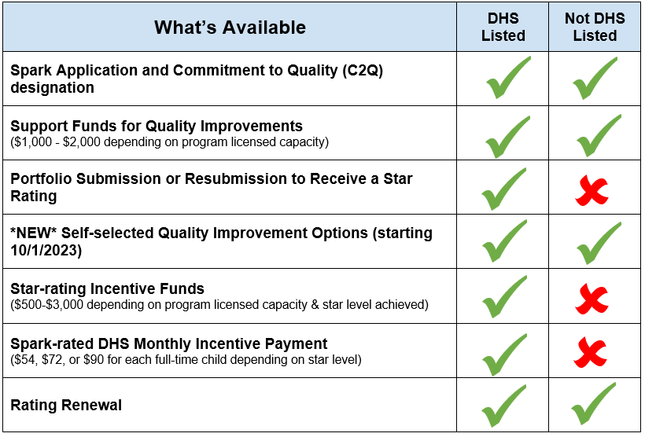

Slide 8
When is it changing?
The requirement to be listed with DHS to submit or resubmit a Spark portfolio will begin October 1st.
We will begin requiring that programs be listed with DHS to receive a portfolio in their Welcome Kit on August 1st.

Slide 9
Why is it changing?
These changes will:
Enable the Spark team to devote resources to the redesign
Maintain a pathway for programs who are listed with DHS to participate and receive DHS monthly incentive payment for star rated programs
Create a pathway for programs who do not wish to be DHS listed to apply, receive a C2Q designation, support funds and participate in Spark related activities

Slide 10
How will this be communicated to programs?
All information will be available in Russian, Spanish, and English
Spark website will have a prominent announcement on multiple pages
Spark application
Printed materials in the Welcome Kit and in the portfolio mail back
Email to current Spark participants
QIS during Spark orientations, FCCN meetings, etc.

Slide 11
Questions, Comments, Thoughts?

Slide 12

ODHS approved child care providers
2 categories of ODHS approved child care providers
Providers licensed by the Early Learning Division, Office of Child Care (OCC)
License Exempt providers (Family, Friends & Neighbors – FFN)

Slide 13
Child Care Provider Approval Process
Initial approval for ODHS Payments
Meet ODHS Provider and Health & Safety requirements ***
Submit completed listing form to ODHS, Direct Pay Unit (DPU)***
Pre-service trainings
Complete the Central Background Check Registry with OCC, get FBI fingerprints and pass criminal and child protective service records check
Health and Safety Site visit for providers not related to all children in care
After approval complete ODHS Orientation Trainings and the Fundamental Learning training within 30 days of approval
*** Licensed Providers must be actively approved with OCC and complete these steps to be approved for ODHS payments.

Slide 14
How a licensed exempt (FFN) child care provider becomes approved for ODHS payment
1. Child care provider completes the ODHS 7494 Child Care Provider Listing form completely and submits to DPU.***
2. DPU staff review for completeness, and to make sure that the child care provider meets ODHS requirements, including pre-service trainings. .***
4. For Regulated Subsidy providers (license-exempt and not related to children in care), a home visit is completed.
5. Child care provider is approved for ODHS payment once the provider passes the background check and home visit.
6. The provider can be connected to an eligible case and issued billing forms for payment (effective the date they met all ODHS requirements).
3. Providers complete the Central Background Registry application and submit to OCC.

Slide 15
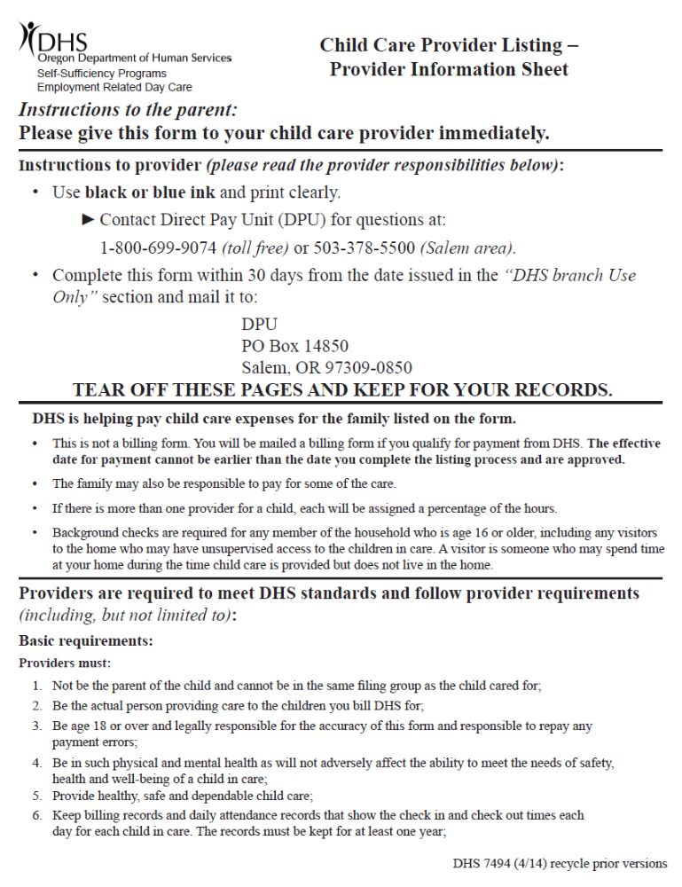
Important Information regarding the 7494 Child Care Provider Listing Form
Use the most current version from the Form Server
Using an old version will delay the providers approval and day care payment

Slide 16
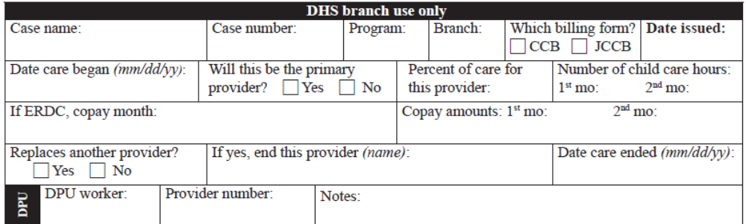
To be completed by the eligibility worker after eligibility has been determined for the family
Percent of Care
DPU uses this information to issue billing forms. If it is blank, a billing form will not be issued the parent will need to call DPU once the provider is approved.
Important – The provider must be approved by DPU on or before the date care began in order to start receiving payment from that date.
Remember if there is more than 1 provider the percentage of care needs to be given.

Slide 17
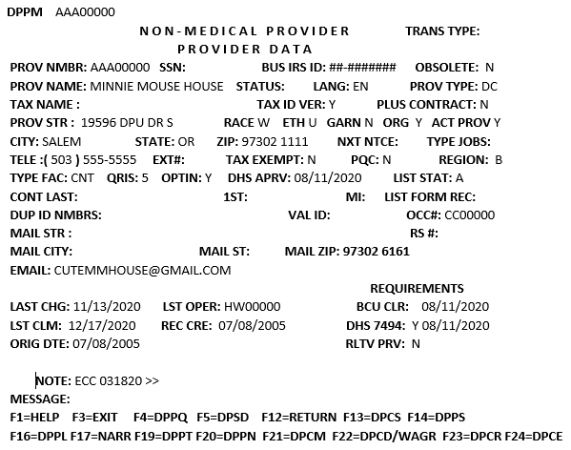
DPPM – Provider Master Screen
Example of a provider who is listed and approved on DPPM
5
Facility Type
Approval Date for ODHS Payment or last time they were re-approved for 2 yr reevaluation
Provider List Status
  A- Approved
  I – Approved only in child’s home
  F – Failed
  D – Denied
  C – Collections
  P – Inactive
If it is F, D, C or P the provider needs to fill out a 7494 Child Care Provider Listing Form.
1
2
3
If you have access and would like to learn how to search for a provider's master screen in DHR, contact DPU and they can provide assistance.

Slide 18

Who do you call?
Direct Pay Unit
Listing/Payment/Customer Service related questions:
Call Direct Pay Unit at 1-800-699-9074 Monday - Friday 8:30am - 4:30pm
E-mail CustomerService.DPU@odhsoha.oregon.gov
E-mail addresses for families and providers:
  Billing forms and listing forms (attached as a PDF): DPU.childcarebilling@odhsoha.oregon.gov
  General questions: Customerservice.DPU@odhsoha.oregon.gov
Fax Lines:
  Billings: 503-373-1580
  7494’s Child Care Provider Listing forms: 503-378-5953
  DPU internal line (misc. documents): 503-378-5957
DPU staff:
  Jo Ann Lindorfer Operations Manager 503-779-7456; Joann.Lindorfer@odhs.oregon.gov
  Joseph Litke Provider Specialist 503-507-8453; DPU.ProviderSpecialist@odhsoha.oregon.gov
  Bridget Maruame Unit Trainer 971-388-9309; Bridget.L.Maruame@odhs.oregon.gov
  DPU Leads PSR4/Branch Liaison DPU.Lead@odhsoha.oregon.gov
  Kristalina Ayala & Hilda Diaz
For child care policy related questions:
E-mail Child Care Policy at ChildCare.Policy@odhsoha.oregon.gov

Slide 19
Questions

Slide 20
Spark Help Desk

