Slide 1
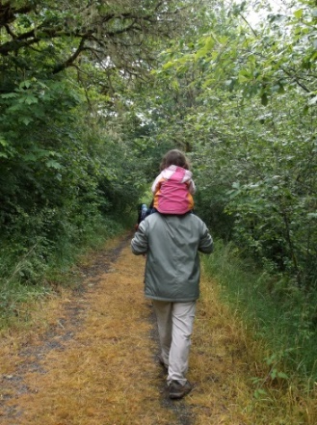
Honoring Your
Families’ Cultures
Trainer Information
Location
Date

Slide 2
Group Courtesies
Notes:
To start off the training with an inclusive feel, ask the participants what they want for participant guidelines and write them down on a large post-it or whiteboard they can see throughout the training. They often come up with things like “turn off cell phones” and “no side conversations”. I always add, “all responses are valid” and then explain that we don’t have to agree with everyone, but we need to allow everyone the chance to voice their ideas.
Not written down but we (trainers) always let the group know that some of the discussions may trigger past trauma and/or strong emotions and to do whatever they need to take care of themselves. Sharing is always optional.
Lastly, we say that “We are all teachers, and we are all learners”. Add what you want to make this point.

Slide 3
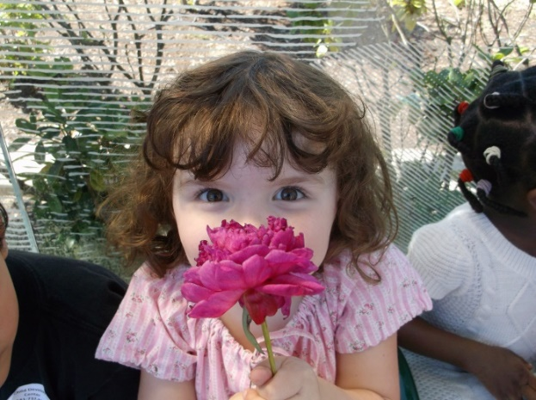
Introductions and Ice Breaker
Describe the story of your name
Share why you are attending this workshop
Notes:
Explain that everyone has a story behind their name (an inclusive activity).
Please share with the whole group the story of your name and your motivation for attending this workshop. It’s okay to share about any of their names: first, middle, last, married, etc.
If this is a large group, ask participants to input answers in the chat.

Slide 4


Agenda, Materials, Outcome, and Objectives
Notes:
Discuss any materials available to the participants and point out the participant agenda.

Slide 5
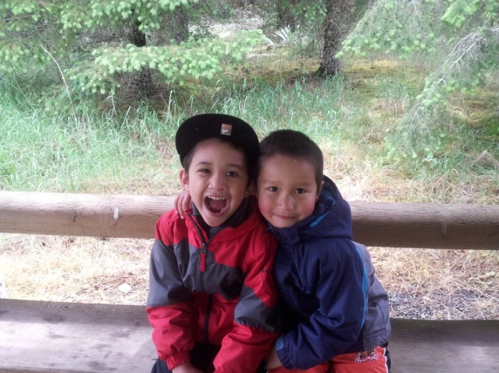
Session Outcome
Participants will develop a culturally responsive Early Learning & Development Program.
Notes:
Your program is likely already “culturally responsive” in many ways; this training may inspire you to become even more purposeful in how you are culturally responsive to every child and every family.

Slide 6
Session Objectives
Participants will:
  Examine their own cultural experiences and beliefs.
  Examine why it’s important to provide a culturally responsive Early Learning and Development Program (ELDP).
  Explore how to be linguistically responsive to their families.
  Explore and select strategies to support children’s cultures and home languages.
Notes:
Assure participants we will review what “linguistically responsive” means when we get to that part of the training.

Slide 7

What is “Culture”?
Notes:
Word Cloud Activity: Prior to training, the presenter will use slido.com to prep the question for the activity.
The presenter will input the link to slido.com or the number to join in the chat. The presenter will give participants 3-5 minutes to type in one-word answers in slido.com to the question: What is “culture”? After time is up, the presenter will share the results to the whole group as a word cloud
Give time for the answers to start coming. Generally you will get a thorough flow of responses. Point out to participants that they know what culture means and that the collective answers really capture the concept, if appropriate. (Just as an aside, in the 15 times the original trainers have presented this training across Oregon, not one time have the words “race” or “ethnicity” been suggested to complete the idea “Culture is . . . “)

Slide 8
A Definition of Culture
“Refers to how particular groups of people live. It is the way we eat, sleep, talk, play, care for the sick, relate to one another, think about work, arrange our kitchens, and remember our dead. It includes the languages we speak, the religion or spirituality we practice (or do not), and the clothing, housing, food, and rituals/holidays with which we feel most comfortable.”
Derman-Sparks & Edwards. (2010). Anti-Bias Education for Young Children and Ourselves. National Association for the Education of Young Children: Washington, D.C. p. 55.
Notes:
Point out that this is just one definition of culture that incorporates many of the participants’ responses from the “What is Culture?” activity which was just completed. If time, ask participants if there are any words or phrases from this definition which are of particular interest/importance to them.

Slide 9
Reflective Activity
Think about your family culture. Write down and/or draw some of the most important elements of your family’s culture.
What feelings surface in regards to your family culture? Pride? Shame? Identity? Confusion? Belonging? Other feelings?
Notes:
Explain that it is important to take time to reflect on our own experiences so we can be prepared in our work with children and families. For example, if you’re serving children that are in foster care and you’ve had a traumatic experience in foster care yourself, it’s important that you know your triggers and what how to manage those feelings so they don’t interfere with your professionalism.
Individually reflect on the following statement: Think about your family culture. Write down and/or draw some of the most important elements of your family’s culture.
Then have participants input in the chat their response to the following question: What feelings surface regarding your family culture?
Give at least five minutes of time for this activity. When finished, ask for volunteers to share their stories with the whole group.

Slide 10
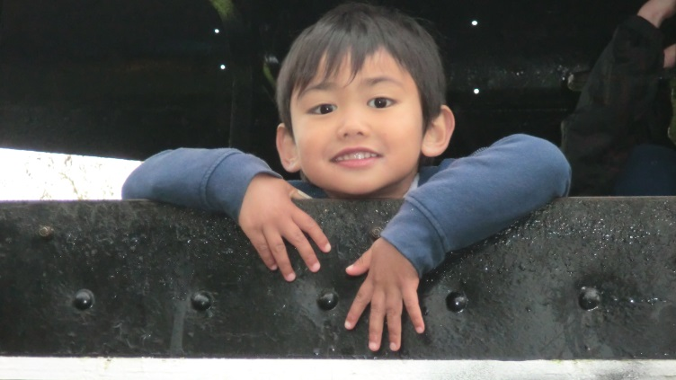
Early Childhood Educators and Culture
We want to honor each child and family’s culture but often look at surface aspects (i.e., costumes, holidays, food, etc.)
Notes:
We must avoid the "tourist approach". This is an anti-bias curriculum term. This approach trivializes differences instead of dealing with the real-life
experiences of different people.
Examples:
Trivializing: Only having activities around holidays or foods.
Tokenism: One person of color in a storybook among many white characters.
Stereotyping: Images of Native Americans in traditional dress or posters of children around the world in their country’s traditional dress.
It may be important to point out the “positive intent” of early educators who may be unintentionally doing any of the above.

Slide 11
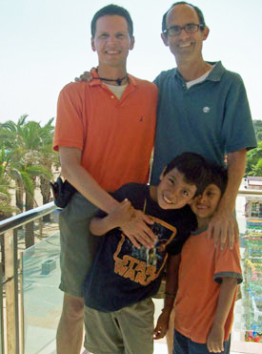
Family Structure
How will types of families be shared/valued in your programs?
Will children of various family structures see their family?
    Single parent
    Nuclear
    Nuclear – same gender
    Blended
    Grandparent (1 in 14 children in U.S.)
    Extended

Slide 12
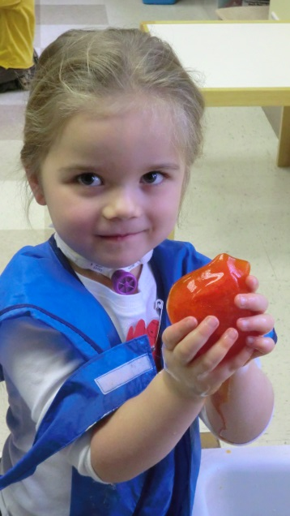
Assumptions Can Lead to Generalizing or Stereotyping
Think about some stereotypes you’ve heard about an individual, a certain group, or yourself
How have these thoughts/beliefs influenced your life and work with children and families?
Complete Group Activity
Poetry Slam video
Notes:
Briefly discuss the terms stereotype and generalization. Then share that it’s essential to learn how each person defines her or his cultural identity rather than generalize from societal attitudes. Otherwise, this leads to self-fulfilling prophecies….you see what you assume about a group or individual.
Example: Statistics say children raised in poor families do not get as much exposure to language. What if I assume this is true of all of the families? What might I miss? How might this negatively affect my relationship with a child/family?
In breakout rooms with a group of 3-4, participants will discuss their responses to questions in the Cooperative Activity: Assumptions can lead to generalizing or stereotyping. After completing the questions, participants will elect someone in their group to share with the large group.
Give groups 10-15 minutes to answer the questions.
Play the Poetry Slam video or Alex Dang. Share the importance of ensuring our current and future generations of children will grow up in a world free of hurtful stereotyping. Let participants respond to the video if time.

Slide 13
Influences on Your
Classroom Culture
Children and Families
ELDP Staff
Community
Dominant Culture
Notes:
Remind participants that as they think about their classroom or program culture, it’s truly a combination of the individual children’s and families’ cultures, your staff members’ cultures, the culture of the community in which you live/work, and the dominant culture in the greater society. Multiple cultures affect every classroom culture.

Slide 14

Early Childhood Experiences . . .
What Research Tells Us
Unless adults support and guide children at home and in other settings, children may internalize what they’ll interpret is “right” and “wrong” about how they live, possibly leading to prejudice (their way is the “right” way) or feelings of not-belonging (their way is the “wrong” way).

Slide 15
Resources
  Anti-Bias Education for Young Children and Ourselves. Louise Derman-Sparks and Julie Olsen Edwards, 2010.
  Developmentally Appropriate Practice. Carol Copple and Sue Bredekamp, editors, third edition, 2009.
Notes:
If possible, have these books with you at the training to share as references.

Slide 16
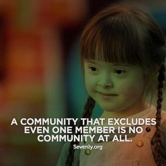
Break
Notes:
Play the “Chocolate” video/song either during or near the end of the break time.

Slide 17
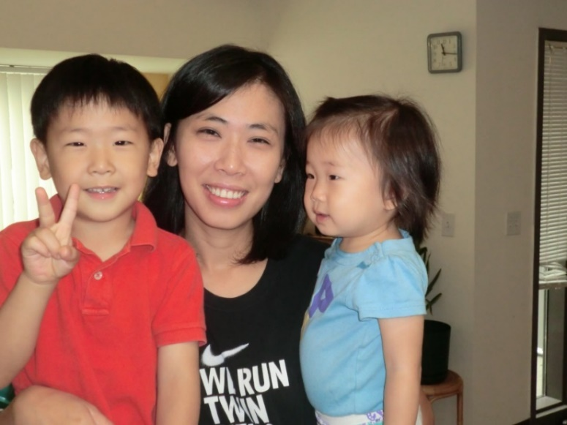
Moving From Why to HOW
How can we be purposeful about creating a linguistically responsive ELDP?
Notes:
What does it mean to be “linguistically responsive?” Ask for a few participants to share their thinking. Add to what they share to include how programs support the communication of children and families: speaking, reading, and writing. Playing music in children’s home languages (such as “Chocolate”) is also a way to be “linguistically responsive” to children.

Slide 18
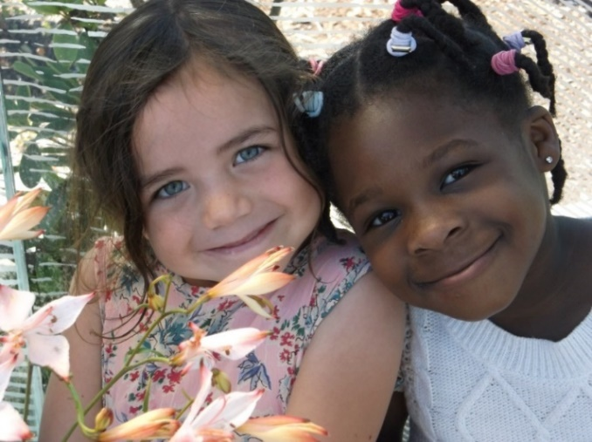
Linguistically Responsive Strategies
Compare strategies (on handout) with your own experiences
What else did your group come up with that could be added to our list?
Compare/Share/Add to list
Notes:
In breakout rooms with a group of 3-4, participants will go through the Linguistically Responsive Strategies list and discuss which things they already do and brainstorm additional ways they can support children and families when communicating by speaking, reading, and writing in their home languages – including sign language.
A few participants will share in the large group what additional ways their group came up with.
OPTIONAL: The little girl on the right in this picture is named Fiyinfoluwa. Her family is originally from Nigeria, and her parents speak Yoruba and English. If there is time, I often write her name in large letters on the whiteboard or chart paper. Then I ask participants to share what they think is the correct pronunciation of her name. I let them take a few guesses and then tell them the correct pronunciation is “Feen-fo-loo-wah”. What is important about this is that pronouncing children’s and family members’ names correctly is very important, and the best way to know how to pronounce names correctly is to ASK the families. Then listen to them when they are speaking to each other -- and practice. As an aside, her father’s name is Adenaii, her mother’s name is Oyebola, her older sister’s name is Ifeoluwa, the last name of the family is Adenuga . . . and the baby boy they had in the United States was named . . . David. ;)
OPTIONAL: You can always just give the quick example of how you would feel if a teacher mispronounced your name or your child’s name all year long . . . “Candice is pronounced “Candis”, not “Canned Ice!”

Slide 19
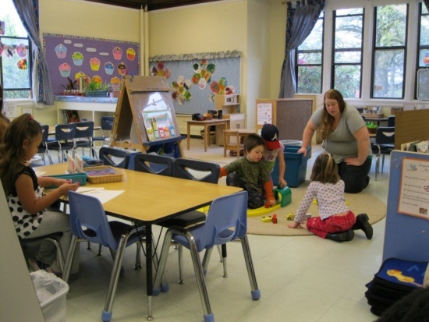
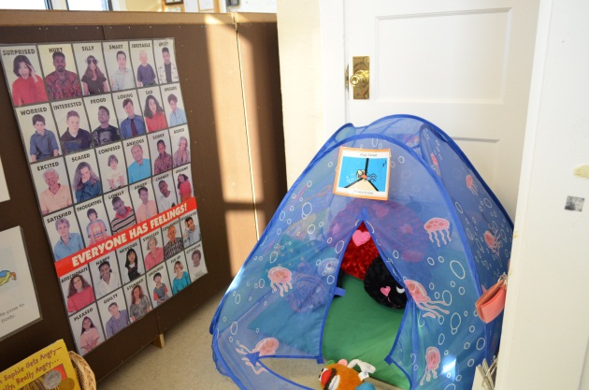
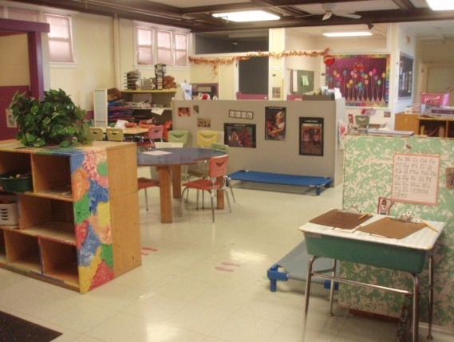
Program Tour With Fresh Eyes
Take a few minutes to think about your programs silently.
How are teachers’, children’s, and families’ lives reflected?
What are the invisible/underlying ways that culture is valued?
Notes:
One idea to add to this is to have programs “Imagine you are a new family coming to visit your program for the first time. What would you see/hear which tells you how this program would value your own family culture?”

Slide 20
Spark/Quality Rating and Improvement System
In the Children’s Learning and Development domain many of the standards have a focus on inclusion and culture.
Some examples:
  “Shelves or containers with toys, books, etc., labeled with words in the languages of all the children in the program”
  “Represents the culture of the community”
  “Includes some written materials in the children’s home language”
Notes:
Briefly discuss what QRIS is (for participants who are unfamiliar with it). Then share how Oregon’s QRIS addresses family cultures in a variety of ways and weaves those requirements for supporting diversity throughout the standards.

Slide 21
Spark/QRIS (continued)
  “Activities designed to promote understanding of cultures represented in the program”
  “Activities designed to promote understanding of cultures beyond those represented in the program”
  “Interactions with persons who are culturally or linguistically diverse”
  “Some activities in children’s home languages such as singing or storytelling”
Notes:
Give examples of each statement to help participants get a clearer picture of what those statements look like “in action.”
Examples:
For “Activities designed to promote understanding of cultures represented in the program” talk about how this might look in the classroom for families you are CURRENTLY serving. If you have families from Mexico, you might sing songs daily in Spanish, read stories in Spanish, and incorporate projects on a regular basis such as making tortillas. Cooking projects and story times are examples of activities that family members can lead or support. Activities representing the cultures in the program should be ongoing and not just for special occasions.
If your families are all from the same or similar cultural background (i.e., white, middle class), it’s still important to incorporate individual family culture into your daily activities. For example, have children bring their favorite book for story time or have a family member read this book at story time. Incorporate favorite foods from home into cooking activities, again having family members involved when possible. The more you know your families, the more you can incorporate individual family culture into the program.

Slide 22
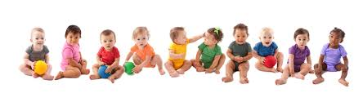
Why Does QRIS Include Those Criteria?
So children will feel pride in their families’ cultures
So children and families feel comfortable and valued when in your program
Notes:
QRIS goals mirror provider and family goals.

Slide 23
Activity: Strategies Which
Honor Families’ Cultures
Fill out the Self-Evaluation
Discuss in your groups any other strategies not listed on the form
Groups share/add additional ideas
Notes:
The presenter will give the participants 5 minutes to individually complete the self-evaluation handout
Encourage participants who came with other staff members to work together. We also always encourage people to take the Self-Evaluation back to their directors/programs and share with their colleagues at staff meetings, etc.
After participants have had enough time to complete the first two bulleted items, invite them to share their thoughts about the last item to add to the self-evaluation.

Slide 24
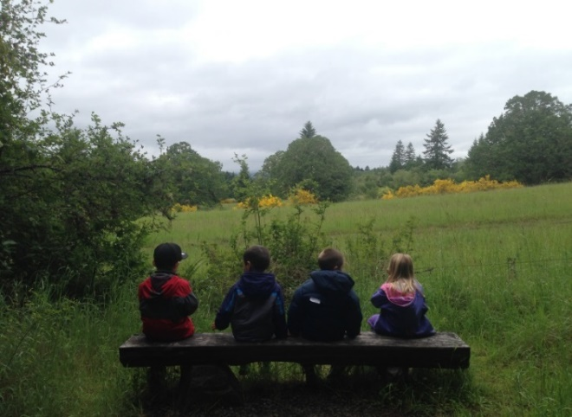
Planning Out Your Goal
Share with your peers at least one strategy you plan to implement which honors families’ cultures
    Be specific and realistic
    Give yourself a timeline
Can highlight on your self-evaluation any other goals you plan to implement
Notes:
Participants will respond by unmuting or typing into the chat their response to the following statements: Share one strategy you plan to implement which honors families’ culture and highlight on your self-evaluation any other goals you plan to implement.

Slide 25
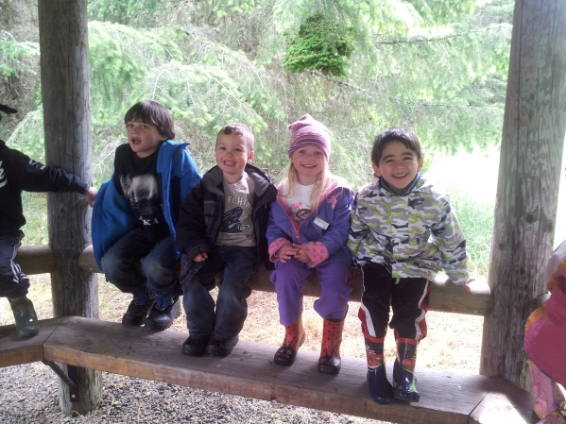
Evaluation/Certificates/Conclusion
There are many ways that cultural differences
are taught to young children.
Everything we do
tells children about how we see the world
and what we think of others.
Thank you for your participation! ☺
Notes:
Thank the participants for participating, sharing their ideas, and being committed to honoring their families’ cultures. Encourage them to give you honest feedback in their evaluations, get their certificates, and share any other housekeeping items/announcements you want them to know.

