Slide 1
Spark Recognition and Resubmission Phase
New Quality Improvement Specialist Training: Module 6
Notes:
Lauren 1-10

Slide 2

Welcome
Please type your name in the chat
Notes:
Trainer notes:
Photo
"Welcome" by WaywardShinobi is licensed under CC BY-SA 2.0

Slide 3
Module 5 Review
Module 5 included:
Spark standards and evidence in the Health and Safety, Personnel Qualifications, Family Partnerships, and Administrative and Business Practices domains
Notes:
ChienFei share ORO report document

Slide 4
Module Series
Introduction to Spark: Oregon’s QRIS
Engaging Early Learning Programs in Spark
Spark Quality Improvement Phase, part 1
Spark Quality Improvement Phase, part 2: Spark Standards
Spark Quality Improvement Phase, part 3: The Portfolio
Spark Quality Recognition Phase
Spark Continuous Quality Improvement Phase

Slide 5
Objectives
Participants will examine the Spark rating process
Participants will develop strategies to support programs during the resubmission process
Participants will explore how to access and use Spark program rating data

Slide 6

Reflection
Have you worked with early educators that have felt frustrated and “stuck?” How did you help them?
Notes:
https://www.youtube.com/watch?v=47rQkTPWW2I&list=RD47rQkTPWW2I&start_radio=1&t=0 STOP VIDEO AT 1:40

Slide 7
Spark Oregon’s Quality Rating and Improvement System Participation Phases
 | Commitment to Quality Phase | Quality Improvement Phase | Quality Rating Phase | Continuous Quality Improvement Phase
Enter this phase when: | Licensed program Interested in Spark Meet C2Q compliance requirements | Achieved C2Q Program uses QIP/SA to identify areas for CQI Need Spark resources to improve program | Achieved C2Q Best practices implemented | Have submitted a complete portfolio Received initial rating and feedback
Steps and materials: | Attend Spark Orientation Apply for C2Q by submitting: Application MOU Receive C2Q rating and Welcome Kit Use Quality Improvement Plan (QIP) and Self Assessment (SA) to decide next steps in Spark | Complete personalized action plan using the QIP Request financial supports by submitting: Request for Supports form WOU W-9 form Work individually or with Quality Improvement Specialist Implement quality improvements in programs using QIP as a guide | Document evidence in Spark portfolio Clearly label evidence and place in appropriate section of portfolio Use score sheet and other Spark resources to make sure evidence is well documented and complete Apply for 3-4-5 star quality rating by submitting complete Spark portfolio for review | Receive financial incentive at 3-4-5 star levels Create an action plan using the QIP to address any standards not initially met at desired level Document updated evidence in portfolio as needed Resubmit Spark portfolio as needed Maintain Spark quality and compliance requirements
Notes:
Trainer Notes:
This slide introduces the participants to the all of the phases of Spark participation.
See Handout, “Spark_Participation_Phases_Updated_6-16-20”
I:\Train\QRIS\Quality Improvement Specialists\QIS Meetings & Trainings\QIS Training modules\Module 2 docs

Slide 8
Spark Portfolio Submission Process

Slide 9
Portfolio Development and Submission Process
  Compile evidence for star level — evidence must be provided for EVERY indicator
1
  Place labeled evidence in portfolio
2
  Check box indicating evidence has been provided
3
  Make a copy and submit portfolio to TRI for review
4
Notes:
Remind programs to make a copy!

Slide 10
QIS Role in Rating Phase
Checking for completeness; copying, mailing, and delivery if needed
Provide program with information about timeline and process
Remind program to respond quickly to requests from TRI
Prepare programs to receive and respond to rating received
Stay in touch with programs
Check status of rating on QIS monthly report, portal or by checking in with programs
Notes:
Portfolio checklist document for QIS in the portal – ChienFei will show document

Slide 11
Portfolio Submission Checklist
Provider Submission Checklist: Early Educator - Current Participant – Spark Resources – Portfolio Submission Checklist
QIS Portfolio Submission Checklist: QIS portal – Early Educator Materials – Portfolio Documents
Notes:
ChienFei show where these documents located on the website

Slide 12
Spark Portfolio Review Process
Notes:
Nate 10-28

Slide 13
Portfolio Review Process
Mail or deliver complete portfolio
Completeness check by TRI
Spark Review Team examines portfolio
Portfolio and designation materials mailed back
Program notified of decision
Spark rating assigned
Program may resubmit at any time!
Notes:
Overview of process

Slide 14
Portfolio Review Timeline
Initial rating 1-3* months after complete portfolio received
Review may be delayed by:
    Portfolio organization or completeness
    Incorrect license numbers or other identifying information
    Missing information in Oregon Registry
    Staff list not updated with licensing
Notes:
Usually it is considerably faster than 3 months!

Slide 15
Rigorous Review Process
Completeness and pre-score
Assigned to review team
Reviewer 1
Reviewer 3/ Final Quality Check
Discussion
Reviewer 2
Notes:
Explain the reason for 2 reviewers
Explain the role of Reviewer 3

Slide 16
Percentage Scoring – Minimum to Achieve Rating
 | Learning Development | Health and Safety | Personnel Qualifications | Family Partnerships | Administration and Business Practices
Total number of standards by domain | 12 | 6 | 5 | 4 | 6
Total number of standards needed to pass each domain | 10 | 5 | 5 | 3 | 5

Slide 17
Common Stumbling Blocks
policy vs. description
unclear photos/insufficient photos
lack of evidence submitted for each age group or classroom
missing evidence/meeting some but not all criteria
Notes:
Trainer notes:
These are common mistakes that Reviewers see when reviewing portfolios.

Slide 18
Sample review of standard LD4, 3 star
Look at criteria in the indicator
  Look at the evidence requirements
  Written description and captioned photos
Can all of the criteria be located?
Notes:
Nate: I made a couple of changes in this section. Rather than ask the participants to review the evidence to see if it passes, I would rather we show them exactly why it does pass. I don’t want to give the message that they are meant to be able know if things pass or don’t.

Slide 19
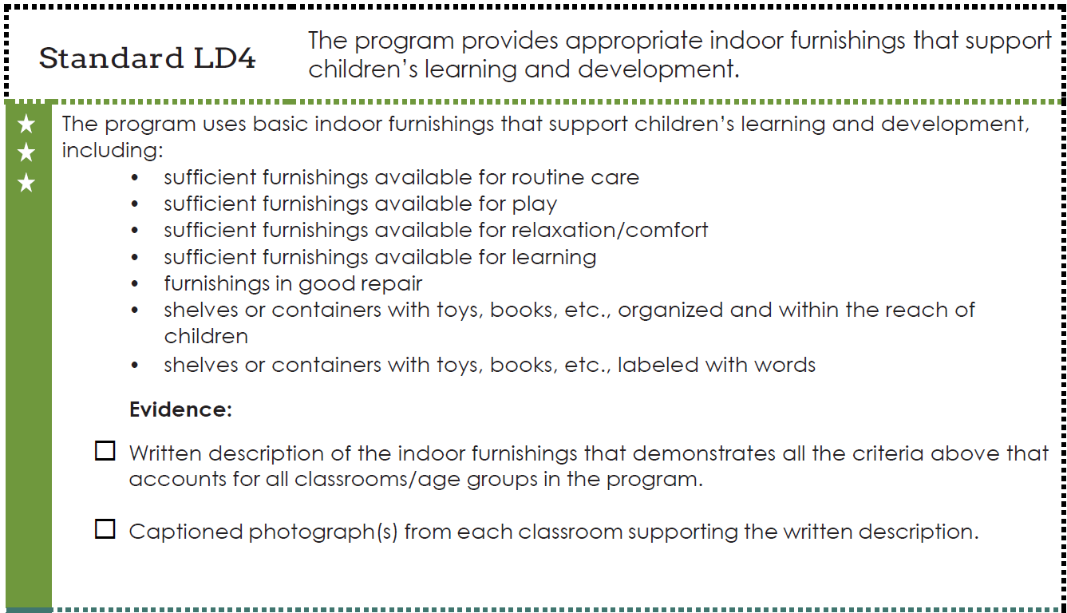
Notes:
Reviewers need to see all of the criteria addressed in either the written description and the photos combined

Slide 20
  LD4 3-star
  Each of our rooms has child sized furniture. We have tables for puzzles, art, and small toys like Legos and shelves with toys and supplies. For our babies and toddlers, we have changing tables, highchairs, cribs, and bouncy chairs. We have a cozy corner with pillows and books and stuffed animals. We keep everything organized in different areas using shelves with bins and baskets. The bins and baskets are labeled with the words of the toys that are inside. All of our furniture is clean and in good, safe condition.
Notes:
Written description
Bold words/phrases meet criteria in the standard

Slide 21
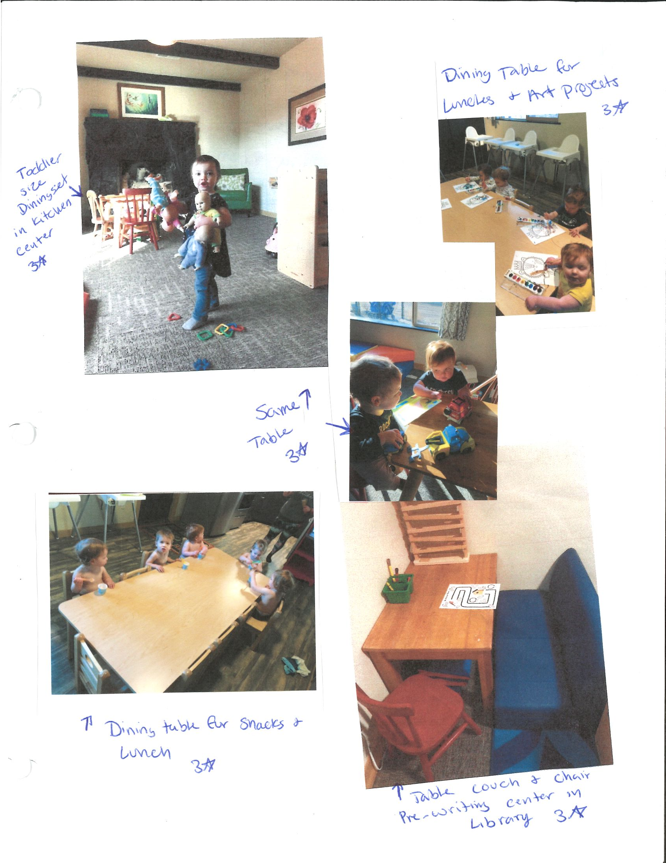
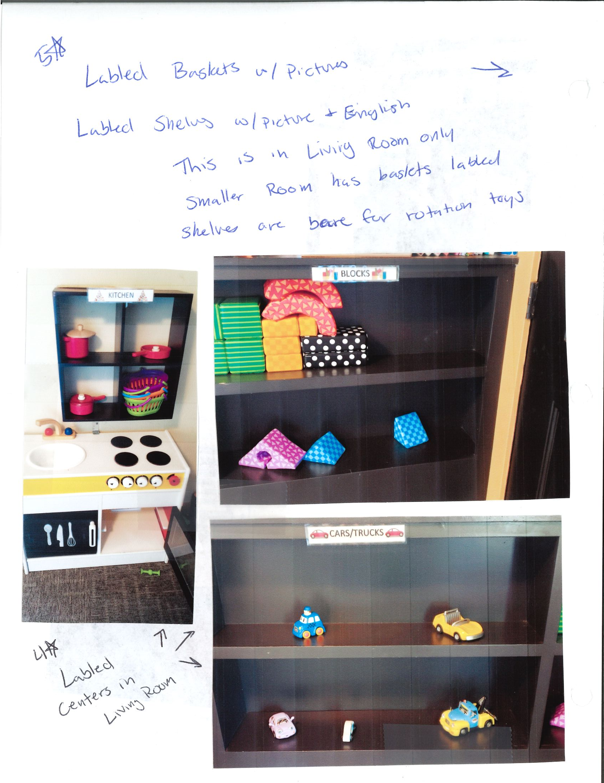
Notes:
Shown are furnishings for routine care, learning, play,
Organized, labeled shelves within reach of children

Slide 22
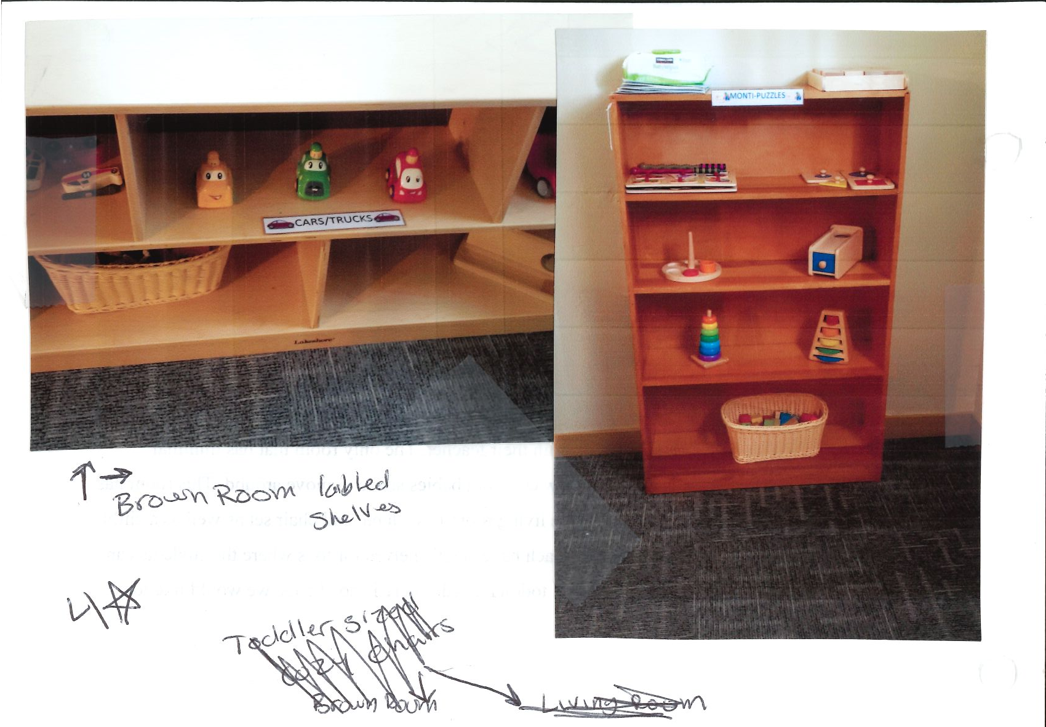
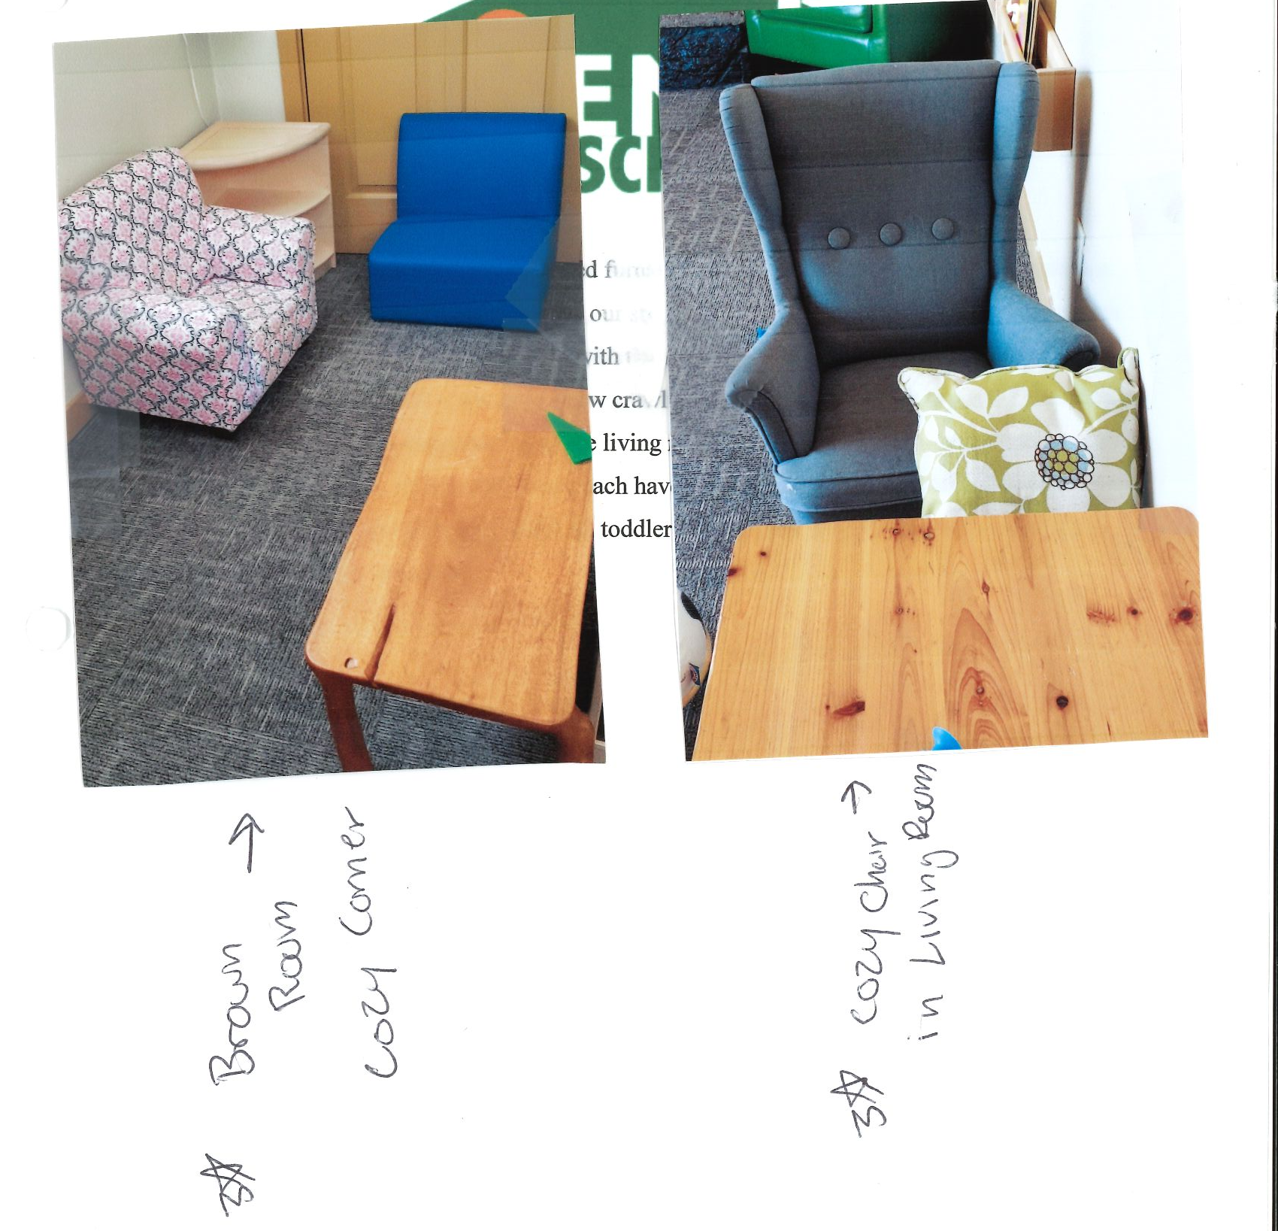
Notes:
The photos also meet the criteria place for relaxation

Slide 23
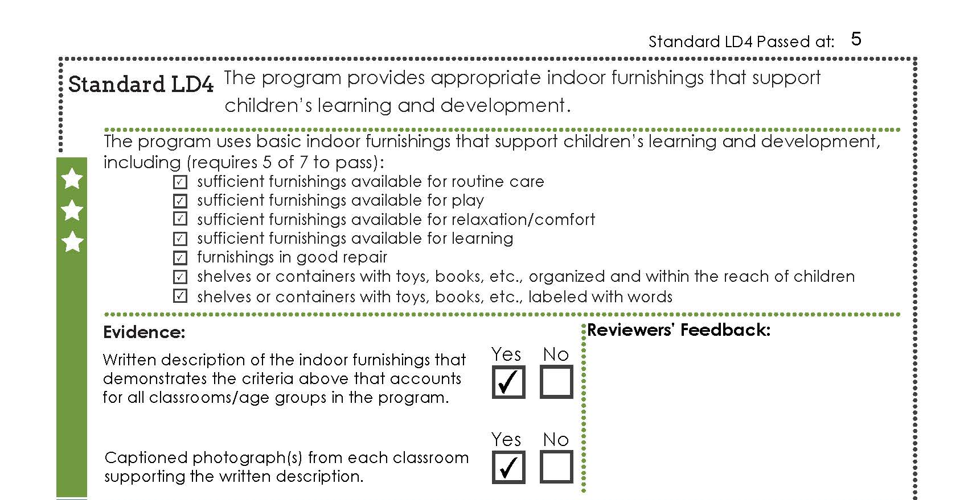
Notes:
Photos and written description meet criteria

Slide 24
The reviewers’ perspective
Reviewers have enormous respect for the effort involved in creating and submitting a portfolio.
Reviewers want programs to succeed!
Reviewer reliability is paramount
  We can not give the “benefit of the doubt” or make assumptions.
  We must locate the actual evidence requested in the standard.
  Too much evidence is as challenging as too little.
Notes:
Nate 27-31
Our system is built to have an inter-rater reliability of 85% or greater.
We have a rigorous training process for reviewers which includes co-reviewing multiple portfolios with experienced reviewers and get to 85% accuracy of the experienced reviewer’s score before they review on their own.
We can not give the benefit of the doubt when are reviewing portfolios. If the evidence doesn’t meet the criteria then it doesn’t pass.
We are looking for the “Goldilocks” of evidence… not too little, not to much…
Portfolios with too much information can be challenging to review. It is easier to possibly miss things

Slide 25
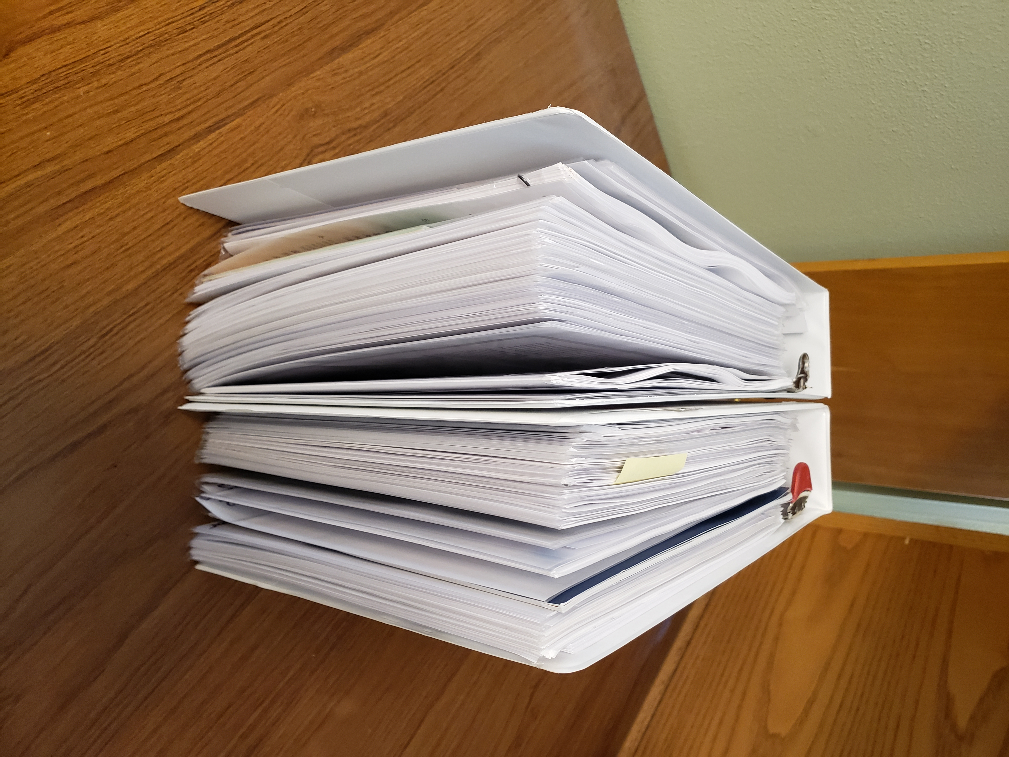
Notes:
Trainer notes:
This an example of the amount of information some early educators provide. This is a single portfolio that needed two binders to hold all their evidence.
This is not typical however, it is an example of what reviewers have to look through as they rate portfolio.

Slide 26
Small Group Discussion
What questions do you have about the review process?
Notes:
Trainer notes:
Break us up into 2 groups
Allow at least 10 minutes for this break out

Slide 27
Financial Incentives
Awarded by TRI after program receives star rating. (Programs do not need to apply for these funds.)
Amount depends on size of program (license capacity) and rating awarded
Recognizes achievements and provides support for ongoing cost of quality
***Same restrictions on use as support funds
Notes:
The checks take time!

Slide 28
Additional Incentives for
Spark Star Rating
Legislature passed tiered reimbursement tied to Spark rating
  Providers serving children receiving ERDC subsidy get payment for each full time child each month – amount depends on star rating ($54/$72/$90)
Notes:
Trainer notes:
If time, you can go to the ODHS website and show them this financial benefit.
https://www.oregon.gov/dhs/ASSISTANCE/CHILD-CARE/Pages/Star-Rated-Provider-Incentive.aspx

Slide 29

Questions and Comments
"Things that make you go hum..." by arvtpei is licensed under CC BY-NC-ND 2.0

Slide 30

Break
"People talking during break" by TEDxMonterey is licensed under CC BY-SA 2.0

Slide 31
Spark Portfolio
Resubmission Process
Notes:
Lauren 30-41

Slide 32
Resubmission statistics
50% of all programs do not achieve their desired star rating upon initial submission.
  Of these, 50% disengage from the process and never resubmit.
94% of programs who resubmit their portfolio receive the desired star rating.

Slide 33
The role of the QIS when programs face a rating disappointment
Support programs in processing feelings of frustration and disappointment.
Assist programs in understanding portfolio feedback.
Encourage programs to remain engaged by focusing on strengths and the goal of quality for children and families.

Slide 34
Explanation of rating received
Cover sheet explanation
What was passed/not passed
Compliance grid
Notes:
Being upset and disappointed can impair cognitive functioning, making it hard to understand the Summary Score Sheet. Take some time to explain it.

Slide 35
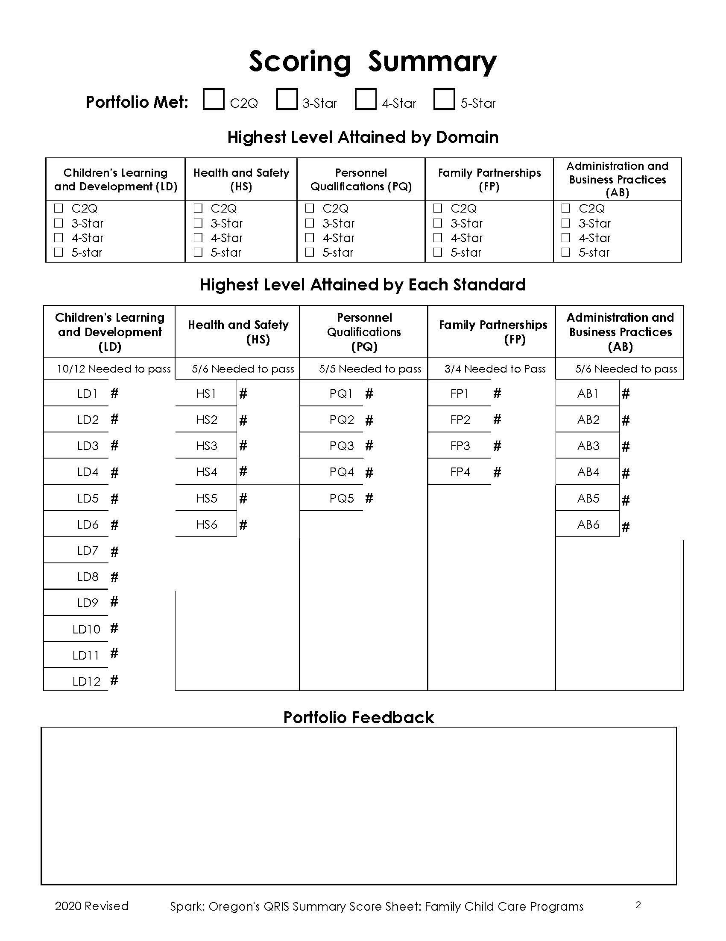
Notes:
Trainer notes:
Example of a blank score sheet
Use annotation feature to point out different parts of the score sheet.

Slide 36
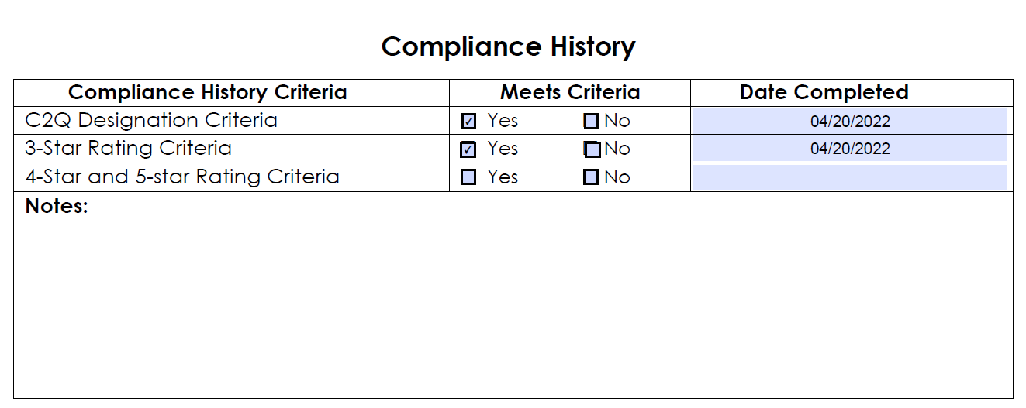

Slide 37
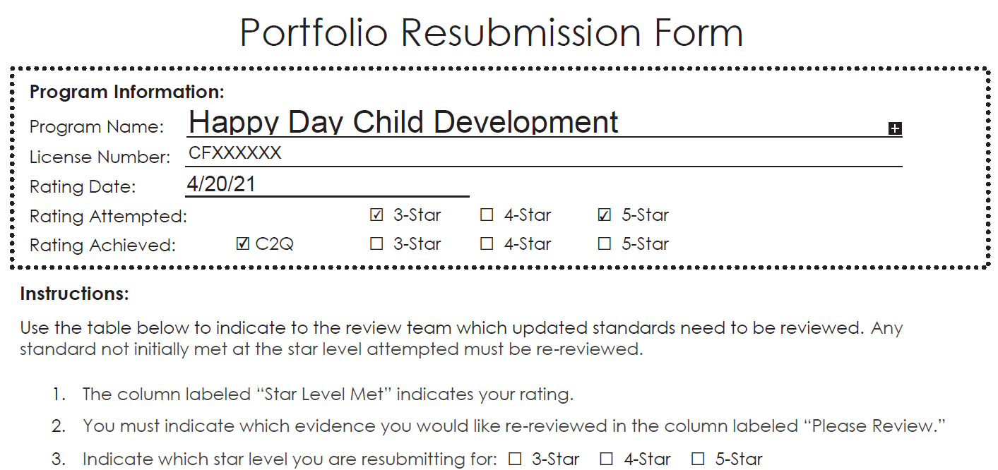
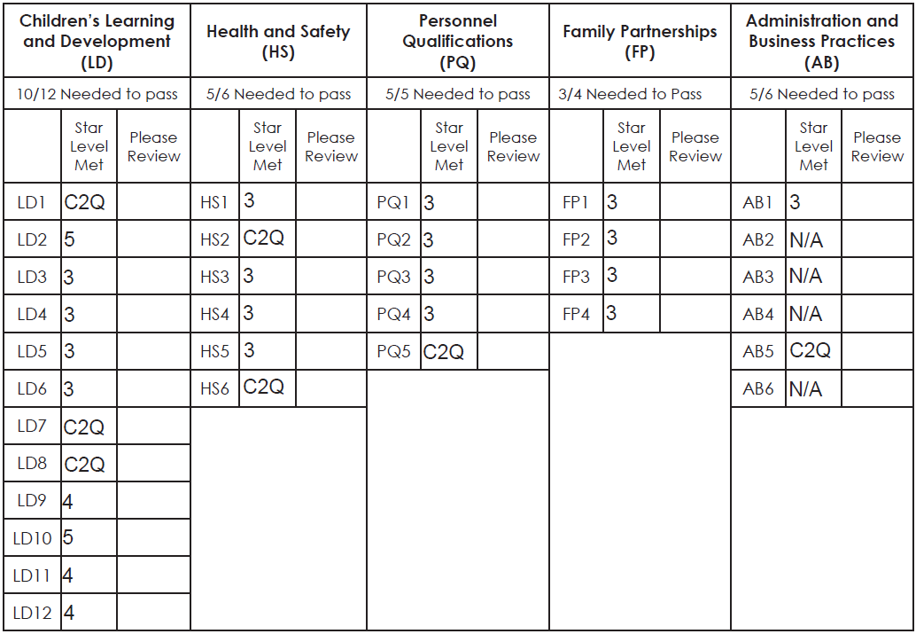
Notes:
Trainer notes:
USE ANNOTATION FEATURE

Slide 38
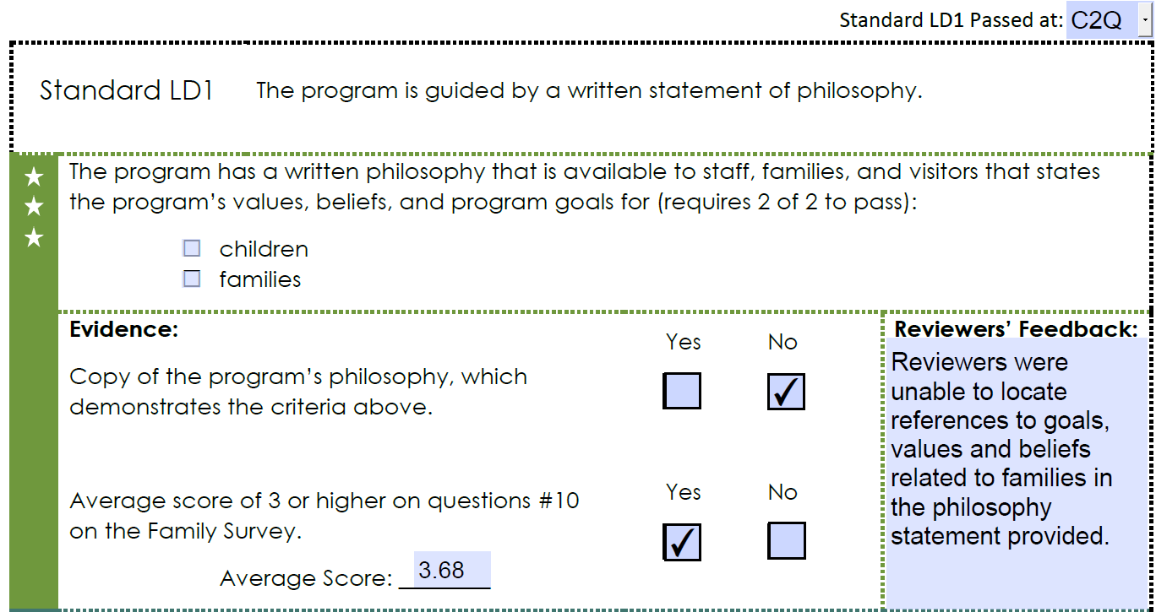

Slide 39
Portfolio Resubmission
Portfolio Resubmission Form included with feedback; use it as a guide for resubmission
Indicate on Resubmission Form which standards are to be re-reviewed
Clearly indicate what the new evidence is
You can help set the tone for the resubmission process by being positive and straight-forward.
Notes:
Encourage early educators to resubmit! Most portfolios that did not achieve the desired rating only missed by a few standards

Slide 40
Creating a Resubmission Plan
How many standards need to be passed per domain?
Which standards does the provider wish to resubmit evidence for?
What exactly does the provider need to do to pass the standard? (document? implement?)
Read the feedback on individual standards. This provides guidance on how to pass the standard when resubmitting the portfolio.
Notes:
Start with the yellow resubmission form programs need to make the on the form what star level they want to reviewer to review. They can’t just check the box and assume that reviewer know what they mean.
The importance of clearly indicating what is new evidence
If new evidence isn’t clearly marked, it can lead to delays in the portfolio being reviewed in a timely manner.
Reviewer want the program to receive the rating the desire
Electronic resubmission

Slide 41
Maintain Focus on Quality
Keep the focus to quality improvement
Recognize the small steps that make up quality improvement
Celebrate program improvements and the positive impact they had for children and families!
Notes:
Remember we want early educators to be in the process and not just get through the process.
ChienFei ping Pat

Slide 42
Questions and Comments
"Things that make you go hum..." by arvtpei is licensed under CC BY-NC-ND 2.0

Slide 43
How, where, and when to use data
Notes:
Pat 43-43

Slide 44
Monthly QIS Report
Patrick Aldrich
Director, Center on Evaluation, Technology, and Research

Slide 45
Professional Action
Do you currently receive the monthly QIS report?
If not, contact Pat to get on the monthly email distribution!
If yes, access your most recent report and find out which programs in your area have received Welcome Kits in the last 60 days.
Notes:
Lauren to end

Slide 46
Preview of Module 7
Participants will explore principles in assisting programs in developing a Continuous Quality Improvement Plan
Participants will develop strategies to assist programs in implementing their Continuous Quality Improvement Plan
Participants will examine the use of the ERS and CLASS tools in a CQI plan
Notes:
Mention Rebecca and Maria will host

Slide 47
Questions and Final Thoughts
Evaluation
Please type your name in the chat
Notes:
Trainer notes:
Remind participants to type their names in the chat before they leave.

