Slide 1
Portfolio Building:
Health and Safety Standards
Date
Trainer Name
Trainer Contact Info
Agency Name
Notes:
Timing: For a 3-hour training session, plan to spend about 20 minutes on the introduction (slides 1-10) and 20 minutes on each standard. This will leave 10 minutes for a break, 10 minutes for certificates and evaluations, and 20 minutes that you can allocate wherever you feel you need to spend more time.
Slides 1-10 should take about 20 minutes.
Materials:
All participants should bring their Quality Improvement Plan to the training session.
Portfolios will also be helpful. Plan to have at least one sample portfolio available so that you can refer to the evidence required for each indicator.
Dry erase board or flip chart, markers
Samples of parent / staff handbooks to show policies for Health and Safety standards (optional)
Introduce trainers,
Ask participants to introduce themselves
Optional: Ice breaker activity chosen by the trainer

Slide 2
Session Outcome and Objectives
Examine the QRIS Health and Safety standards.
Create documentation of policies and procedures as required by the QRIS Health and Safety standards.
Discuss the application of health and safety standards in your program.
Discuss strategies and tactics for achieving program-wide implementation of Health and Safety standards.
Complete the “Health and Safety” portion of your QRIS Portfolio
Notes:
Allow participants time to read the objectives, discuss as needed
Objectives:
Examine the QRIS Health and Safety standards.
Discuss the application of health and safety standards in your program.
Create documentation of policies and procedures as required by the QRIS Health and Safety standards.
Discuss strategies and tactics for achieving program-wide implementation of Health and Safety standards.
Outcome:
Complete the “Health and Safety” portion of your QRIS Portfolio

Slide 3
Reflection
How close are you to meeting the Health and Safety standards at your desired star level?
Notes:
This can be done as a large-group or individual reflection followed by discussion.
Invite participants to share the quality improvements they have already made, and the quality improvements they have in mind.
Consider:
focusing the conversation on participants’ confidence in their ability to make improvements
focusing the conversation on participants’ reasons for making particular improvements

Slide 4
Portfolio
Your chance to show off what your program does
Document your quality, including quality improvements
Required for a quality rating
Ratings are never final, you can resubmit as many times as you want
Notes:
Slides 4-9 have been cut and pasted from the IQT training. They are included here as a reminder of the process. Feel free to spend more time or less on them as needed by your group.

Slide 5
Evidence
Evidence is meant to be a measurable indicator of the quality of a program
Pay careful attention to the type of evidence asked for in the portfolio
You may add supplemental evidence but do not omit any required evidence
Notes:
Slides 4-9 have been cut and pasted from the IQT training. They are included here as a reminder of the process. Feel free to spend more time or less on them as needed by your group.

Slide 6
Evidence Example
Program policy, written procedure or guidelines
  Copy of program policy, procedure, guidelines, philosophy, code of ethics, rules, etc. from a program document such as a parent handbook or operator’s manual selected to clearly demonstrate criteria
Written description
  Description of an activity, approach or procedure which demonstrates the criteria. This can include: an experience which demonstrates the performance criteria, teaching strategy used, or the physical environment or room arrangement
How are they different? Why are they different?
Notes:
Slides 4-9 have been cut and pasted from the IQT training. They are included here as a reminder of the process. Feel free to spend more time or less on them as needed by your group.

Slide 7
Portfolio Requirements
(Note: QRIS designation given by OCC licensing location)
Some standards are classroom-specific
Programs with multiple classrooms need to submit evidence for each classroom
Some standards are age-specific
Programs with multiple age groups will need to submit evidence for each age group
Multiple licensing locations
Programs can choose whether to submit for one, some or all locations
Contact TRI for details
Notes:
Slides 4-9 have been cut and pasted from the IQT training. They are included here as a reminder of the process. Feel free to spend more time or less on them as needed by your group.

Slide 8
Portfolio Development and Submission Process
Compile evidence for star level — evidence must be provided for EVERY indicator
Place labeled evidence in portfolio using included instructions and evidence pages
Check box indicating evidence has been provided
Submit portfolio to the Teaching Research Institute for review
Don’t forget to look at the scoring guide to help you understand how your portfolio will be rated!
Notes:
Slides 4-9 have been cut and pasted from the IQT training. They are included here as a reminder of the process. Feel free to spend more time or less on them as needed by your group.

Slide 9
Percentage Scoring – Minimum to Achieve Rating
 | Learning and Development | Health and Safety | Personnel Qualifications | Family Partnerships | Administration and Business Practices
Total number of standards by domain | 12 | 6 | 5 | 4 | 6
Total number of standards needed to pass each domain | 10 | 5 | 5 | 3 | 5
Remember, evidence must be submitted for each indicator.
Your portfolio will not pass the initial screening and move on to a review team if it is not complete!
Notes:
Slides 4-9 have been cut and pasted from the IQT training. They are included here as a reminder of the process. Feel free to spend more time or less on them as needed by your group.

Slide 10
What Star Level?
Have you decided on which star level you will apply for?
What barriers exist that make achieving that star level a challenge?
Notes:
Focus conversation on the Health and Safety Domain.
Depending on how far they are into their QRIS work, participants may not yet have encountered barriers. If they bring up more than a few barriers, you may want to list them on a whiteboard / flip chart page and address them as part of your discussion of each standard / indicator.

Slide 11
HS1 - Children are provided instruction and support to independently manage health and hygiene practices.
3 Star
4 Star
5 Star
At least once per year, children are provided instruction on how and when to brush teeth and have opportunities to practice tooth brushing.
Support and instruction is provided during toileting.
Children are provided instruction on preventing germ transmission.
Notes:
Slides 11-16 should take about 20 minutes, including time for individual writing
Materials:
Quality Improvement Plan and / or portfolio
Large group discussion:
Discuss what the standard and indicators mean, why they are included in the QRIS.

Slide 12
Evidence
3 Star
4 Star
5 Star
Written description or policy explaining how and when instruction is provided to children on toileting.
Written description or policy explaining how and when instruction is provided to children on germ transmission.
Written description or policy explaining how and when instruction is provided to children on tooth brushing.
Notes:
Mini Lecture
Tell participants what kind of evidence to include in their portfolio, where it should go, and how to label it.
If you can, provide a sample of portfolio evidence.
If participants need it, this is a good opportunity to review the difference between a written description and a policy.
A policy is addresses to parents, staff, or visitors, and is generally found in a parent or staff handbook. A written description is addressed to the portfolio review team and may be found only in the program’s portfolio.

Slide 13
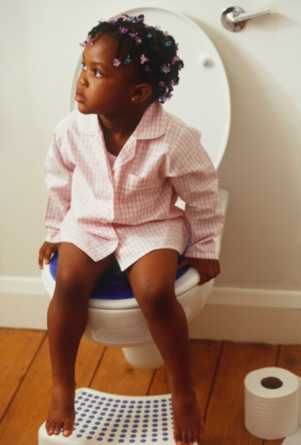
How can we implement this?
Children are provided positive support and instruction at the individual ability level of the child during toileting. Instruction is provided:
in a positive manner
using naturally occurring opportunities
on an individual basis
Notes:
Materials:
Dry erase board or flipchart, markers
Large group discussion
What do the criteria mean?
How do you teach children about toileting?
Large group brainstorming
Many QRIS participants find it difficult to write an effective description of their practices. Ask participants to describe their Health and Safety verbally.
Write their responses on whiteboard / flip chart.
When you get to slide 16, you will lead the group in writing a sample description based on the input everyone has given.

Slide 14

How can we implement this?
Children are provided instruction on preventing germ transmission (for example, instruction on frequent and thorough hand washing, using a tissue to wipe nose, sneezing and coughing in elbow, and not sharing drinks). Instruction is provided:
in a positive manner
using naturally occurring opportunities
on an individual basis
during group activities
Notes:
Materials:
Dry erase board or flipchart, markers
Large group discussion
What do the criteria mean?
Germ transmission?
Large group brainstorming
Many QRIS participants find it difficult to write an effective description of their practices. Ask participants to describe their Health and Safety verbally.
Write their responses on whiteboard / flip chart.
When you get to slide 16, you will lead the group in writing a sample description based on the input everyone has given.

Slide 15
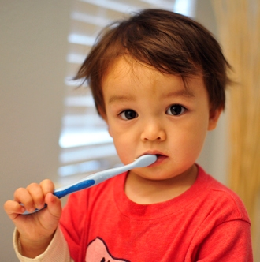
How can we implement this?
At least once per year, children are provided instruction on how and when to brush teeth (for example, staff or dental hygienist demonstrating techniques, providing brushes and having children practice technique, etc.) and have opportunities to practice tooth brushing.
Notes:
Materials:
Dry erase board or flipchart, markers
Large group discussion
What do the criteria mean?
How do you teach children about brushing their teeth?
Large group brainstorming
Many QRIS participants find it difficult to write an effective description of their practices. Ask participants to describe their Health and Safety verbally.
Write their responses on whiteboard / flip chart.
When you get to slide 16, you will lead the group in writing a sample description based on the input everyone has given.

Slide 16
Writing your description…
How do you teach children about toileting independently?
How do you teach children about hand washing and germs?
How do you teach children about brushing their teeth?
Notes:
Materials
Dry erase board or flip-chart, markers
Large group collaboration
Work together to write a sample description. You may need to do quite a bit of scaffolding here, depending on the participants’ needs. Stress the importance of writing in their own words about their own practices for their portfolio evidence.
Individual work
Allow participants time to write or outline a rough draft of their own written description. Encourage collaboration / peer-to-peer help. In order to build participants’ ability to write independently for their portfolio, consider asking participants to “buddy up” or work in teams. They should ask you for help only if neither buddy can solve whatever problem they are having.
If time permits and there is interest, invite participants to share their work with the large group.

Slide 17
HS2 - Children are provided instruction and support on safety rules and expectations.
3 Star
4 Star
5 Star
None
The program has a set of safety rules for children that is posted in a visible place.
Use both formal instruction and naturally occurring opportunities to teach safety rules and expectations.
Notes:
Slides 17-21 should take about 20 minutes, including time for individual writing
Materials:
Quality Improvement Plan and / or portfolio
Large group discussion:
Discuss what the standard and indicators mean, why they are included in the QRIS.

Slide 18
Evidence
3 Star
4 Star
5 Star
None
Written description.
Copy of the program’s child safety rules, captioned photograph of program’s child safety rules posted in the program.
Written example of an incidence of naturally occurring instruction on safety rules and expectations.
Notes:
Mini Lecture
Tell participants what kind of evidence to include in their portfolio, where it should go, and how to label it.
If you can, provide a sample of portfolio evidence.
If participants need it, this is a good opportunity to review the difference between a written description and a policy.
A policy is addresses to parents, staff, or visitors, and is generally found in a parent or staff handbook. A written description is addressed to the portfolio review team and may be found only in the program’s portfolio.

Slide 19
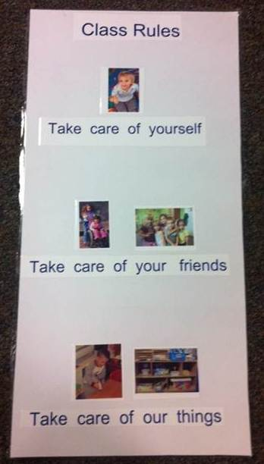
How can we implement this?
The program has a set of safety rules for children that is posted in a visible place.
Notes:
Materials:
Dry erase board or flipchart, markers
Large group discussion
What do the criteria mean?
How do you teach children about classroom rules?
Where do you have rules posted?
What / how many rules are developmentally appropriate? Can you reduce the number of rules to 3?
Large group brainstorming
Many QRIS participants find it difficult to write an effective description of their practices. Ask participants to describe their Health and Safety verbally.
Write their responses on whiteboard / flip chart.
When you get to slide 21, you will lead the group in writing a sample description based on the input everyone has given.

Slide 20
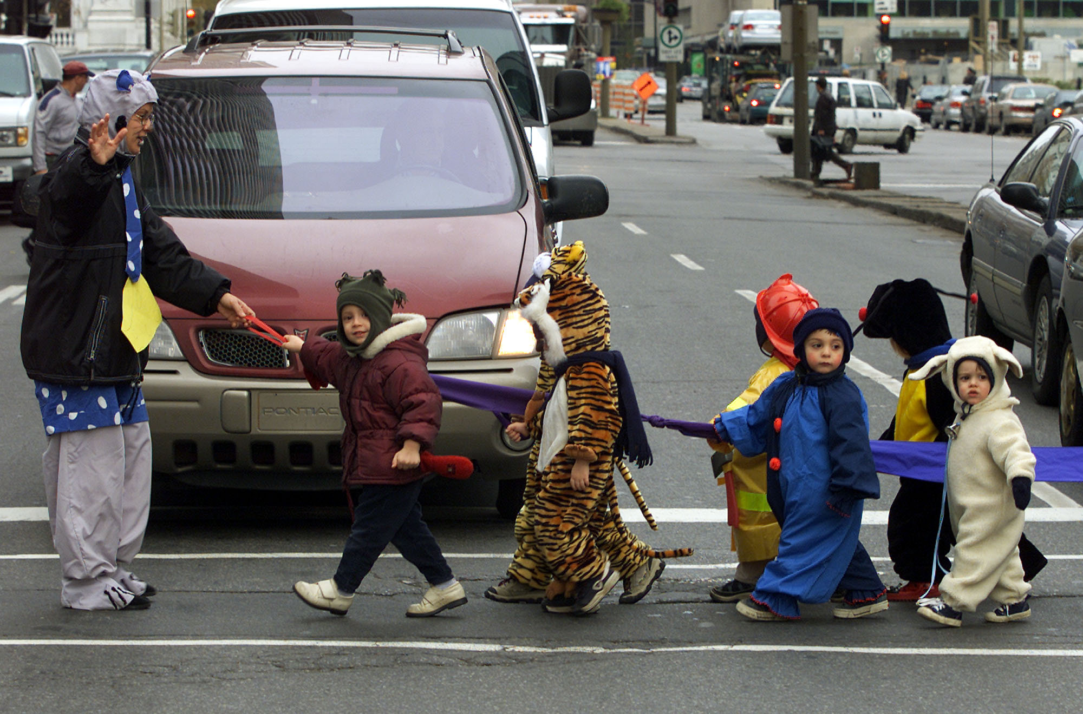
How can we implement this?
Program personnel use both:
formal instruction
naturally occurring opportunities
to teach safety rules and expectations that apply both in the program and in the community
Notes:
Materials:
Dry erase board or flipchart, markers
Large group discussion
What do the criteria mean?
How do you teach children about safety rules and expectations?
Large group brainstorming
Many QRIS participants find it difficult to write an effective description of their practices. Ask participants to describe their Health and Safety verbally.
Write their responses on whiteboard / flip chart.
When you get to slide 21, you will lead the group in writing a sample description based on the input everyone has given.

Slide 21
Writing your description…
If you don’t have rules posted, how will you decide what the rules should be?
  Involve children
  Make them few and simple
Where could rules be posted?
How do you teach children about safety rules and expectations?
Notes:
Materials
Dry erase board or flip-chart, markers
Large group collaboration
Work together to write a sample description. You may need to do quite a bit of scaffolding here, depending on the participants’ needs. Stress the importance of writing in their own words about their own practices for their portfolio evidence.
Individual work
Allow participants time to write or outline a rough draft of their own written description. Encourage collaboration / peer-to-peer help. In order to build participants’ ability to write independently for their portfolio, consider asking participants to “buddy up” or work in teams. They should ask you for help only if neither buddy can solve whatever problem they are having.
If time permits and there is interest, invite participants to share their work with the large group.

Slide 22
HS3 - Healthy eating habits are supported and encouraged.
3 Star
4 Star
5 Star
Healthy eating habits are supported and encouraged.
Program personnel encourage healthy eating habits during mealtime.
Program personnel provide instruction about healthy nutrition.
Notes:
Slides 22-27 should take about 20 minutes, including time for individual writing
Materials:
White board or flipchart, markers
Large group discussion:
Discuss what the standard and indicators mean, why they are included in the QRIS.

Slide 23
Evidence
3 Star
4 Star
5 Star
Program policy for meals and snacks that demonstrates the criteria.
Program policy for meals and snacks that demonstrates the criteria.
Written description of how and when instruction is provided on nutrition that demonstrates the criteria.
Notes:
Mini Lecture
Tell participants what kind of evidence to include in their portfolio, where it should go, and how to label it.
If you can, provide a sample of portfolio evidence.
If participants need it, this is a good opportunity to review the difference between a written description and a policy.
A policy is addresses to parents, staff, or visitors, and is generally found in a parent or staff handbook. A written description is addressed to the portfolio review team and may be found only in the program’s portfolio.

Slide 24
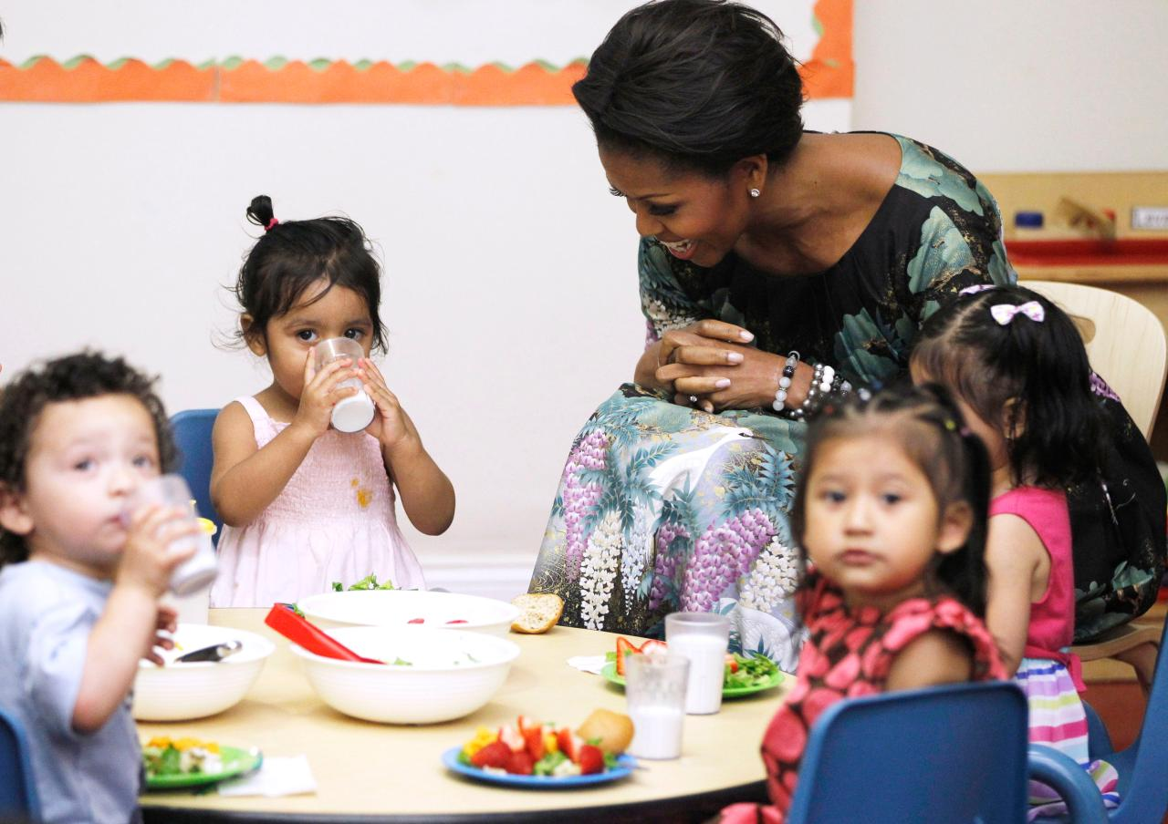
How can we implement this?
Program personnel encourage healthy eating habits during mealtime by:
sitting with children during meals and snacks
engaging in conversations with children
encouraging conversations between children
providing appropriate portion sizes
Notes:
Materials:
Dry erase board or flipchart, markers
Large group discussion
What do the criteria mean?
How do you teach children about healthy eating habits?
Large group brainstorming
Many QRIS participants find it difficult to write an effective description of their practices. Ask participants to describe their Health and Safety verbally.
Write their responses on whiteboard / flip chart.
When you get to slide 27, you will lead the group in writing a sample description based on the input everyone has given.

Slide 25
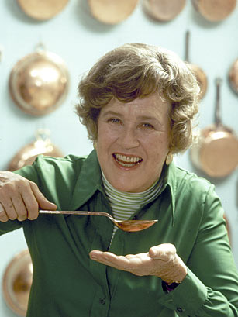
How can we implement this?
Program personnel encourage healthy eating habits during mealtime by:
encouraging children to try foods but not requiring them to eat specified foods or amounts
providing information about good nutrition and eating habits
dividing children into small groups
providing child size serving utensils for children to use
having children help during meals (setting the table, serving themselves, clearing the table or their place setting)
offering fresh fruit and vegetables at least twice a week
Notes:
Materials:
Dry erase board or flipchart, markers
Large group discussion
What do the criteria mean?
How do you teach children about healthy eating habits?
Large group brainstorming
Many QRIS participants find it difficult to write an effective description of their practices. Ask participants to describe their Health and Safety verbally.
Write their responses on whiteboard / flip chart.
When you get to slide 27, you will lead the group in writing a sample description based on the input everyone has given.

Slide 26
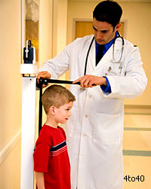
How can we implement this?
Program personnel provide instruction about healthy nutrition, including instruction on eating from the USDA guidelines, how foods help bodies grow (preschool), and how good nutrition helps keep bodies healthy (school-age). Instruction is delivered:
in a positive manner
using naturally occurring opportunities
on an individual basis
during group activities
Notes:
Materials:
Dry erase board or flipchart, markers
Large group discussion
What do the criteria mean?
How do you teach children about nutrition?
Large group brainstorming
Many QRIS participants find it difficult to write an effective description of their practices. Ask participants to describe their Health and Safety verbally.
Write their responses on whiteboard / flip chart.
When you get to slide 27, you will lead the group in writing a sample description based on the input everyone has given.

Slide 27
Writing your policy…
What should a policy on encouraging healthy eating habits say?
How do you teach children about healthy nutrition?
Notes:
Materials
Dry erase board or flip-chart, markers
Large group collaboration
Work together to write a sample description. You may need to do quite a bit of scaffolding here, depending on the participants’ needs. Stress the importance of writing in their own words about their own practices for their portfolio evidence.
Individual work
Allow participants time to write or outline a rough draft of their own written description. Encourage collaboration / peer-to-peer help. In order to build participants’ ability to write independently for their portfolio, consider asking participants to “buddy up” or work in teams. They should ask you for help only if neither buddy can solve whatever problem they are having.
If time permits and there is interest, invite participants to share their work with the large group.

Slide 28
HS4 - Healthy fitness habits are supported and encouraged.
3 Star
4 Star
5 Star
None
Program personnel use natural opportunities to increase physical activity and plan daily moderate to vigorous physical activity.
Program personnel provide instruction on the importance of physical activity.
Notes:
Slides 28-32 should take about 20 minutes, including time for individual writing
Materials:
Quality Improvement Plan and / or portfolio
Large group discussion:
Discuss what the standard and indicators mean, why they are included in the QRIS.

Slide 29
Evidence
3 Star
4 Star
5 Star
None
Written description of how and when program personnel use natural opportunities to encourage activity.
Written description of instruction provided to children on the importance of physical activity.
Notes:
Mini Lecture
Tell participants what kind of evidence to include in their portfolio, where it should go, and how to label it.
If you can, provide a sample of portfolio evidence.
If participants need it, this is a good opportunity to review the difference between a written description and a policy.
A policy is addresses to parents, staff, or visitors, and is generally found in a parent or staff handbook. A written description is addressed to the portfolio review team and may be found only in the program’s portfolio.

Slide 30
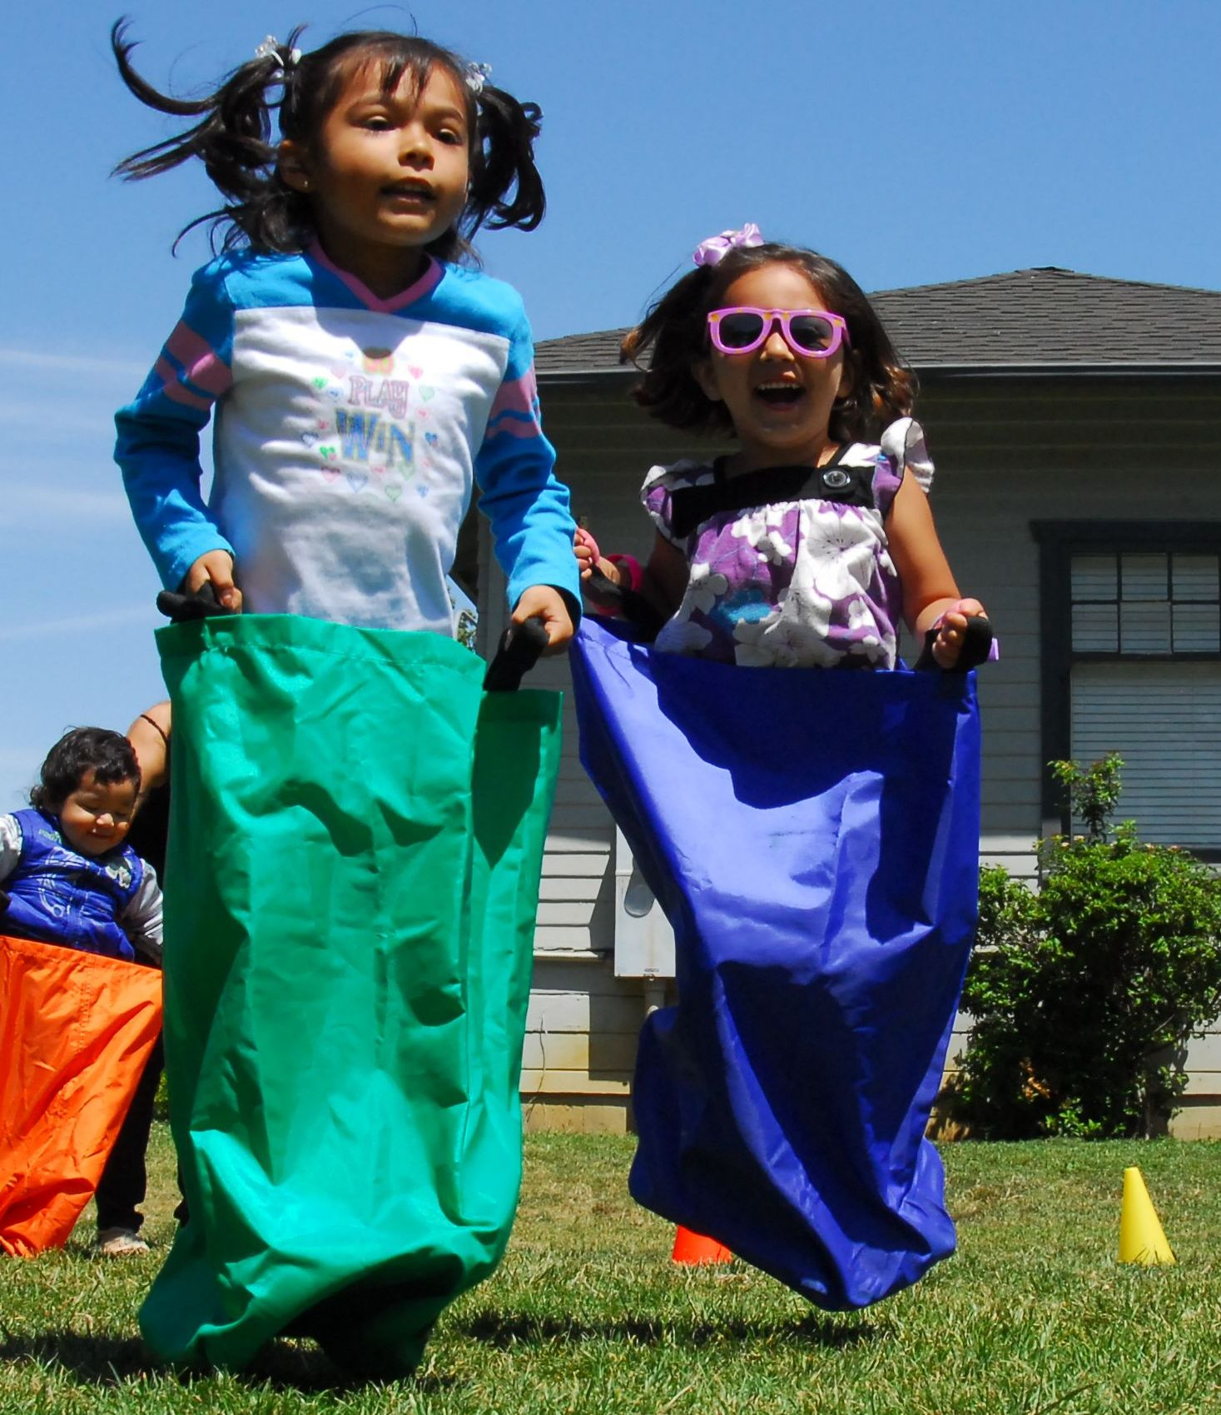
How can we implement this?
Program personnel use natural opportunities to:
increase physical activity
plan daily moderate-to-vigorous physical activity
Notes:
Materials:
Dry erase board or flipchart, markers
Large group discussion
What do the criteria mean?
How do you include physical activity in your day?
Large group brainstorming
Many QRIS participants find it difficult to write an effective description of their practices. Ask participants to describe their Health and Safety verbally.
Write their responses on whiteboard / flip chart.
When you get to slide 32, you will lead the group in writing a sample description based on the input everyone has given.

Slide 31
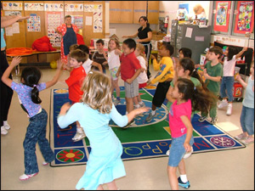
How can we implement this?
Program personnel provide instruction on the importance of physical activity.
Notes:
Materials:
Dry erase board or flipchart, markers
Large group discussion
What do the criteria mean?
How do you teach children about the importance of physical activity?
Large group brainstorming
Many QRIS participants find it difficult to write an effective description of their practices. Ask participants to describe their Health and Safety verbally.
Write their responses on whiteboard / flip chart.
When you get to slide 32, you will lead the group in writing a sample description based on the input everyone has given.

Slide 32
Writing your description…
How and when do you use natural opportunities to encourage moderate to vigorous play?
How do you teach children about the importance of physical activity?
Notes:
Materials
Dry erase board or flip-chart, markers
Large group collaboration
Work together to write a sample description. You may need to do quite a bit of scaffolding here, depending on the participants’ needs. Stress the importance of writing in their own words about their own practices for their portfolio evidence.
Individual work
Allow participants time to write or outline a rough draft of their own written description. Encourage collaboration / peer-to-peer help. In order to build participants’ ability to write independently for their portfolio, consider asking participants to “buddy up” or work in teams. They should ask you for help only if neither buddy can solve whatever problem they are having.
If time permits and there is interest, invite participants to share their work with the large group.

Slide 33
HS5 - Program personnel collaborate with health and related service professionals to address the individual needs of children, as applicable.
3 Star
4 Star
5 Star
None
The program’s policy indicates willingness to include children with special health needs and to make the necessary exceptions and accommodations.
Program personnel consult and collaborate with health care and related service professionals to meet children’s special health care needs, as applicable.
Notes:
Slides 33-37 should take about 20 minutes, including time for individual writing
Materials:
Quality Improvement Plan and / or portfolio
Large group discussion:
Discuss what the standard and indicators mean, why they are included in the QRIS.

Slide 34
Evidence
3 Star
4 Star
5 Star
None
Program policy on including children with special health needs.
Program policy on collaborating with other professionals
Documentation of a consultation (if applicable).
Notes:
Mini Lecture
Tell participants what kind of evidence to include in their portfolio, where it should go, and how to label it.
If you can, provide a sample of portfolio evidence.
If participants need it, this is a good opportunity to review the difference between a written description and a policy.
A policy is addresses to parents, staff, or visitors, and is generally found in a parent or staff handbook. A written description is addressed to the portfolio review team and may be found only in the program’s portfolio.

Slide 35

How can we implement this?
The program’s policy indicates willingness to include children with special health needs (temporary or ongoing) and to make the necessary exceptions and accommodations.
Notes:
Materials:
Dry erase board or flipchart, markers
Large group discussion
What do the criteria mean?
How do you include children with special health needs?
Large group brainstorming
Many QRIS participants find it difficult to write an effective description of their practices. Ask participants to describe their Health and Safety verbally.
Write their responses on whiteboard / flip chart.
When you get to slide 37, you will lead the group in writing a sample description based on the input everyone has given.

Slide 36
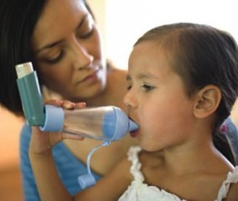
How can we implement this?
Program personnel consult and collaborate with health care and related service professionals to meet children’s special health care needs, as applicable.
Notes:
Materials:
Dry erase board or flipchart, markers
Large group discussion
What do the criteria mean?
Can anyone share a story about your experience with this kind of consultation?
(Trainer should be prepared with an anecdote or a hypothetical example)
How do you (or how could you) consult with other professionals to meet children’s needs?
Large group brainstorming
Many QRIS participants find it difficult to write an effective description of their practices. Ask participants to describe their Health and Safety verbally.
Write their responses on whiteboard / flip chart.
When you get to slide 37, you will lead the group in writing a sample description based on the input everyone has given.

Slide 37
Writing your policy…
What should a policy on including children with special health needs say?
How would you consult or collaborate with other professionals to meet children’s health needs?
Notes:
Materials
Dry erase board or flip-chart, markers
Large group collaboration
Work together to write a sample description. You may need to do quite a bit of scaffolding here, depending on the participants’ needs. Stress the importance of writing in their own words about their own practices for their portfolio evidence.
Individual work
Allow participants time to write or outline a rough draft of their own written description. Encourage collaboration / peer-to-peer help. In order to build participants’ ability to write independently for their portfolio, consider asking participants to “buddy up” or work in teams. They should ask you for help only if neither buddy can solve whatever problem they are having.
If time permits and there is interest, invite participants to share their work with the large group.

Slide 38
HS6 - Program uses screen time appropriately.
3 Star
4 Star
5 Star
See portfolio or Quality Improvement Plan for screen time criteria.
None
See portfolio or Quality Improvement Plan for screen time criteria.
Notes:
Slides 38-42 should take about 20 minutes, including time for individual writing
Materials:
Quality Improvement Plan and / or portfolio
Large group discussion:
Discuss what the standard and indicators mean, why they are included in the QRIS.

Slide 39
Evidence
3 Star
4 Star
5 Star
None
Program policy on screen time that demonstrates the criteria.
Program policy on screen time that demonstrates the criteria.
Written description of how the program uses screen time in an intentional manner.
Notes:
Mini Lecture
Tell participants what kind of evidence to include in their portfolio, where it should go, and how to label it.
If you can, provide a sample of portfolio evidence.
If participants need it, this is a good opportunity to review the difference between a written description and a policy.
A policy is addresses to parents, staff, or visitors, and is generally found in a parent or staff handbook. A written description is addressed to the portfolio review team and may be found only in the program’s portfolio.

Slide 40
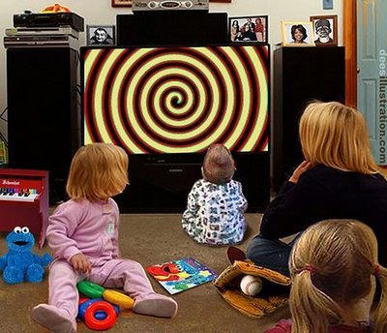
How can we implement this?
Appropriate screen time use includes:
parents are informed if electronic media are used in the program
screen content is appropriate for ages of children, nonviolent, and culturally sensitive
at least one alternative activity is available while electronic media is used
program’s use of screen viewing encourages active child involvement
electronic media is not on during non-viewing time and is not allowed during meals or snack time
no screen time for children younger than two years of age
adults do not use electronic media for personal use during the care day
Notes:
Materials:
Dry erase board or flipchart, markers
Large group discussion
What do the criteria mean?
How do you make sure your use of screens is appropriate?
Large group brainstorming
Many QRIS participants find it difficult to write an effective description of their practices. Ask participants to describe their Health and Safety verbally.
Write their responses on whiteboard / flip chart.
When you get to slide 42, you will lead the group in writing a sample description based on the input everyone has given.

Slide 41
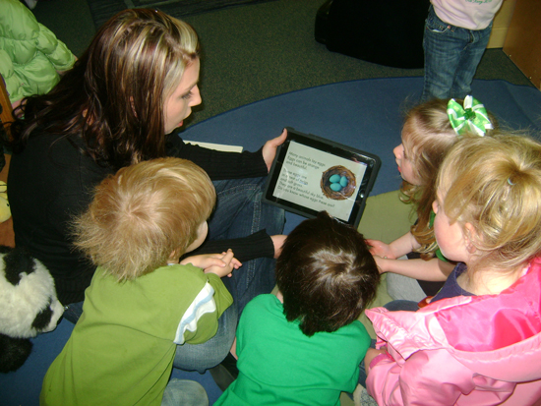
How can we implement this?
Appropriate screen time use includes:
program uses screen time intentionally
screen time is related to instructional goals (i.e., supports and extends children’s current interests and experiences, content is discussed with children, etc.)
screen media is free of advertisement and brand placement
screen time is limited to no more than one hour per day
Notes:
Materials:
Dry erase board or flipchart, markers
Large group discussion
What do the criteria mean?
How do you use screens intentionally?
Large group brainstorming
Many QRIS participants find it difficult to write an effective description of their practices. Ask participants to describe their Health and Safety verbally.
Write their responses on whiteboard / flip chart.
When you get to slide 42, you will lead the group in writing a sample description based on the input everyone has given.

Slide 42
Writing your description…
What should a screen time policy say?
What is appropriate use of screen time?
How can screen time be used intentionally?
Notes:
Materials
Dry erase board or flip-chart, markers
Large group collaboration
Work together to write a sample description. You may need to do quite a bit of scaffolding here, depending on the participants’ needs. Stress the importance of writing in their own words about their own practices for their portfolio evidence.
Individual work
Allow participants time to write or outline a rough draft of their own written description. Encourage collaboration / peer-to-peer help. In order to build participants’ ability to write independently for their portfolio, consider asking participants to “buddy up” or work in teams. They should ask you for help only if neither buddy can solve whatever problem they are having.
If time permits and there is interest, invite participants to share their work with the large group.

Slide 43

Questions?
Notes:
Be sure to let participants know about any upcoming training that might be helpful to them.

Slide 44
Portfolio Building:
Health and Safety Standards
Evaluations
Certificates
Date
Trainer Name
Trainer Contact Info
Agency Name
Thank you!

