Slide 1
Completing your program’s Quality improvement plan
Date
Trainer Name
Trainer Contact Info
CCR&R of Multnomah County
Notes:
Materials:
All participants should bring their Quality Improvement Plan to the training session.
You will also need an overhead projector and printed transparencies of several pages from the QIP.
Introduce trainers,
Ask participants to introduce themselves
Optional: Ice breaker activity chosen by the trainer

Slide 2
Session Outcome and Objectives
Explore the resources available to help you implement quality improvement
Apply goal setting techniques to fit the needs of your program
Gain the knowledge and tools needed to complete and effectively use your program’s
Quality Improvement Plan
Cultivate your community of practice
Examine the role your QIP plays in the process of increasing quality through the QRIS
Complete your QIP, share it with CCR&R staff, and submit it to TRI
Examine key standards in the QRIS and determine which star level seems right for your program
Notes:
Allow participants time to read the objectives, discuss as needed

Slide 3
Reflection
Find someone you don’t already know well.
Talk together about your current level of understanding and progress with the QRIS.
For example:
  Do you know where to start?
  Are you feeling confident or overwhelmed?
  Do you feel that you have time for it?
  Do you know what to do next?
Notes:
Reflection activity in dyads
The approved session proposal reads:
Participants will reflect on their current progress in the QRIS, including their understanding of the QIP, the domains, and the overall process.

Slide 4
Getting to know the standards
Find the domains and standards placed in an envelope on your table.
Work together as a team.
Can you group the standards together under the correct domain?
This is a cooperative game – have fun!
Notes:
Matching game –
This is intended to be a matching game to help training participants increase their familiarity with the standards of the QRIS. It is not intended to be competitive – we want to encourage our training participants to collaborate in this game and in their work, even across teams. Encourage teams to help each other out if others get stuck. “Cheating” isn’t in our vocabulary because we want people to work together.
Give each table group one envelope containing a complete set of domains and standards.
Let participants know the purpose of the game, including the collaborative aspect and time limit, if you have set one.
Tell participants that their task is to match each standard with the correct domain. Don’t give them any other info – wait for them to ask for help (you might want to mention that you are available to answer questions).
If participants need help, try scaffolding techniques instead of immediately giving direct answers.
Tell participants to start.
When they are finished, or when time runs out, facilitate any spontaneous discussion, then move on to discussion questions.

Slide 5
Discussion
Are there any standards that surprised you?
What do you already meet?
Which standards appear easier to meet?
What sounds most challenging?
Notes:
More discussion questions:
Are there any standards that you want to read more completely (in the QIP, to see what is required at different star levels, etc.) or discuss?
Is there anything that concerns you?

Slide 6
Learning & Development
The program is guided by a written statement of philosophy.
The program uses a curriculum that supports all children’s learning and development.
The program provides an appropriate indoor environment that supports children’s learning and development and is accessible to all children enrolled in the program.
Notes:
Check – did the small groups match all of the standards to the correct domain?
Are there any standards that participants want to read more closely in the QIP to see what is expected at each star level, or how a standard might be documented (what kind of evidence is required)?

Slide 7
Learning & Development
The program provides appropriate indoor furnishings that support children’s learning and development.
The program provides appropriate and well-maintained outdoor gross motor area with equipment.
The program uses materials that support children’s learning and development.
Notes:
Check – did the small groups match all of the standards to the correct domain?
Are there any standards that participants want to read more closely in the QIP to see what is expected at each star level, or how a standard might be documented (what kind of evidence is required)?

Slide 8
Learning & Development
The program uses planned curriculum activities that support children’s learning and development.
The program uses daily routines that support children’s learning and development.
The program uses information from screening and assessment to measure children’s learning and development in order to make referrals and do program planning.
Notes:
Check – did the small groups match all of the standards to the correct domain?
Are there any standards that participants want to read more closely in the QIP to see what is expected at each star level, or how a standard might be documented (what kind of evidence is required)?

Slide 9
Learning & Development
Group size, child-staff ratios, and staffing patterns are appropriate for the children’s age and positively affect children’s emotional development, cognitive development, safety, and health.
The program facilitates and supports appropriate adult-child interactions in the areas of social and emotional support, organization and management of children’s behavior, and instructional support.
The program facilitates and supports children’s positive social and emotional development.
Notes:
Check – did the small groups match all of the standards to the correct domain?
Are there any standards that participants want to read more closely in the QIP to see what is expected at each star level, or how a standard might be documented (what kind of evidence is required)?

Slide 10
Health & Safety
Children are provided instruction and support to independently manage health and hygiene practices.
Children are provided instruction and support on safety rules and expectations.
Healthy eating habits are supported and encouraged.
Notes:
Check – did the small groups match all of the standards to the correct domain?
Are there any standards that participants want to read more closely in the QIP to see what is expected at each star level, or how a standard might be documented (what kind of evidence is required)?

Slide 11
Health & Safety
Healthy fitness habits are supported and encouraged.
Program personnel collaborate with health and related service professionals to address the individual health needs of children as applicable.
Program uses screen time appropriately. Screen time includes all electronic media such as television, video/DVD, electronic games, computers, tablets, smart phones, or any other screened electronic devices.
Notes:
Check – did the small groups match all of the standards to the correct domain?
Are there any standards that participants want to read more closely in the QIP to see what is expected at each star level, or how a standard might be documented (what kind of evidence is required)?

Slide 12
Personnel Qualifications
The program’s leader is presently qualified through education, training, and experience.
The program’s head teacher(s) and teacher(s) are presently qualified to serve in their positions through education, training, and experience. (N/A not applicable to Family Child Care)
The program’s aide II(s) are presently qualified to serve in their positions through education, training, and experience.
Notes:
Check – did the small groups match all of the standards to the correct domain?
Are there any standards that participants want to read more closely in the QIP to see what is expected at each star level, or how a standard might be documented (what kind of evidence is required)?

Slide 13
Personnel Qualifications
Program personnel continue to advance their knowledge and skills through participation in training and/or college course credits annually that are part of a professional development plan that will lead to advancement up to Step 10 on the Oregon Registry.
Program personnel are trained in ethics, professional responsibility, and maintaining confidentiality.
Notes:
Check – did the small groups match all of the standards to the correct domain?
Are there any standards that participants want to read more closely in the QIP to see what is expected at each star level, or how a standard might be documented (what kind of evidence is required)?

Slide 14
Family Partnerships
The program uses family input and feedback to guide program planning and policy decisions.
The program meets the individual needs of children through mutually respectful, two-way communication with families.
Families are encouraged to be regular and frequent participants in the program.
The program provides support and information to assist families in meeting their child’s needs and goals.
Notes:
Check – did the small groups match all of the standards to the correct domain?
Are there any standards that participants want to read more closely in the QIP to see what is expected at each star level, or how a standard might be documented (what kind of evidence is required)?

Slide 15
Administration & Business Practices
The program follows sound business practices, policies, and procedures that support financial sustainability.
The program assures a professional working climate. (N/A for programs without multiple staff)
Personnel are evaluated on their performance.
The program promotes positive working relationships and professionalism. (N/A for programs without multiple staff)
Notes:
Check – did the small groups match all of the standards to the correct domain?
Are there any standards that participants want to read more closely in the QIP to see what is expected at each star level, or how a standard might be documented (what kind of evidence is required)?

Slide 16
Administration & Business Practices
A comprehensive program evaluation process is developed and performed on an annual basis. The evaluation examines the program’s policies and procedures, care and education environment, curriculum, and administration and business practices.
Benefits are offered to encourage retention.
Notes:
Check – did the small groups match all of the standards to the correct domain?
Are there any standards that participants want to read more closely in the QIP to see what is expected at each star level, or how a standard might be documented (what kind of evidence is required)?

Slide 17
Using the QIP
The Quality Improvement Plan is designed to be a dynamic, evolving document – use it to guide your quality improvement work.
Notes:
As you talk about how to fill out and effectively use the QIP, be sure to address a couple of points:
CCR&R staff are available to help with technical assistance, but we do not know what support participants might need unless they tell us
The bottom portion of each standard can be used to help participants figure out what they need
Setting specific goals will help too
SMART goal setting is coming up after two more slides

Slide 18
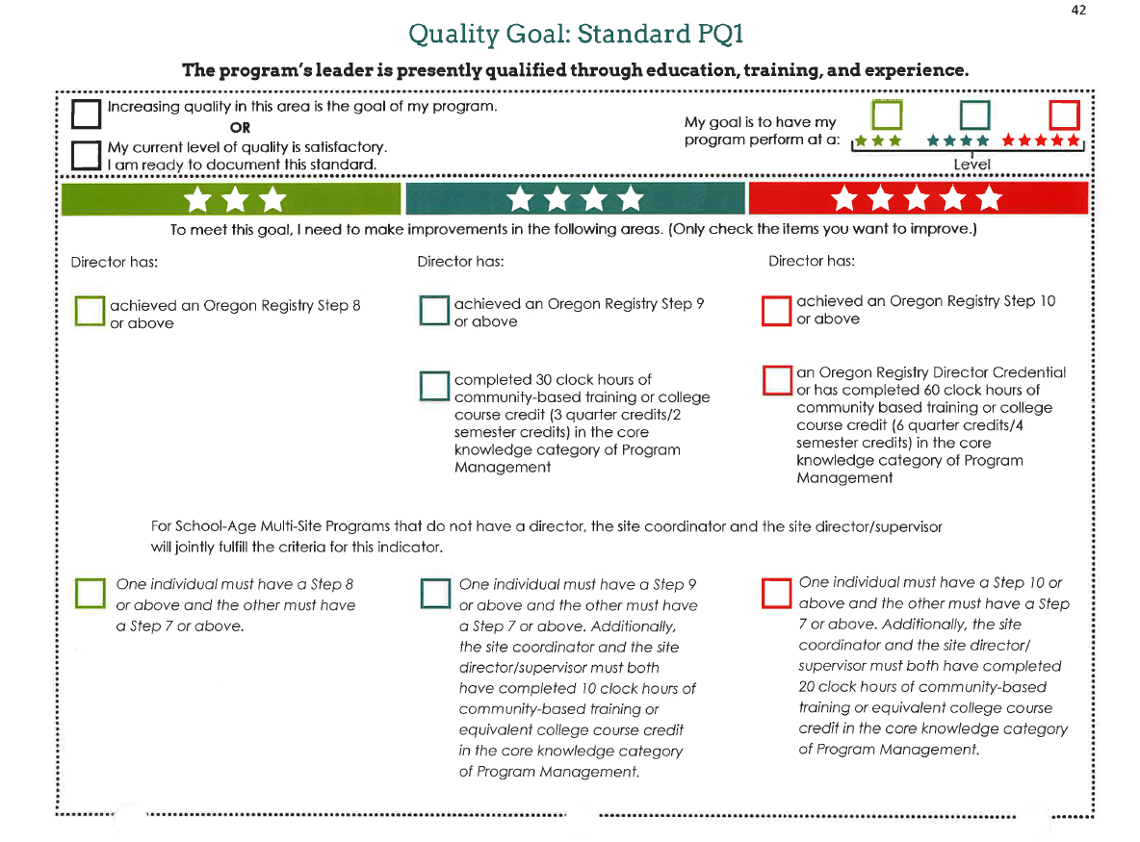
Notes:
Materials –
P. 42 of QIP
Spend enough time on this slide so that participants understand what is required at each star level, including the number of training hours in Program Management.
Be sure to ask whether any participants work in multi-site programs with a multi-site coordinator and site directors

Slide 19
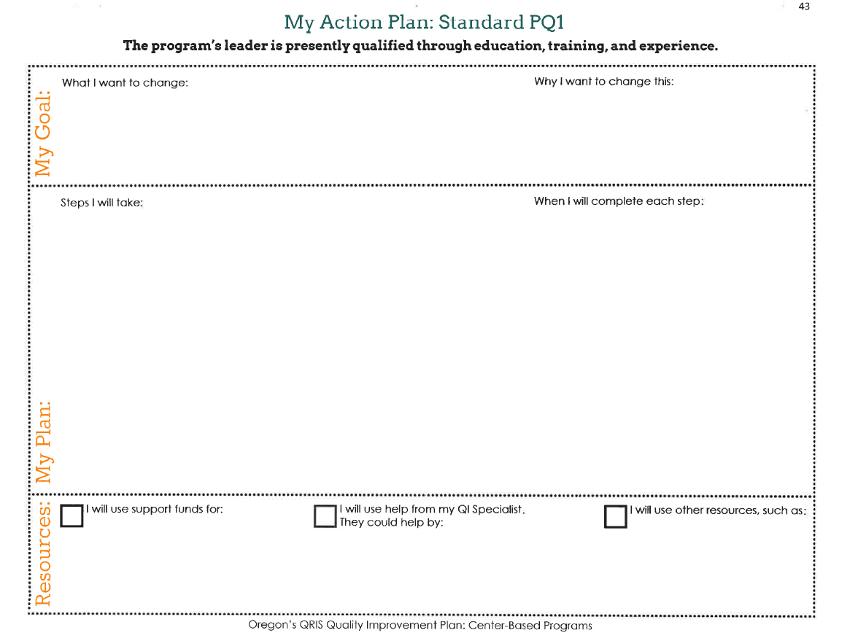
Notes:
Materials –
Pages 42 and 43 of QIP
My Goal:
Discuss making this section meaningful, especially “why I want to change this.” Participants should reflect on their reasons for improving quality in each area.
My Plan:
Ask participants what kinds of steps they might take in order to meet this standard., how long those steps might take to implement.
Resources:
Large group discussion of available resources.

Slide 20
SMART Goal Setting

Slide 21
SMART Goal Setting
Clearly state your goals
Identify the main tasks needed to accomplish the goal and who is responsible for the task
Resources needed to accomplish the goal -- Are the resources targeted to support your plans?

Slide 22
SMART Goal Setting
Develop completion dates and timelines for implementation
Monitor the progress of your action plan
Build on the success of your action plan
Reassess when obstacles and setbacks occur
Keep in mind -- it is highly recommended you adopt a collaborative approach to the development of your plan. Wherever possible, involve families, education, staff and children’s needs.

Slide 23
SMART Goal Setting
Specific
Measurable
Accountable
Resources needed
Time bound

Slide 24
Let’s practice
Large Group – Standard LD9
Small Groups – Standards LD8, HS1, PQ4, FP1, AB5
Notes:
Materials:
Vis-à-vis markers
Transparencies of two-page spread for standards listed on the slide, including LD9
Overhead projector
Switch from Power Point slide show to transparencies on overhead projector.
Large group practice and discussion:
Discuss what participants need to do/learn, etc.
Set one or more SMART goals for standard LD9
Small group work:
In table groups, participants choose one of the standards to work with.
Each group will complete both QIP pages for the standard they choose
Each group will set goals for the standard they chose, using the SMART technique
When small groups have completed their work, The trainer will project each group’s standard using the overhead projector
Trainer will facilitate discussion of each group’s goals, including what goals other participants might need to set for each standard
After discussion of all groups’ work, return to slide presentation.

Slide 25
Discussion
How will you meet your goals?
What do you need?
  Resources
  Assistance
  Training
  Purchases
  What else?
Notes:
This is meant as a general follow-up discussion of the standards that were completed in the small group work time. In this discussion, tie together the SMART goal setting technique, the participants’ goals for meeting the standard, and the availability of technical assistance and other resources.

Slide 26
Developing communities of practice
What can we do to support one another?
  Through the QRIS process
  In other professional areas
Notes:
Facilitate a discussion of how the participants would like to work together going forward. Examples:
Exchange contact info
Agree to meet to work together (at CCR&R office or elsewhere)
Agree to check in with each other

Slide 27
You’re not quite done yet!
Notes:
Materials:
“Distance learning portion” handout
Discussion of expectations for the distance learning portion of the class

Slide 28
Portfolio Completion Classes
Health and Safety Standards July 21st
Writing a Philosophy Statement August 18th
Notes:
Materials:
Registration forms for Portfolio Completion classes

Slide 29

Questions?

Slide 30
Thank you, and good luck!
Closing thoughts
Evaluations

