Slide 1
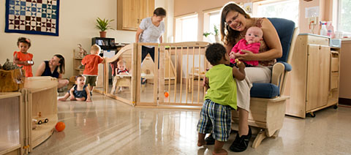
Responsive Caregiving in
Infant/ Toddler Programs:
The Key to Healthy Development
Lauren Peterson petersonls@wou.edu
Candi Scott scottc@wou.edu
Early Learning Specialists
The Research Institute at Western Oregon University
Notes:
Add trainer and/or conference/training specific information in the designated area.

Slide 2
Reflective Activity
Think back to your earliest memories. Describe at least two behaviors from adults in your life that shaped who you are today.
How did these caregiving behaviors affect your ability to form positive relationships, learn in school, and impact your work with children and families.
Optional sharing with group
Notes:
Participants can record their thinking on the PP notepages provided or on sticky notes. Depending on the group size and time available, participants may want to share in pairs or small groups with each other before the optional sharing with the whole group. You can choose to record the optional sharing responses on chart paper/a whiteboard or not.

Slide 3

Outcome
Participants will develop a responsive caregiving program for infants and toddlers
Notes:
Explain that each participant has an agenda, notetaking PP packet, a training evaluation which they can fill out at the end of the training, and any other materials available to them. It may be helpful to acknowledge that “develop” may not be an accurate word to use here since they are likely already providing responsive caregiving. A more accurate outcome may be to “maintain and enhance providing a responsive caregiving program for infants and toddlers.

Slide 4
Objectives
Participants will examine foundational and current theories linking responsive caregiving and secure attachment to healthy brain development and positive child outcomes
Participants will explore practices critical in developing a responsive caregiving program for infants and toddlers and examine factors that may potentially interfere with building healthy adult-child relationships
Notes:
Invite volunteers to read each of the objectives out loud to the whole group.

Slide 5
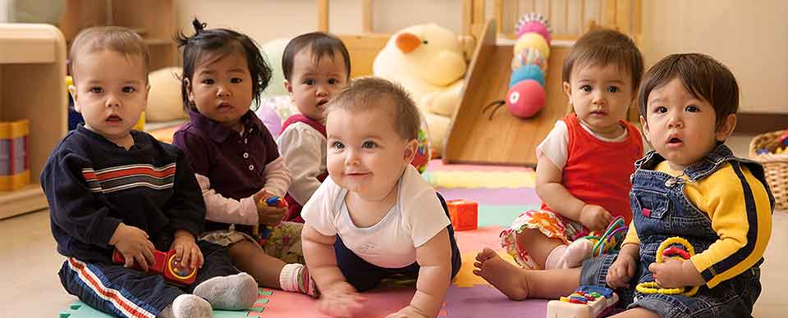
Objectives (continued)
Participants will examine, practice, and select strategies critical in developing a responsive caregiving program for infants and toddlers
Notes:
Remind participants that throughout the training, they will have the opportunity to reflect upon and share their ideas about their program’s practices.

Slide 6
Responsive caregiving is a key ingredient to healthy development of a young child’s relationships with the important people in his or her life, both within and outside the family. Relationships engage children in the human community in ways that help them define who they are, what they can become, and how and why they are important to other people.
(Center of the Developing Child, 2009)
Notes:
Have a participant read this quote. Ask participants which words or phrases stand out or resonate with them.

Slide 7
Responsive Caregiving
Supports children's social and emotional development
Creates nurturing and secure early care and learning environments
Collaborates with families to support children's growth and development
Notes:
What is responsive caregiving?

Slide 8
Goals of Responsive Caregiving
To build secure and healthy relationships
To empower children as effective communicators
To promote self-regulation
Notes:
This sets the stage for a future of healthy relationships and lifelong learning.

Slide 9

Healthy Brain Development
  http://developingchild.harvard.edu/index.php/key_concepts/toxic_stress_response/
The Impact of Stress on Brain Development
Notes:
https://youtu.be/VNNsN9IJkws Watch each video (first the Healthy Brain and then the Impact of Stress) and discuss how early experiences have lifelong implications on the developing brain.

Slide 10
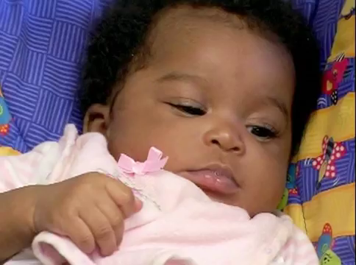
Still Face Video
Notes:
https://youtu.be/apzXGEbZht0
Have participants share in pairs, small groups, or each other what their thoughts are about the video and how it’s related to their work.

Slide 11

Adult-Child Relationships
Acknowledge each child’s unique characteristics and family culture
Respond sensitively to cues and behaviors
Tune into feelings and empathize
Form a trusting relationship
Notes:
All of the above leads to creating trusting and healthy relationships. Show the video.

Slide 12

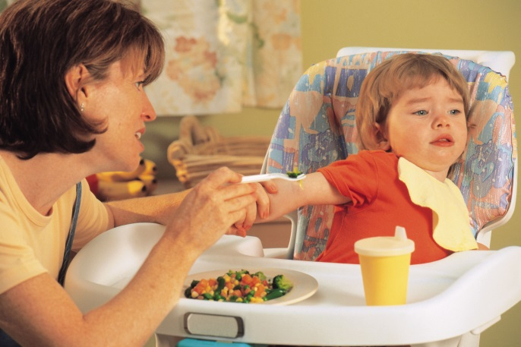
Reading the Cues
How do infants and toddlers communicate?
Engagement and disengagement cues
  crying, laughing, language
  facial expression, gaze
  gestures
Notes:
Because many cues are non-verbal and silent, it’s especially important to know where all children are and to check in with them often. Ask participants “What are the children in these photos communicating?”

Slide 13
Responding to Cues
Observe
Evaluate
Respond
Adjust
Notes:
Magda Gerber’s advice is to “wait, wait, wait” to ensure you have time to evaluate before you respond.

Slide 14
Creating a Positive
Relational Climate
Consistent positive behavior
Frequent smiling and laughter
Respect
Clear absence of negative behavior
Notes:
Even occasional incidents of negative behavior compromise the adult-child relationship and can have lasting impact on children’s development.

Slide 15
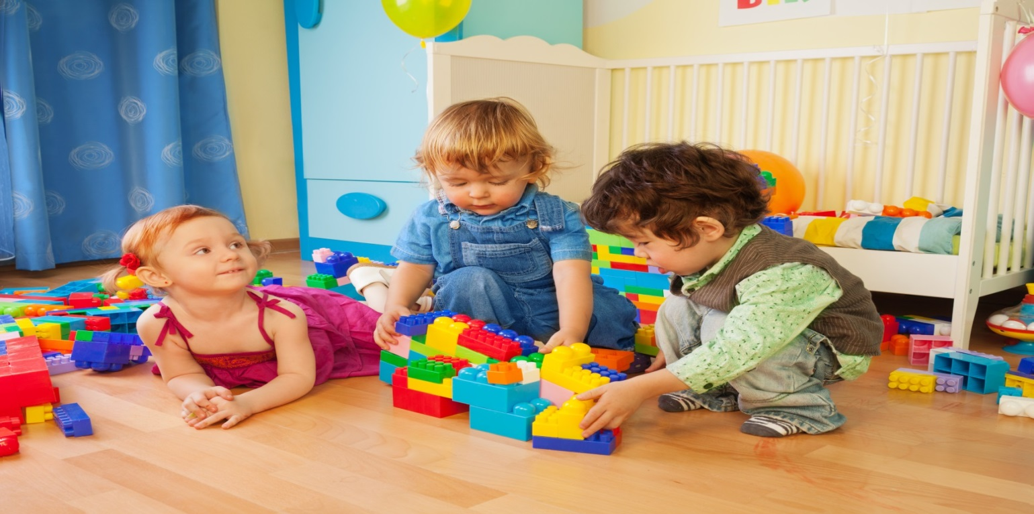
Routines and Schedules
Individualized
Unhurried
Predictable
Notes:
Routines:
They influence a child’s emotional, cognitive, and social development.
They help children feel secure and comfortable.
They help children understand the expectations of the environment.
They help reduce the frequency of behavior problems (e.g., tantrums).
They can result in higher rates of child engagement.
Play Time:
Increases children’s play behaviors and skills
Reduces negative behaviors like tantrums
Transitions:
Can be difficult, especially with multiple children
Plan for transitions

Slide 16
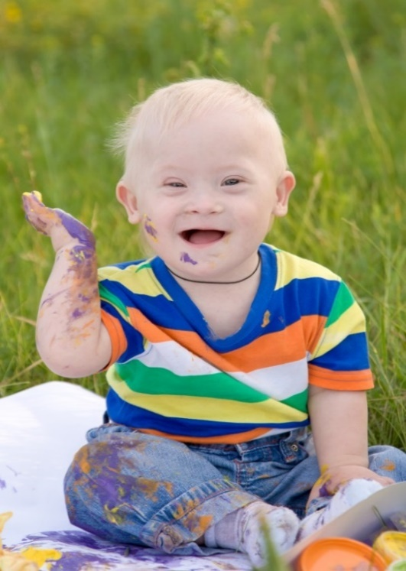
Facilitating Exploration
The environment is prepared
The child directs the experience
The caregiver extends the exploration
The schedule allows ample time
Notes:
Part of your everyday routines includes providing guidance by facilitating exploration. Make sure you attend to the bulleted practices.

Slide 17
Cultural Responsiveness
Create a climate that models respect, inclusion, and pride in all families’ cultures
Maintain an environment and implement caregiving practices that incorporate culturally and linguistically responsive methods
Provide opportunities for authentic conversations
Notes:
Commit to on-going training; educate yourself and your colleagues on inclusive practices and cultures of the families you serve.
Create an inclusive practices policy for your program.
Take time to meet with families and staff in groups and individually.
Ask questions! Reflect families’ cultures in the environment.

Slide 18
Relationships with Families
Communication
Respect
Collaboration
Flexibility
Notes:
You have a shared goal which relies on creating a partnership with your families: caring for and supporting the development of their children.

