Slide 1
The Appropriate Use of Early Childhood Assessments and Developmental Screenings
Training Location
Trainer Information
Date

Slide 2

Reflective Activity
What questions do you have around screening and assessment?

Slide 3
Session Objectives
Participants will
  Examine different types of developmental screenings, assessments, and supplemental assessments.
  Be able to apply this information as they participate in Spark.

Slide 4
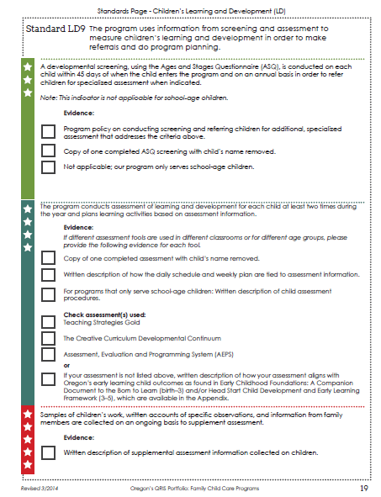
Screening
This session covers developmental screenings for children birth through 6 years of age.
There are other types of screenings such as mental health screenings, health screenings, etc.
This session will focus on the developmental screening as it relates to LD9 in the Spark portfolio.

Slide 5

What is a Developmental Screening?
The practice of looking for and monitoring signs that a child may be delayed in one or more areas of development and/or to confirm that they are typically developing.
Screening is not meant to establish a diagnosis for the child.
Helps determine whether more in-depth assessment is needed.

Slide 6

Why do we use Screenings?
To help identify whether a child may need an additional evaluation or is typically developing.
    For example, a child may score low in the communication area and need an additional assessment to determine if there is a delay and a need for support services.
    Support services may be private (medically related) or a part of the Special Education system from your local Education Service District (EI/ECSE).

Slide 7
Who does the Screening?
Anyone who works with the child:
  Families (parent/guardian)
  Early intervention professionals
  Early childhood and special education educators
  Social service providers
  Public health providers
  Home visitors and parent educators
  Pediatricians and nurses
  Other early childhood professionals

Slide 8
Screening and Spark
For a 3-star rating
    The Ages and Stages Questionnaire (ASQ) is performed on each child within 45 days of when the child enters the program and on an annual basis in order to refer children for specialized assessment when indicated.
    Note: This indicator is not applicable for school-age children.
Evidence
    Program policy on conducting screening and referring children for additional, specialized assessment that addresses the criteria above.
  And
  A copy of one completed ASQ screening with the child’s name removed.

Slide 9
Spark Screening Requirement
Spark requires the ASQ
    ASQ measures 5 key areas of development:
      Communication
      Gross Motor
      Fine Motor
      Problem Solving
      Personal-Social

Slide 10

Why do you have to use the ASQ for Spark?
The State of Oregon’s Early Learning Council
adopted the Ages and Stages Questionnaire (ASQ) as the statewide screening to be used in Oregon.

Slide 11
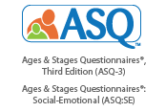
ASQ
Ages and Stages Questionnaire
Designed to be completed by parents or caregivers.
Includes simple directions to help indicate children’s skills in language, personal-social, fine and gross motor, and problem solving.
http://asqoregon.com/

Slide 12
About the ASQ
ASQ includes about 30 items for each age range
Used to determine which children need further evaluation
Published in English, Spanish, French & Korean; other translations are in development
The target age range is Birth to 60 months
Takes about 15 - 20 minutes to complete

Slide 13
Child Assessment

Slide 14
What is Child Assessment?
“A systematic procedure for obtaining information from observation, interviews, portfolios, projects, tests, and other sources that can be used to make judgments about children’s characteristics.” (NAEYC)
The process of gathering information about a child in order to make decisions about his/her education.

Slide 15
Types of Assessments
There are different types of assessments
    Program
    Staff/personnel
    Family
    Children’s learning and development
There are a variety of ways to assess children’s learning and development and collect assessment information.

Slide 16

Types of Assessment
Formal and Informal/Natural/Authentic
Formal Assessments broken down into:
    Norm-referenced
    Criterion-based
    Curriculum-based

Slide 17

Who Conducts Child Assessments?
Depends on the assessments
May be providers, parents, or others

Slide 18
Why Programs Conduct Child Assessments ?
Assessments are conducted to:
    Find out what children are interested in
    Find out children’s strengths and areas of difficulty
    Make informed decisions about interventions
    Find common needs
    Discover how children change over time
    Learn what children know in particular areas
    Link with instruction – making sure instruction is responsive and appropriate, matching what children can and cannot do
    Serve as a basis to report to parents

Slide 19

Where Child Assessment Fits with Spark
Addressed in LD9 – 4 Star
    The program conducts assessment of learning and development for each child at least two times during the year and plans learning activities based on assessment information.

Slide 20

When Child Assessments are Done
At least 2 times during year
    Early in year
    Later in year
Spark specifies that assessments be conducted at least two times during the year. Some assessments are designed to be done quarterly.

Slide 21
Early Childhood Assessments and Spark
Spark’s Portfolio identifies two pre-approved assessments.
    Teaching Strategies Gold
    Assessment, Evaluation and Programming System (AEPS)
    Both assessments are designed for ages birth through age 6
If a program does not use either of these assessments, they need to provide a written description of how their assessment aligns with:
    Head Start Child Development and Early Childhood Framework
    Oregon’s Early Childhood Foundations

Slide 22
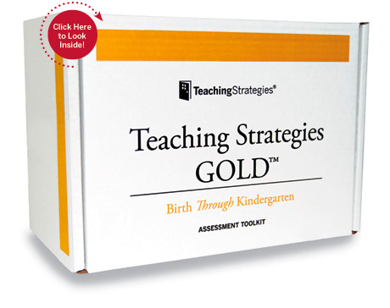
Teaching Strategies Gold
  Assesses children ages birth through kindergarten
  Available online and in print
  English and Spanish versions
  Covers 10 areas of development: social-emotional, physical, language, cognitive, literacy, mathematics, science and technology, social studies, the arts, English language acquisition
  38 objectives – are aligned with Common Core State Standards and Head Start Child Development and Early Learning Framework
  Observation based
  Basic online free training course/live phone help
  Number of online reports available including individual child/class/program
  Cost for Birth Through Kindergarten Toolkit: $200
  http://www.frazercenter.org/files/2014/09/Teaching-Strategies-GOLD-Assessment-Touring-Guide-.pdf

Slide 23
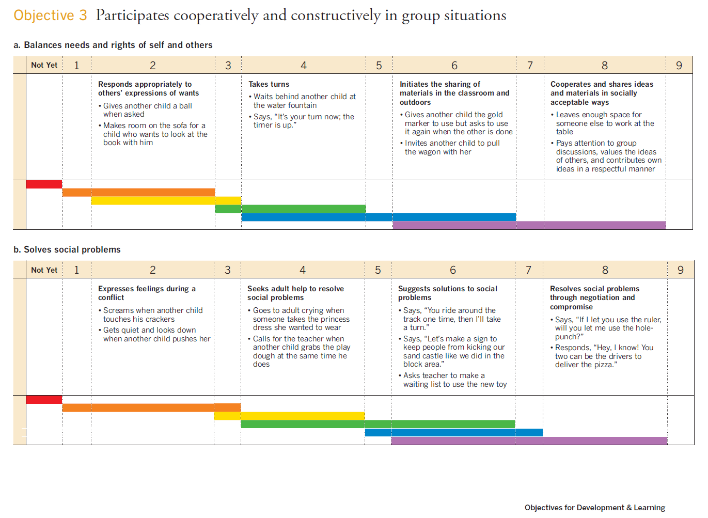

Slide 24

AEPS and AEPSi
  Assessment for birth through age six. Two versions – one for birth to three and one for children three to six
  AEPS Administration Guide provides instructions to use assessment
  Covers 6 developmental areas: fine motor, gross motor, cognitive, adaptive, social-communication, and social
  Tied to AEPS curriculum
  Can be used in center and home based programs
  Place on form to record scores quarterly
  Score 0 (does not pass), 1 (inconsistent performance) or 2 (passes consistently)
  Paper and online interactive versions
  English, Spanish, French and Korean versions
  Cost for Administration Guide, Test, Curriculum 0-3 and 3-6: $239; Administration Guide, Test, Curriculum 0-3: $179 (same for 3-6 )
  http://www.aepsinteractive.com/.

Slide 25
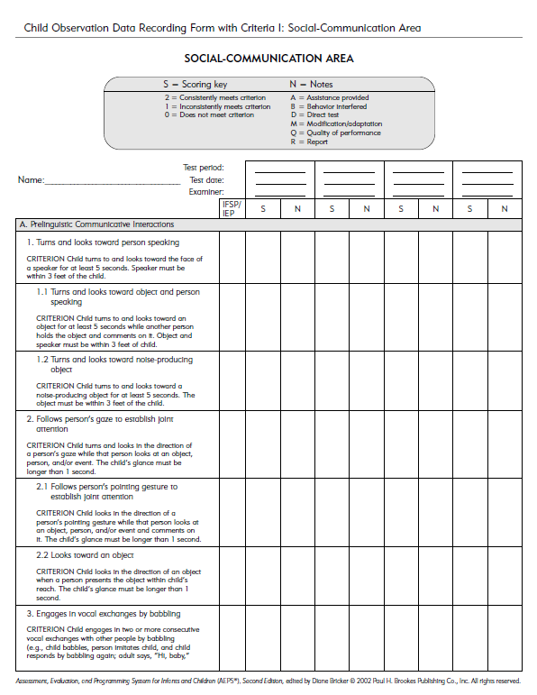

Slide 26
What is Supplemental Assessment?
Sometimes called informal assessments or ongoing assessments.
A process that identifies the child’s strengths and needs in addition to more formal assessment instruments.
Additional information collected on child.
Collected on an ongoing basis.

Slide 27
Why use Supplemental Assessments?
Allows providers to track the ongoing progress of children regularly and often
Provides continual snapshots of where children are throughout the year
Serves as a guide to help establish a current performance level in order to make informed instructional decisions
Can provide valuable information to parents and educators
Ensures that the curriculum is meeting the developmental stages of the children in their program

Slide 28
How can programs use Supplemental Assessments?
  To plan future instruction so that child needs are met
  To help understand where and if children should be grouped for instruction
  To ensure that instruction is being delivered at the right pace
  To understand where children may need individual support

Slide 29
Who Does Supplemental Assessments?
Families (parents/guardians)
Child care providers
  Early intervention professionals
Early childhood and special education educators
Social service providers
Public health providers
Home visitors and parent educators
Other early childhood professionals

Slide 30
Supplemental Assessments and Spark
LD 9 - 5 STAR (completion for a 3 and 4 star have previously been done)
Samples of children’s work, written accounts of specific observations, and information from family members are collected on an ongoing basis to supplement assessment.
Evidence:
Written description of supplemental assessment information collected on children.

Slide 31
Difference Between Child Assessment and Screening
Screening is designed to determine whether further testing is needed. It is not intended to be used to identify what needs to be taught.
Child assessment is a more comprehensive process to determine child needs. Child assessments provide information to guide instructional decisions.

Slide 32
How the Daily Schedule and Weekly Plan are Tied to Child Assessment Information
In the Spark Portfolio LD9 – 4 Star, programs are required to provide a “written description of how the daily schedule and weekly plan are tied to assessment information.”

Slide 33
What will you do the same or different regarding screening and assessment in the coming year?

