Slide 1
Program Evaluation for Purposeful Planning
Child Care Business Conference
November 10, 2018
Notes:
Add the title of the training conference or event and the date in the green box.

Slide 2



Notes:
Add presenter titles/contact information and agency logos, etc. on this slide.

Slide 3
Introductions:
Professionals Here today
Name
Program
Position
Community
Experience
Notes:
If a group of fewer than 10, have everyone share this information with the whole group.
If a larger group, have them share in their table groups, with a partner, etc. this information. Then, once everyone has shared with a partner or small group, find out at least through show of hands who works for family programs and who work for centers as that may influence the discussions throughout the day. Acknowledge that there is a wealth of experience in the room, and we will be learning from each other throughout the day.

Slide 4
Icebreaker
With someone at your table group, discuss:
  Why did you choose this training?
  What does “program evaluation” mean to you?
Optional sharing with larger group

Slide 5


Review Agenda, Materials, Outcome, and Objectives
Notes:
Briefly review or refer to the agenda. Remind participants to fill out the evaluation before the session ends (if you choose to give it to them at this time); explain any training materials (such a sticky notes, highlighters, fidgets, etc.) which are also available to them. Let them know that you will be sharing more materials later in the session. This would be a good time to let them know where restrooms are and explain if/when there will be a break in the training.

Slide 6
Session Outcome
Participants will understand how program evaluation leads to purposeful planning and improvement
Notes:
Invite a participant to read this slide to the group.

Slide 7
Session Objectives
Participants will:
  Examine why it’s important to evaluate their programs
  Explore and examine program evaluation sources
  Examine and apply program evaluation practices
  Develop strategies to use program evaluation sources to plan for program improvements
Notes:
Invite a participant to read this slide to the group.

Slide 8

Reflective
Activity
Think/write/draw about why you feel it’s important for a program to evaluate their practices
Share with at least one other person in your table group
Notes:
Make sure participants have access to paper, sticky notes, or just use the backs of their agendas to write their thoughts before sharing with a partner/table group peers.

Slide 9
WHY is Program
Evaluation Important?
Collective knowledge activity:
  Why is it important to evaluate early learning and development programs (ELDPs)?
Notes:
Encourage small groups to share the ideas they discussed in the reflective activity; you can record their ideas on chart paper or a whiteboard or just have group discussion.

Slide 10

What Does the Research Say?
Importance of evaluating ELDPs
Frequency of evaluating ELDPs
Notes:
Research indicates that programs who conduct a comprehensive evaluation at least once per year have better success with program improvement and enhancing the quality of their program practices.

Slide 11
NAEYC Position Statement
“Programs undertake regular evaluation, including self-evaluation, to document the extent to which they are achieving desired results, with the goal of engaging in continuous improvement. Evaluations focus on processes and implementation as well as outcomes.” (p.4)
A Joint Position Statement of the NAEYC and NAECS/SDE. Early Childhood Curriculum, Assessment, and Program Evaluation: Building an effective, accountable system in programs for children birth through age 8. (2003). Retrieved from https://www.naeyc.org/files/naeyc/file/positions/pscape.pdf .
Notes:
Invite a participant to read this slide to the group.
This quote confirms that program evaluation is a recommended practice in the field of early learning.

Slide 12

Comprehensive Program Evaluation
All of the following are reviewed:
  Policies & procedures
  Family engagement
  Environment
  Curriculum
  Administration & business practices
Notes:
What does “comprehensive program evaluation” include? These five categories (listed on the slide).

Slide 13

Carousel Brainstorm Activity
Sources which can contribute to meaningful program evaluation:
  Family Input
  Program Personnel Feedback/Input
  Rating Scales or Evaluation Instruments
  Child Outcome Data
  Outside Evaluators
Notes:
As a program looks at the five categories of program evaluation, these sources of information which can contribute to their program’s evaluation.
Put chart paper up in five wall spaces in the room (or at five tables) with one each of the following headings: Family Input, Program Personnel Feedback/Input, Rating Scales or Evaluation Instruments, Child Outcome Data, and Outside Evaluators. Discuss what each heading means to ensure that all participants know what each term means. Make sure there are chart paper markers available for each chart. Break participants into 5 groups: have each group being brainstorming ideas/recording the ideas on a chart; rotate every couple of minutes. When all groups are back at their original chart, have a participant read the list of resources at each chart.

Slide 14

BREAK
Notes:
Let participants know how long they have for the break (if 3-hour training). Let them know that after the break, you will share how the program evaluation sources are related to QRIS.

Slide 15

Oregon’s SPArk
Goals of Spark:
Raise the quality of child care and early learning programs
Provide resources and supports to improve programs
Recognize program quality through a rating system
Because:
Quality programs serve and support the needs of all children
Notes:
Read or have a participant read this slide. Ask who in the room is familiar with Oregon’s QRIS or Spark. Explain that whether or not your program participates in Spark, program evaluation practices will help support your program’s continuous quality improvement goals.

Slide 16
Standard AB5
How do the sources you brainstormed support Standard AB5?
“A comprehensive program evaluation process is developed and performed on an annual basis. The evaluation examines the program’s policies and procedures, care and education environment, curriculum, and administration and business practices.” (Continued on next slide)
Notes:
Help connect the chart paper brainstormed sources with this specific standard (in the current Spark system). Invite a participant to read the quote . . .

Slide 17
Standard AB5 (cont’d)
“Evaluation sources include:
  Family input/Family Survey
  Program personnel feedback/input (or provider self-evaluation)
  Rating scales or evaluation instruments (for example, ECERS-R/FCCERS-R, Preschool Program Quality Assessment)
  Child outcome data from assessments
  Outside evaluators”
Notes:
. . . invite a participant to finish reading the quote.

Slide 18
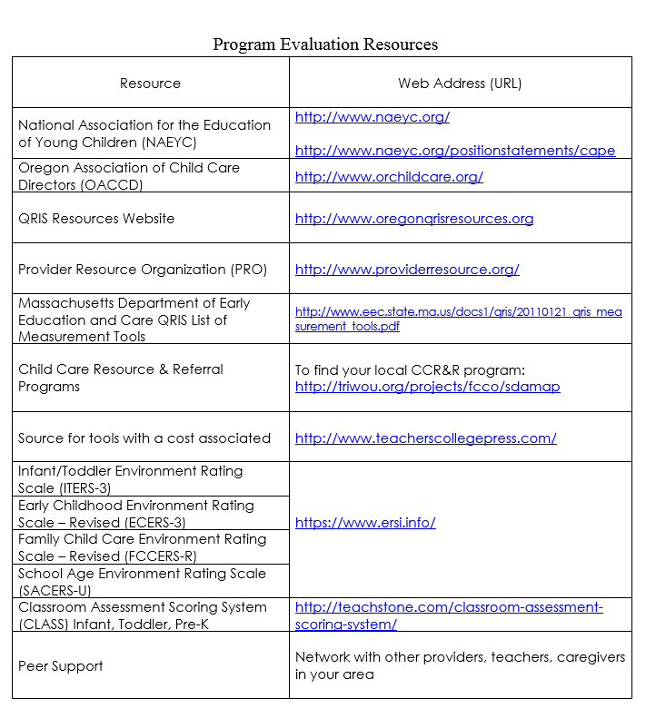
How Can Programs Access Program Evaluation Sources?
Notes:
Share Program Evaluation Resources handout and ask if participants can think of other resources to add.
If you have ECERS-R or any other actual evaluation tools/resources to share/show, this is the time to show participants what they look like.

Slide 19
Self-Evaluation
Fill out your “Survey on Program Evaluation Practices”
Add how often (frequency) you use the strategies (once a year, monthly, on-going, etc.)
Notes:
Give participants the “Survey on Program Evaluation Practices”. If they are attending the training with colleagues, they can fill this out together. Encourage programs to do this survey with their colleagues in the future (at a staff meeting or other professional development opportunity).

Slide 20


Program Evaluation
Practices Activity
Program Evaluation Input Activity
Notes:
Have participants move into a large circle facing each other (if less than 10 participants). Hand them each a “Program Evaluation Input Example” card on their way to a place in the circle; they can read the card to themselves ahead of time. Place a mini “garbage can” in the middle and an “Inbox” in the middle of the circle on the floor. Invite participants to take turns reading their card; then each participant decides if they will use the information for program improvement (and place it in the “Inbox” of ideas) OR they can decide that information will go directly in the “garbage”. Explain that there is no right or wrong answer; each participant is simply deciding what they are going to do with the input they are receiving.
The main point of this activity is to reinforce how Program Evaluation Input is on-going and is both formal and informal in nature. Providers make decisions daily about their practices based on their own values and beliefs and the input they receive from several sources.

Slide 21
Continuous Quality
Improvement
Using a variety of program evaluation sources to evaluate your program annually is important . . .
AND . . . using that information to purposefully plan how to enhance and improve your program’s practices can lead to genuine Continuous Quality Improvements
Notes:
Connecting the dots: even with ample program evaluation sources and input, if the information is not used to enhance and improve program practices, it won’t necessarily lead to program improvement.

Slide 22
Professional Action Activity
Identify at least three program evaluation sources you will use in the coming year and describe how those evaluation sources will help you plan for program improvements
Notes:
Hand out the “Professional Action Plan” forms and give participants time to fill this out . . .
AND/OR . . .
Do the Green Light, Yellow Light, Red Light Activity (on the next slide). Decide which activity makes the most sense for the group. The participants could take the Professional Action Activity with them (completed or not) and do the “Light Activity” instead.

Slide 23
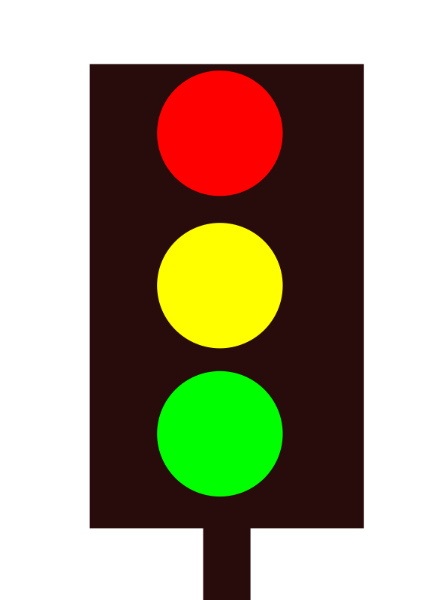
Green light, yellow light, red light activity
Red light – would like to stop doing
Yellow light – would like to continue doing
Green light – would like to start doing
Notes:
Either on Chart Paper (pre-drawn ideally) or on a whiteboard, draw a stop light similar to this slide. Have participants jot down on sticky notes (or small cards) one for each description on the slide and place on the chart or whiteboard. If time, have participants volunteer to share some of their red, yellow, and green light program evaluation actions they plan to do.

Slide 24

Follow Up Activity
Programs are encouraged to share your program evaluation plans with your local Child Care Resource & Referral staff/Quality Improvement Specialists
Notes:
Invite participants to share the Professional Action Plans with their CCR&R programs and/or Quality Improvement Specialists. They can support your Program Evaluation improvement plans!

Slide 25
Closing
Questions?
Evaluations
THANK YOU! ☺
Notes:
Congratulate participants for their commitment to improving their program evaluation plans. Remind them to fill out the evaluations, get certificates, and any other housekeeping duties.
You can add agency logos, contact information, or other references to this slide as desired.

