Slide 1
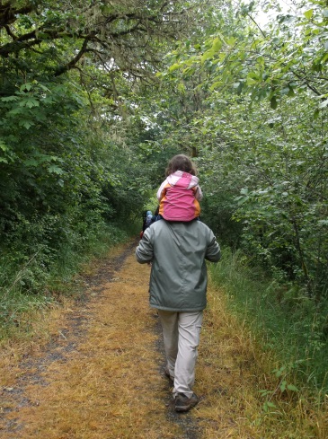
Honrando la cultura de sus familias
DIA E INFORMACION DEL ENTRENADOR AQUI

Slide 2


Información sobre nosotros

Slide 3

Cortesía del grupo
Notes:
To start off the training with an inclusive feel, ask the participants what they want for participant guidelines and write them down on a large post-it or whiteboard they can see throughout the training. They often come up with things like, “turn off cell phones” and “no side conversations”. I always add, “all responses are valid” and then explain that we don’t have to agree with everyone, but we need to allow everyone the chance to voice their ideas.
Not written down but we (trainers) always let the group know that some of the discussions may trigger past trauma and/or strong emotions and to do whatever they need to take care of themselves. Sharing is always optional.
Lastly, we say that “We are all teachers, and we are all learners”. Add what you want to make this point.

Slide 4
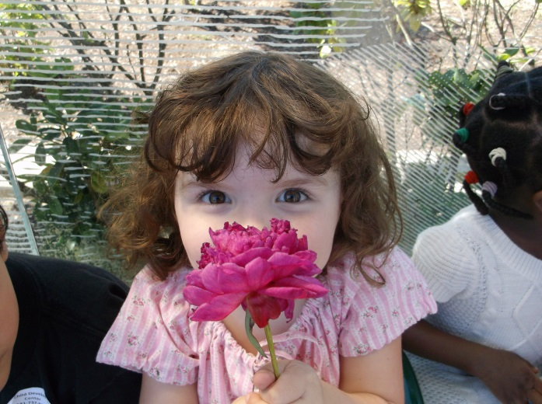
Introducción y rompiendo el hielo
Describa la historia del significado de su nombre
Comparta la motivación al asistir a este entrenamiento
Notes:
Explain that everyone has a story behind their name (an inclusive activity). Please share with your table partners the story of your name and your motivation for attending this workshop. It’s okay to share about any of their names: first, middle, last, married, etc. If this is a small group, you can ask each participant to share to the whole group.

Slide 5


Repaso de resultados, objetivos, agenda y materiales
Notes:
Discuss any materials available to the participants and point out the agenda.

Slide 6
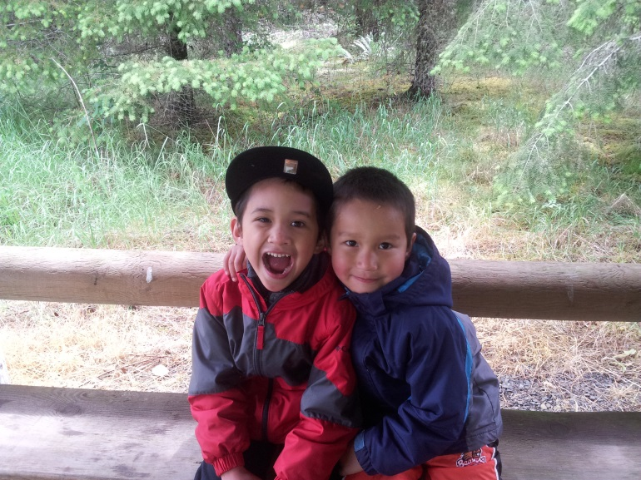
Resultados de esta Sesión
Los Participantes podran desarrollar mas sensíblidad Cultural en la Educación Temprana & Desarrollo del Programa
Notes:
Your program is likely already “culturally responsive” in many ways; this training may inspire you to become even more purposeful in how you are culturally responsive to every child and every family.

Slide 7
Objetivos de esta Sesión:
Los Participantes podran:
  Examinar sus propias creencias y experiencias culturales
  Examinar por que es importante proveer sensibilidad cultural en la Educación Temprana y Desarrollo de Programa (ELDP)
  Explorar como ser lingüísticamente sensible con las familias
  Explorar y seleccionar estrategias para apoyar la cultura de los niños y el languaje en casa
Notes:
Assure participants we will review what “linguistically responsive” means when we get to that part of the training.

Slide 8

¿Qué es cultura?
Notes:
Draw a circle on a large poster paper and post on the wall in the front of the group. In the circle, write the word “Culture”. Ask “What comes to mind when you hear the term culture?” Draw lines out from the circle and write (as best as you can) exactly what the participant says or ask permission to paraphrase long responses. Give time for the answers to start coming. Generally you will get a thorough flow of responses. Point out to participants that they know what culture means and that the collective answers really capture the concept, if appropriate.

Slide 9
Una definición de Cultura
“Se refiere a cómo los grupos de personas viven particularmente. Es la forma en que comemos, dormimos, hablamos, jugamos, el cuidado de los enfermos, como nos relacionamos el uno con el otro, pensamos en el trabajo, organizamos nuestras cocinas y como recordamos nuestros muertos. Incluye los idiomas que hablamos, la religión o la espiritualidad que practicamos (o ninguna) la vestimenta, la vivienda, los alimentos y los rituales/vacaciones que mas disfrutamos.”
Derman-Sparks & Edwards. (2010). Anti-Bias Education for Young Children and Ourselves. National Association for the Education of Young Children: Washington, D.C. p. 55.
Notes:
Point out that this is just one definition of culture that incorporates many of the participants’ responses from the “What is Culture?” activity which was just completed. If time, ask participants if there are any words or phrases from this definition which are of particular interest/importance to them.

Slide 10
Actividad reflexiva
Piense acerca de la cultura de su familia. Escriba o/y dibuje algunos de los elementos mas importantes en la cultura de su familia.
¿Que sentiminetos surgen al referirse a la cultura de su familia? ¿Orgullo? ¿Verguenza? ¿Identidad? ¿Confusión? ¿Pertenencia? ¿Otros sentimientos?
Notes:
Explain that it is important to take time to reflect on our own experiences so we can be prepared in our work with children and families. For example, if you’re serving children that are in foster care and you’ve had a traumatic experience in foster care yourself, it’s important that you know your triggers and what how to manage those feelings so they don’t interfere with your professionalism.
Give at least five minutes of time for this activity. When finished, ask for volunteers to share their stories with the whole group.

Slide 11
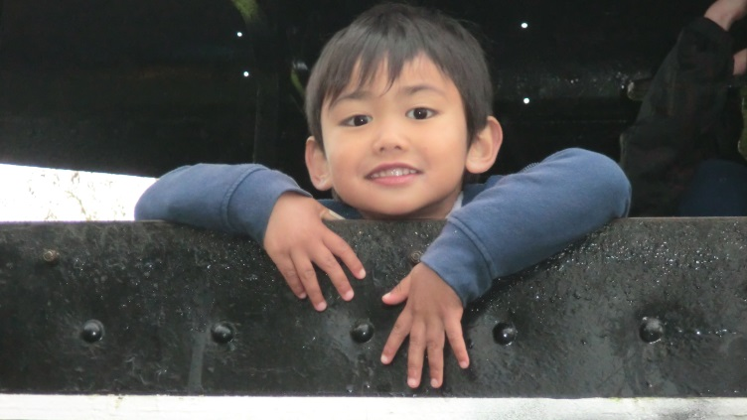
Educadores de Educación Temprana y la Cultura
Quiere honrar a cada niño y la cultura de sus familias pero usualmente solo observa los elementos superficiales (i.e., trajes típicos, festividades, comida, etc.)
Notes:
We must avoid the "tourist approach". This is an anti-bias curriculum term. This approach trivializes differences instead of dealing with the real-life
experiences of different people.
Examples:
Trivializing: Only having activities around holidays or foods.
Tokenism: One person of color in a storybook among many white characters.
Stereotyping: Images of Native Americans in traditional dress or posters of children around the world in their country’s traditional dress.

Slide 12
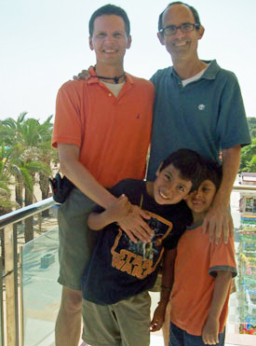
Tipos de Familias
¿Cómo se valorarán/compartirán en sus programas los tipos de familias?
¿Los niños de diversas estructures familiares verán su estructura familiar?
  Padre soltero
  Familia nuclear
  Familia nuclear – mismo sexo
  Mezclado
  Abuelo (1 en 14 niños en EE.UU)
  Extendido

Slide 13
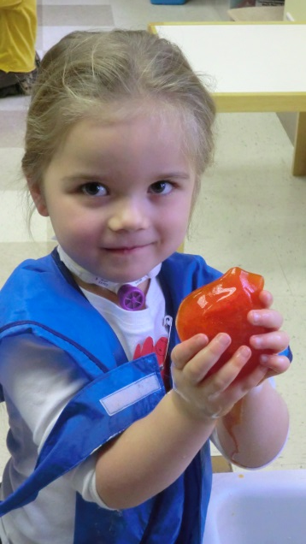
Actividad: Asumir puede llevar a Generalizar o a formar Estereotipos
¿Puede nombrar algunos estereotipos que haya escuchado acerca de algun individuo o cierto grupo o de usted mismo?
¿Como estos pensamientos/creencias influyen en su vida y trabajo con los niños y sus familias?
Actividad del grupo
Notes:
Briefly discuss the terms stereotype and generalization. Then share that it’s essential to learn how each person defines her or his cultural identity rather than generalize from societal attitudes. Otherwise, this leads to self-fulfilling prophesies….you see what you assume about a group or individual.
Example: Statistics say children raised in poor families do not get as much exposure to language. What if I assume this is true of all of the families? What might I miss? How might this negatively affect my relationship with a child/family?
Activity: In groups of 4 or 5 assign:
Facilitator
Recorder
Reporter
Time Keeper
Observer
Give groups 10-15 minutes to answer the questions on the slide. Have each group report out to the larger group.

Slide 14
Influencias de la cultura en su salón
Niños y familias
Personal del ELDP
Comunidad
La cultural dominante

Slide 15
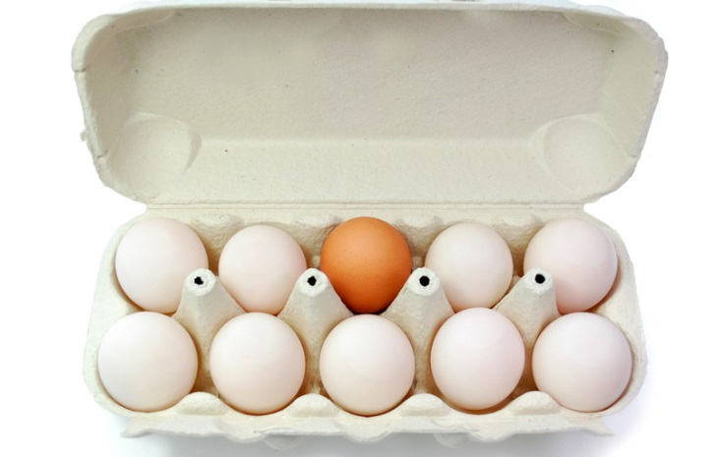
¿Por que honar y reflexionar acerca de la cultura de los niños? experiencias de educacion temprana… Que nos dicen las investigaciones….
A menos que los adultos apoyen y guien los niños en casa y en otros lugares, los niños podrían internalizar como ellos interpretan los que esta“bien” y “mal.” Acerca de como ellos viven, posiblemente los lleve a discriminar (Su manera puede ser “correcta”) o a sentir sentimientos de
no-pertenencia (Su manera puede
ser “equivocada”)

Slide 16
Recursos
  Anti-Bias Education for Young Children and Ourselves
    Louise Derman-Sparks and Julie Olsen Edwards, 2010
  Developmentally Appropriate Practice
    Carol Copple and Sue Bredekamp, editors, third edition, 2009
Notes:
If possible, have these books with you at the training to share as references.

Slide 17
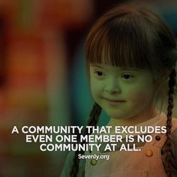
Descanso
La comunidad que excluye a tan solo un miembro no es una comunidad

Slide 18
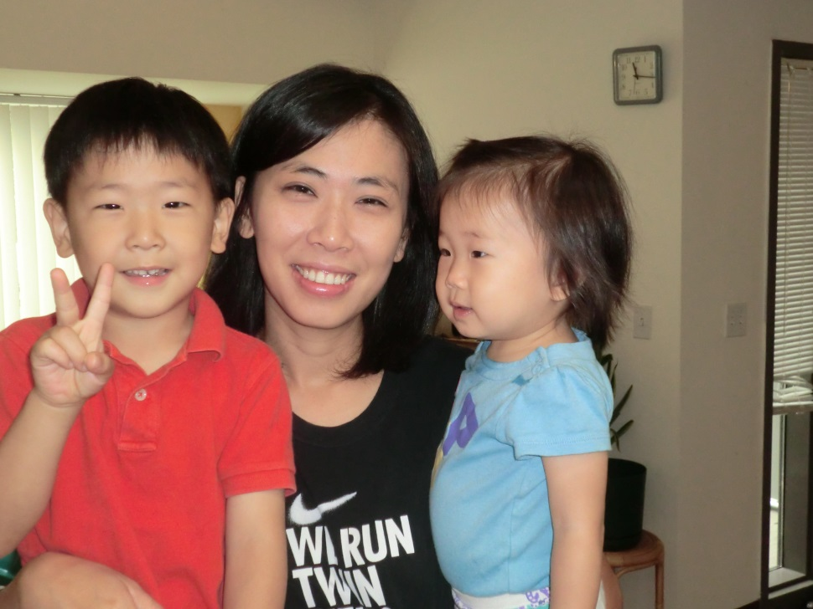
Moviéndose del “por qué” a “cómo”
Cómo podemos ser intencionales y ser linguísticamente sensibles ELDP
Notes:
What does it mean to be “linguistically responsive?” Ask for a few participants to share their thinking. Add to what they share to include how programs support the communication of children and families: speaking, reading, and writing.

Slide 19
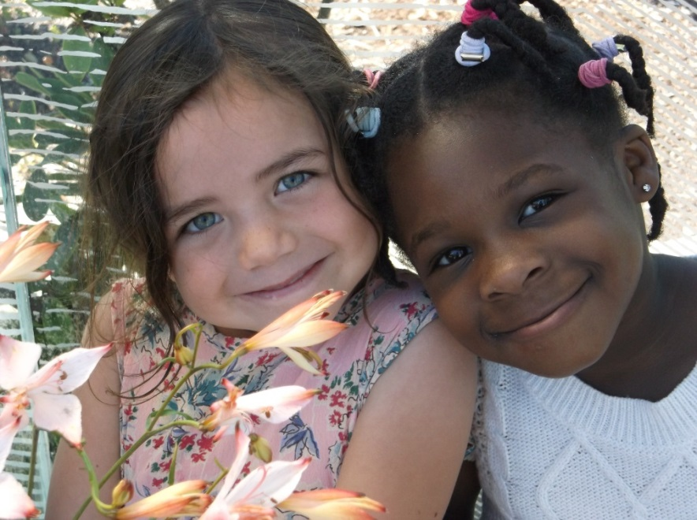
Actividad
En sus grupos crea una lista de cómo pueden ser lingüísticamente sensibles los ELDP con las familias y sus niños
¿Qué más compartieron en su grupos que podríamos añadir en nuestra lista?
  Compare/Comparta/Añada a su lista
Notes:
Each group can brainstorm a list of ways they can support children and families when communicating by speaking, reading, and writing in their home languages – including sign language.
OPTIONAL: The little girl on the right in this picture is named Fiyinfoluwa. Her family is originally from Nigeria, and her parents speak Yoruba and English. If there is time, I often write her name in large letters on the whiteboard or chart paper. Then I ask participants to share what they think is the correct pronunciation of her name. I let them take a few guesses and then tell them the correct pronunciation is “Feen-fo-loo-wah”. What is important about this is that pronouncing children’s and family members’ names correctly is very important, and the best way to know how to pronounce names correctly is to ASK the families. Then listen to them when they are speaking to each other -- and practice. As an aside, her father’s name is Adenaii, her mother’s name is Oyebola, her older sister’s name is Ifeoluwa, the last name of the family is Adenuga . . . and the baby boy they had in the United States was named . . . David. ;)
OPTIONAL: You can always just give the quick example of how you would feel if a teacher mispronounced your name or your child’s name all year long . . . “Candice is pronounced “Candis”, not “Canned Ice!”

Slide 20
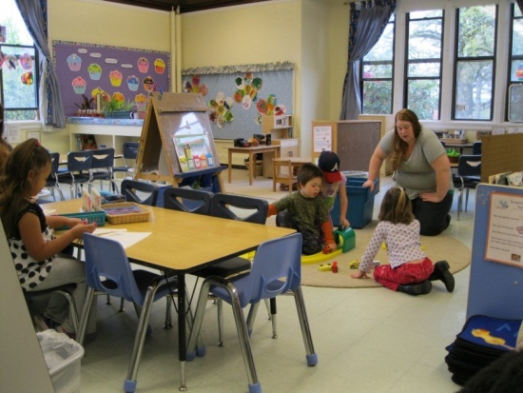
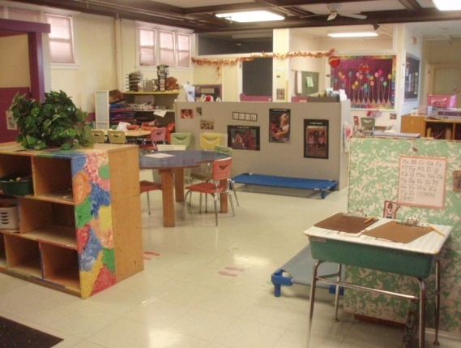
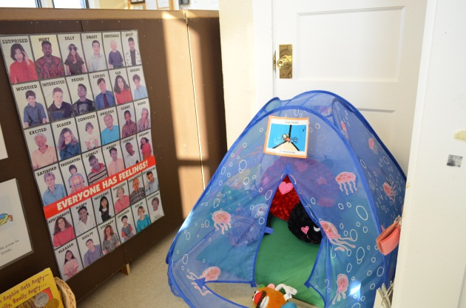
Excursion al Salón con ojos frescos
Tome 5 minutos en silencio para pensar en su programa.
Observe/documente como los maestros, niños y las familias se ven reflejadas.
¿Que es lo invisible/de alguna manera se ignora el valor de las culturas?
Notes:
One idea to add to this is to have programs “Imagine you are a new family coming to visit your program for the first time. What would you see/hear which tells you how this program would value your own family culture?

Slide 21
Sistema de Clasificación y Mejora de la Calidad
En algunos Dominios de Desarrollo y Aprendizaje muchos de estos Estandares estan enfocados en la Inclusíon y Cultura.
Algunos exemplos:
  “Repisas y contenedores con jugetes, libros, etc., con los nombres escritos en el lenguage de todos los niños en el programa
  “Representa la Cultura de la Comunidad”
  “Incluye algun material escrito en el idioma hablado en casa de los niños”
Notes:
Briefly discuss what QRIS is (for participants who are unfamiliar with it). Then share how Oregon’s QRIS addresses family cultures in a variety of ways and weaves those requirements for diversity throughout the standards.

Slide 22
Continuando con QRIS
  “Actividades designadas a promover el entendiminento de las culturas que representan el programa”
  “Actividades designadas a promover el entendimiento de las culturas mas allá de lo que representa el programa”
  “Interaciones con personas que son culturalmente y lisguísticamente diversas”
  “Algunas actividades en el idioma hablado en casa como lo son los cuentos o las canciones”
Notes:
Give examples of each statement to help participants get a clearer picture of what those statements look like “in action.”
Examples:
For “Activities designed to promote understanding of cultures represented in the program” talk about how this might look in the classroom for families you are CURRENTLY serving. If you have families from Mexico, you might sing songs daily in Spanish, read stories in Spanish, and incorporate projects on a regular basis such as making tortillas. Cooking projects and story times are examples of activities that family members can lead or support. Activities representing the cultures in the program should be ongoing and not just for special occasions.
If your families are all from the same or similar cultural background (i.e., white, middle class), it’s still important to incorporate individual family culture into your daily activities. For example, have children bring their favorite book for story time or have a family member read this book at story time. Incorporate favorite foods from home into cooking activities, again having family members involved when possible. The more you know your families, the more you can incorporate individual family culture into the program.

Slide 23
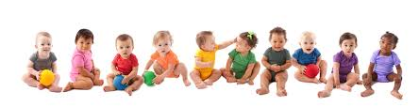
¿Por que el QRIS incluye este Criterio?
Algunos niños se sienten orgullosos de la Cultura en sus familias.
Los niños y sus familias se sienten mas comodos y valorados en su programa.
Notes:
Compare QRIS outcomes (the WHYs listed here) with the chart of ideas brainstormed by the group earlier on the “Why Honor and Reflect Each Child’s Culture?” chart. Similar goals. ☺

Slide 24
Actividad: Estrategias en las cuales se Honran las Culturas de las familias
Llene la Autoevaluación
Compartan en sus grupos alguna otra estrategia no incluida en la autoevaluación
Compartir en grupos/añadir ideas adicionales
Notes:
Encourage participants who came with other staff members to work together. We also always encourage people to take the Self-Evaluation back to their directors/programs and share with their colleagues at staff meetings, etc.
After participants have had enough time to complete the first two bulleted items, invite them to share their thoughts about the last item to add to the self-evaluation.

Slide 25
¿Ahora que? Herramientas de planeación
Comienze con poco!
Identifique una meta (podria o no podria estar basada en la autoevaluacion)
  Sea específico y realista
  Ponga un tiempo limite
  ¿Como pordría celebrar una vez que alcanze su meta?
Notes:
Participants can write the goal on the Self-Evaluation, a sticky note, or any other paper provided.

Slide 26
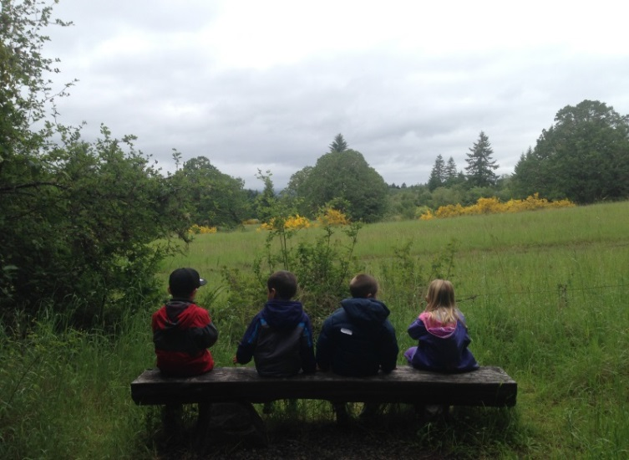
Planee como alcanzará su Meta
Puede añadir a su autoevaluación cualquier otra meta que desee implementar
Comparta con otros en el grupo de su mesa
Notes:
Make sure that participants “speak their goals into existence” by sharing their goal with at least one person at their tables.

Slide 27
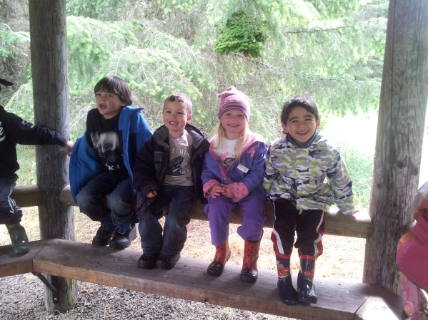
Evaluación/Certificado/Final
Hay muchas maneras de enseñar las diferencias culturales a los niños.
Ellos aprenden Todo lo que nosotros les hablamos acerca de como vemos el mundo
Y de lo que pensamos acerca de otros.
Gracias por su Participación! ☺
Notes:
Thank the participants for participating, sharing their ideas, and being committed to honoring their families’ cultures. Encourage them to give you honest feedback in their evaluations, get their certificates, and share any other housekeeping items/announcements you want them to know.

