Slide 1
The Appropriate Use of Early Childhood Assessments and Developmental Screenings
Training Location
Trainer Information
Date
Notes:
Add training location, trainer information, date, and/or your agency logo on this slide. Throughout the training, it may be helpful to have a blank/sample Spark Portfolio with you as a reference to the different standards.

Slide 2
Opening Activities
Notes:
The next 6 slides will focus on the Opening Activities.

Slide 3
Getting to Know You . . .
Center-based preschool/ child care provider
Home-based child care provider
Head Start staff
Administrator/director/ supervisor
Teacher
Assistant teacher/ paraprofessional
Related service provider
Student
Other
Notes:
Ask the whole group to “raise their hands if this describes you” as you read these roles. For those who selected “Other”, ask them share what their role is.

Slide 4
Introductions
Name
Program
Ages served
How long?
Notes:
Introduce yourself first, if you haven’t already, and share your own information. If you have a smaller group, invite each participant to share this information. If you have a larger group, have them share this information with each other in their table groups.

Slide 5

Reflective Activity
What questions do you have around screening and assessment?
Notes:
Invite participants to think about and record their answers to the question. You can choose to record their answers on a large chart pad or have them bring their sticky notes of recorded answers up to a large chart pad and read out to the group what their questions were. Explain that most of their questions will likely be addressed during the training, but if there are questions which will not be addressed, invite them to ask at the end of the training or when the training has concluded.

Slide 6
Session Objectives
Participants will
  Examine different types of developmental screenings, assessments, and supplemental assessments.
  Be able to apply this information as they participate in Spark.
Notes:
Ask a participant to read the objectives.

Slide 7

Agenda
Notes:
Refer participants to their Participant Agendas.

Slide 8

Materials
Table kits
Training toys - fidgets
Handout materials
    Note pages
    Supplemental information/resources
    Evaluation
Notes:
Refer participants to the table kits, training toys, and any handouts which have been provided (note pages are the “Participant Handout” which are select slides that can be printed on PP with the option for writing notes). Let them know that more resources will be provided later in the training.

Slide 9
Screening
Notes:
The next four slides will focus on Screening.

Slide 10
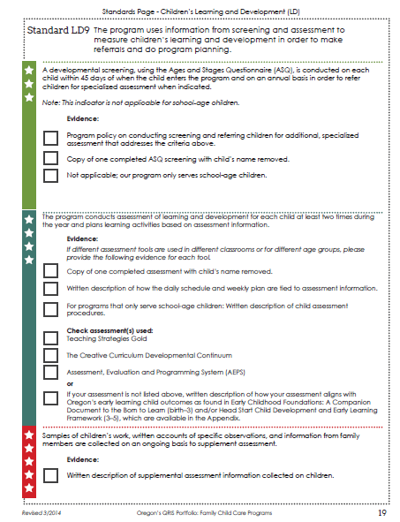
Screening
This session covers developmental screenings for children birth through 6 years of age.
There are other types of screenings such as mental health screenings, health screenings, etc.
This session will focus on the developmental screening as it relates to LD9 in the Spark portfolio.
Notes:
Read or ask a participant to read this slide about what screening is and how the screenings referred to for this training are specific to developmental screenings for children birth to school age.

Slide 11

What is a Developmental Screening?
The practice of looking for and monitoring signs that a child may be delayed in one or more areas of development and/or to confirm that they are typically developing.
Screening is not meant to establish a diagnosis for the child.
Helps determine whether more in-depth assessment is needed.
Notes:
Read or ask a participant to read this slide. Ask and respond to questions.

Slide 12

Why do we use Screenings?
To help identify whether a child may need an additional evaluation or is typically developing.
    For example, a child may score low in the communication area and need an additional assessment to determine if there is a delay and a need for support services.
    Support services may be private (medically related) or a part of the Special Education system from your local Education Service District (EI/ECSE).
Notes:
Read or ask a participant to read this slide. Ask and respond to questions.

Slide 13
Who does the Screening?
Anyone who works with the child:
  Families (parent/guardian)
  Early intervention professionals
  Early childhood and special education educators
  Social service providers
  Public health providers
  Home visitors and parent educators
  Pediatricians and nurses
  Other early childhood professionals
Notes:
Read or ask a participant to read this slide. Ask and respond to questions.

Slide 14
Screening and Spark
Notes:
The next 6 slides will focus on Screening and Spark.

Slide 15
Screening and Spark
For a 3-star rating
    The Ages and Stages Questionnaire (ASQ) is performed on each child within 45 days of when the child enters the program and on an annual basis in order to refer children for specialized assessment when indicated.
    Note: This indicator is not applicable for school-age children.
Evidence
    Program policy on conducting screening and referring children for additional, specialized assessment that addresses the criteria above.
  And
  A copy of one completed ASQ screening with the child’s name removed.
Notes:
Read or ask a participant to read this slide. Ask and respond to questions.

Slide 16
Spark Screening Requirement
Spark requires the ASQ.
    ASQ measures 5 key areas of development:
      Communication
      Gross Motor
      Fine Motor
      Problem Solving
      Personal-Social
Notes:
Read or ask a participant to read this slide. Ask and respond to questions.

Slide 17

Why do you have to use the ASQ for Spark?
The State of Oregon’s Early Learning Council
adopted the Ages and Stages Questionnaire (ASQ) as the statewide screening to be used in Oregon.
Notes:
Read or ask a participant to read this slide. Ask and respond to questions.

Slide 18

ASQ
Ages and Stages Questionnaire
Designed to be completed by parents or caregivers.
Includes simple directions to help indicate children’s skills in language, personal-social, fine and gross motor, and problem solving.
http://asqoregon.com/
Notes:
Read or ask a participant to read this slide. Ask and respond to questions. Emphasize that the ASQ is meant to be completed by the parents of the child and/or together with the child care provider. It is available for free online at the link on the screen; the parent has the option to have the results shared via email with the caregiver.

Slide 19
About the ASQ
ASQ includes about 30 items for each age range
Used to determine which children need further evaluation
Published in English, Spanish, French & Korean; other translations are in development
The target age range is Birth to 60 months
Takes about 15 - 20 minutes to complete
Notes:
Read or ask a participant to read this slide. Ask and respond to questions.

Slide 20
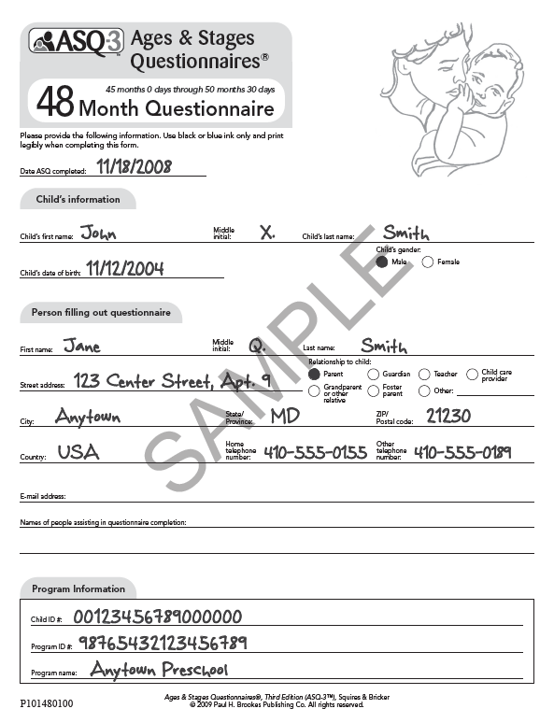
Sample ASQ – Examine in Groups
Notes:
Have participants review the Sample ASQs; one thing they might want to explore is what is the same or different when they compare different ASQ age groups.

Slide 21
Child Assessment
Notes:
The next 5 slides focus on Child Assessment.

Slide 22
What is Child Assessment?
“A systematic procedure for obtaining information from observation, interviews, portfolios, projects, tests, and other sources that can be used to make judgments about children’s characteristics.” (NAEYC)
The process of gathering information about a child in order to make decisions about his/her education.
Notes:
Read or ask a participant to read this slide. Ask participants what stands out to them from the NAEYC definition.

Slide 23
Types of Assessments
There are different types of assessments
    Program
    Staff/personnel
    Family
    Children’s learning and development
There are a variety of ways to assess children’s learning and development and collect assessment information.
Notes:
Read or ask a participant to read this slide. Ask and respond to questions.

Slide 24

Types of Assessment
Formal and Informal/Natural/Authentic
Formal Assessments broken down into:
    Norm-referenced
    Criterion-based
    Curriculum-based
Notes:
Read or ask a participant to read this slide. Ask and respond to questions.

Slide 25

Who Conducts Child Assessments?
Depends on the assessments
May be provider, parents, other
Notes:
Read or ask a participant to read this slide. Ask and respond to questions.

Slide 26
Why Programs Conduct Child Assessments ?
Assessments are conducted to:
    Find out what children are interested in
    Find out children’s strengths and areas of difficulty
    Make informed decisions about interventions
    Find common needs
    Discover how children change over time
    Learn what children know in particular areas
    Link with instruction – making sure instruction is responsive and appropriate, matching what children can and cannot do
    Serve as a basis to report to parents
Notes:
Read or ask a participant to read this slide. Ask and respond to questions.

Slide 27
Child Assessment and Spark
Notes:
The next 7 slides focus on Child Assessment and Spark.

Slide 28

Where Child Assessment Fits with Spark
Addressed in LD9 – 4 Star
    The program conducts assessment of learning and development for each child at least two times during the year and plans learning activities based on assessment information.
Notes:
Read or ask a participant to read this slide. Ask and respond to questions.

Slide 29

When Child Assessments are Done
At least 2 times during year
    Early in year
    Later in year
Spark specifies that assessments be conducted at least two times during the year. Some assessments are designed to be done quarterly.
Notes:
Explain how most programs conduct “fall” and “spring” assessments and some also conduct them in the winter or summer.

Slide 30
Early Childhood Assessments and Spark
Spark’s Portfolio identifies two pre-approved assessments.
    Teaching Strategies Gold
    Assessment, Evaluation and Programming System (AEPS)
    Both assessments are designed for ages birth through age 6
If a program does not use either of these assessments, they need to provide a written description of how their assessment aligns with:
    Head Start Child Development and Early Childhood Framework
    Oregon’s Early Childhood Foundations
Notes:
Read or ask a participant to read this slide. Ask and respond to questions.

Slide 31

Teaching Strategies Gold
  Assesses children ages birth through kindergarten
  Available online and in print
  English and Spanish versions
  Covers 10 areas of development: social-emotional, physical, language, cognitive, literacy, mathematics, science and technology, social studies, the arts, English language acquisition
  38 objectives – are aligned with Common Core State Standards and Head Start Child Development and Early Learning Framework
  Observation based
  Basic online free training course/live phone help
  Number of online reports available including individual child/class/program
  Cost for Birth Through Kindergarten Toolkit: $200
  http://www.frazercenter.org/files/2014/09/Teaching-Strategies-GOLD-Assessment-Touring-Guide-.pdf
Notes:
Refer participants to the samples at their tables.

Slide 32
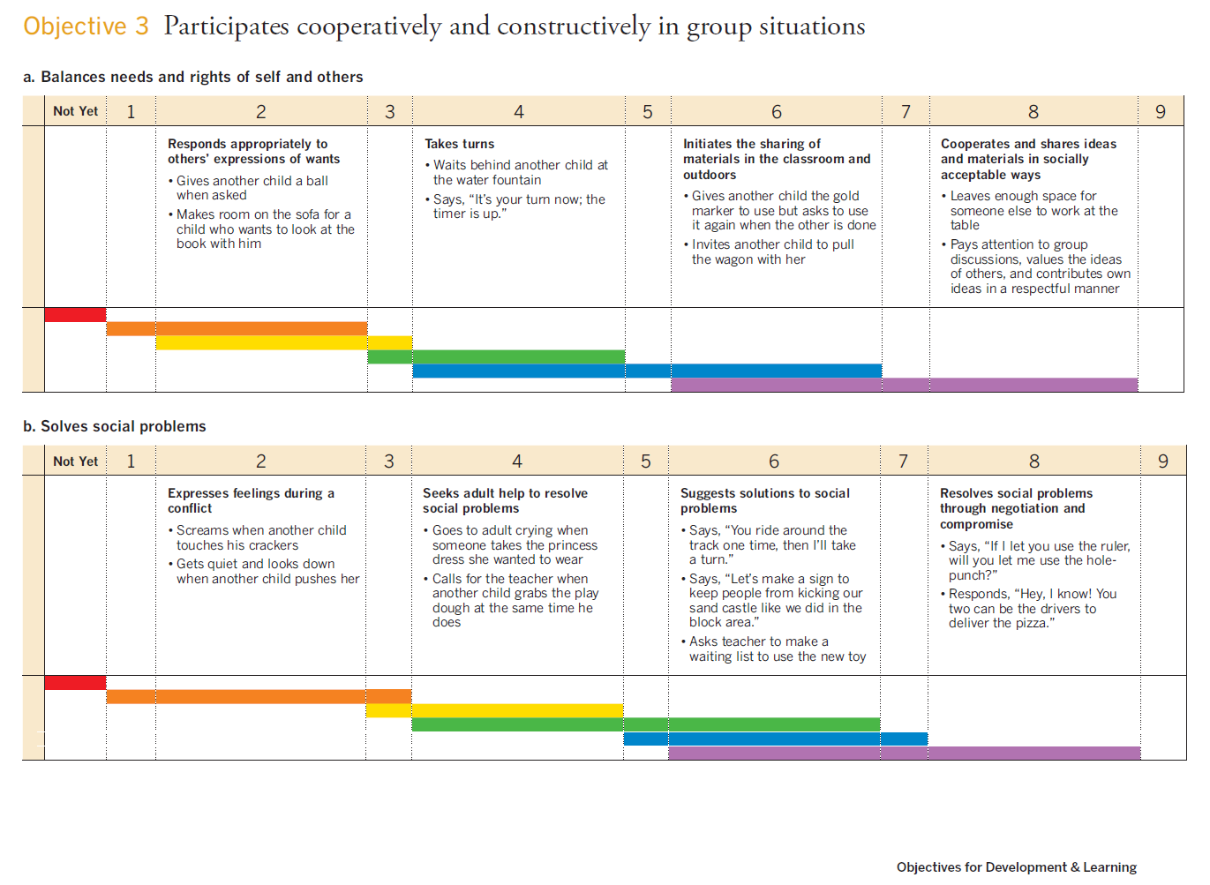
Notes:
Refer participants to the samples at their tables.

Slide 33

AEPS and AEPSi
  Assessment for birth through age six. Two versions – one for birth to three and one for children three to six.
  AEPS Administration Guide provides instructions to use assessment.
  Covers 6 developmental areas: fine motor, gross motor, cognitive, adaptive, social-communication, and social
  Tied to AEPS curriculum
  Can be used in center and home based programs
  Place on form to record scores quarterly
  Score 0 (does not pass), 1 (inconsistent performance) or 2 (passes consistently)
  Paper and online interactive versions
  English, Spanish, French and Korean versions
  Cost for Administration Guide, Test, Curriculum 0-3 and 3-6: $239; Administration Guide, Test, Curriculum 0-3: $179 (same for 3-6 )
  http://www.aepsinteractive.com/
Notes:
Refer participants to the samples at their tables.

Slide 34
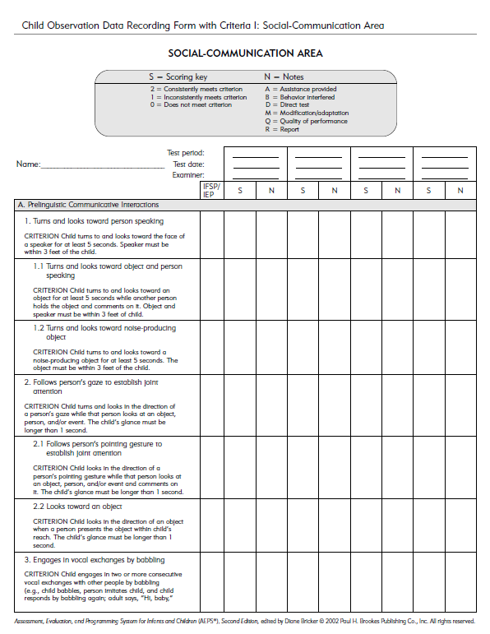
Notes:
Refer participants to the samples at their tables; encourage participants to explore and compare the samples at their tables.

Slide 35
Break Time
Notes:
Provide a 15-minute break if there is time.

Slide 36
Supplemental Assessment and Spark
Notes:
The next 6 slides refer to Supplemental Assessment and Spark.

Slide 37
What is Supplemental Assessment?
Sometimes called informal assessments or ongoing assessments
A process that identifies the child’s strengths and needs in addition to more formal assessment instruments
Additional information collected on child
Collected on an ongoing basis
Notes:
Add that recorded “observations” are one of the most common types of “supplemental assessments.”

Slide 38
Why use Supplemental Assessments?
Allows providers to track the ongoing progress of children regularly and often
Provides continual snapshots of where children are throughout the year
Serves as a guide to help establish a current performance level in order to make informed instructional decisions
Can provide valuable information to parents and educators
Ensures that the curriculum is meeting the developmental stages of the children in their program
Notes:
Read or ask a participant to read this slide. Ask and respond to questions.

Slide 39
How can programs use Supplemental Assessments?
  To plan future instruction so that child needs are met
  To help understand where and if children should be grouped for instruction
  To ensure that instruction is being delivered at the right pace
  To understand where children may need individual support
Notes:
Read or ask a participant to read this slide. Ask and respond to questions.

Slide 40
Who Does Supplemental Assessments?
Families (parents/guardians)
Child care providers
  Early intervention professionals
Early childhood and special education educators
Social service providers
Public health providers
Home visitors and parent educators
Other early childhood professionals
Notes:
Read or ask a participant to read this slide. Ask and respond to questions.

Slide 41
Supplemental Assessments and Spark
LD 9 - 5 STAR (completion for a 3 and 4 star have previously been done)
Samples of children’s work, written accounts of specific observations, and information from family members are collected on an ongoing basis to supplement assessment.
Evidence:
Written description of supplemental assessment information collected on children.
Notes:
Ensure that the participants know that what is required is simply the written description of what and how programs collect as supplemental assessment information, such as “We conduct observations weekly, and we share that information with families and as we make plans to meet children’s needs.”

Slide 42

Activity
What are examples of supplemental assessments that you use?
Notes:
Invite participants to share what they do for supplemental assessments either in their small groups and/or in a large group.

Slide 43
Review Differences Between Assessment and Screening and Application of Assessment Information in Spark
Notes:
The next 3 slides are a review of the differences between assessment and screening and how to apply assessment information in Spark.

Slide 44
Difference Between Child Assessment and Screening
Screening is designed to determine whether further testing is needed. It is not intended to be used to identify what needs to be taught.
Child assessment is a more comprehensive process to determine child needs. Child assessments provide information to guide instructional decisions.
Notes:
Read or ask a participant to read this slide. Ask and respond to questions.

Slide 45
Activity - When and How Can You Do This?
Sort the screening and assessment cards into the when and how categories
Whole group discussion – other ideas?
Notes:
Prior to the workshop, print the “When and How Activity Cards”. Have small groups work to put the statements into the categories provided. Guide participants as needed and invite them to share how they grouped the cards and why when they are finished.

Slide 46
How the Daily Schedule and Weekly Plan are Tied to Child Assessment Information
In the Spark Portfolio LD9 – 4 Star, programs are required to provide a “written description of how the daily schedule and weekly plan are tied to assessment information.”
Notes:
Explain how programs need to describe how the daily schedule (activities and learning planned) are related to the child assessment information they collect. An example of this could be: “We use the information from the TS Gold to plan our small group activities or provide individualized support for children who need it.”

Slide 47
Closing Activities
What will you do the same or different regarding screening and assessment in the coming year?
Notes:
Have participants share in small groups or the larger group what they will do the same or different.

Slide 48
Questions?
Notes:
Review the original questions of what participants wanted to learn and answer them or offer to respond to them when the training is over.

Slide 49

Complete Training Evaluation
Notes:
Invite participants to complete the training evaluation.

Slide 50
Thank you!
Notes:
Thank the participants for coming and providing care and education for Oregon’s children. Hand out certificates.

